Slide 1
Advanced Neuropsychology: Advances in Evidence-Based Practice in Capital Litigation
Dale G. Watson, Ph.D. and Lisa Greenman, Esq.
Capital Case Defense Seminar
Monterey, California
February 15, 2025

Slide 2
What is neuropsychology?
Neuropsychology is the branch of science that combines neuroscience and psychology.
The focus is on the study of brain-behavior relationships as manifested in behavior.
Neuropsychological assessment is the evaluation of the presence, nature and extent of brain damage or dysfunction derived from the results of neuropsychological tests.
Neuropsychologists use batteries of tests to assess functioning.

Slide 3
Why perform a neuropsychological assessment?
Determine the degree of impairment.
Description of the types of cognitive strengths or weaknesses.
Describe the impact of deficits on behavior.
Diagnosis.
Meyers, J. E., & Miller, R. M. (2021). Objective methods for matching neuropsychological patterns: Formulas and comparisons. Applied Neuropsychology: Adult, 30(2), 249–258. https://doi.org/10.1080/23279095.2021.1929986

Slide 5
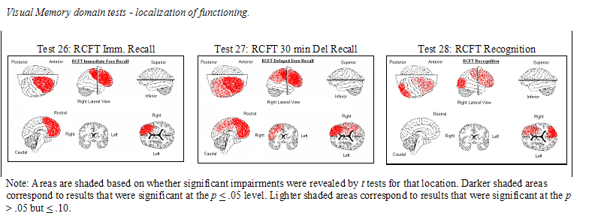
Localization by Test: Rey Complex Figure (RCFT)
Meyers, J. E., & Rohling, M. L. (2009). CT and MRI correlations with neuropsychological tests. Applied Neuropsychology, 16(4), 237–253. https://doi.org/10.1080/09084280903098752

Slide 6
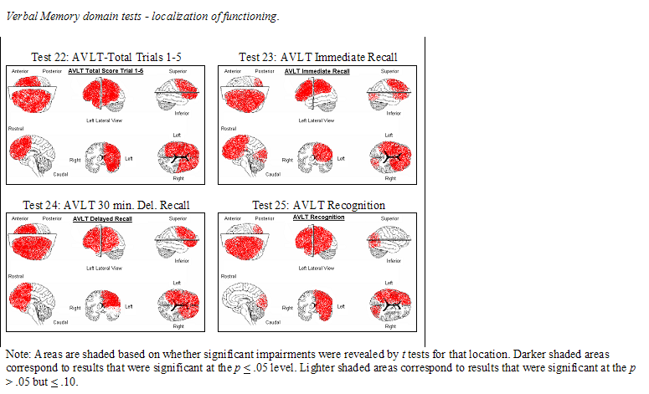
Localization by Test: Rey Auditory Verbal Learning Test (AVLT)
Meyers, J. E., & Rohling, M. L. (2009). CT and MRI correlations with neuropsychological tests. Applied Neuropsychology, 16(4), 237–253. https://doi.org/10.1080/09084280903098752

Slide 7
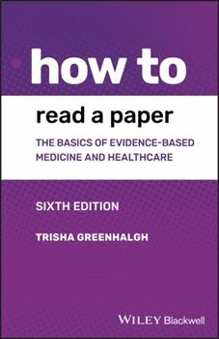
Evidence-Based Medicine (Practice)
“Evidence-based medicine is the use of mathematical estimates of the risk of benefit and harm, derived from high-quality research on population samples, to inform clinical decision-making in the diagnosis, investigation or management of individuals patients…. A very important aspect of the subject…is the use of mathematics.”

Slide 8
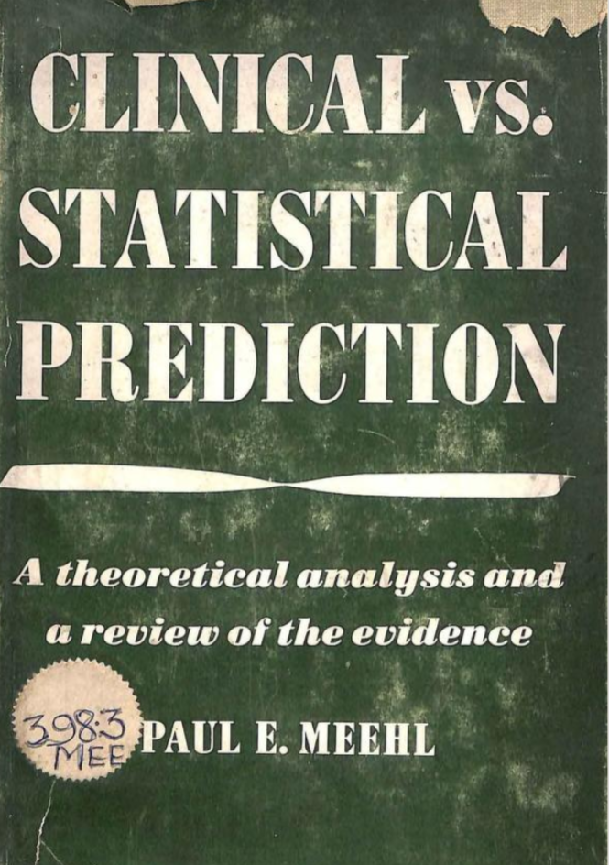
Tests reduce diagnostic uncertainty
We have known since the 1950s that statistical prediction is far better than clinical judgment.
Statistical approaches enhance diagnostic accuracy compared to clinical judgment alone.
Clinical judgment is still required.

Slide 9
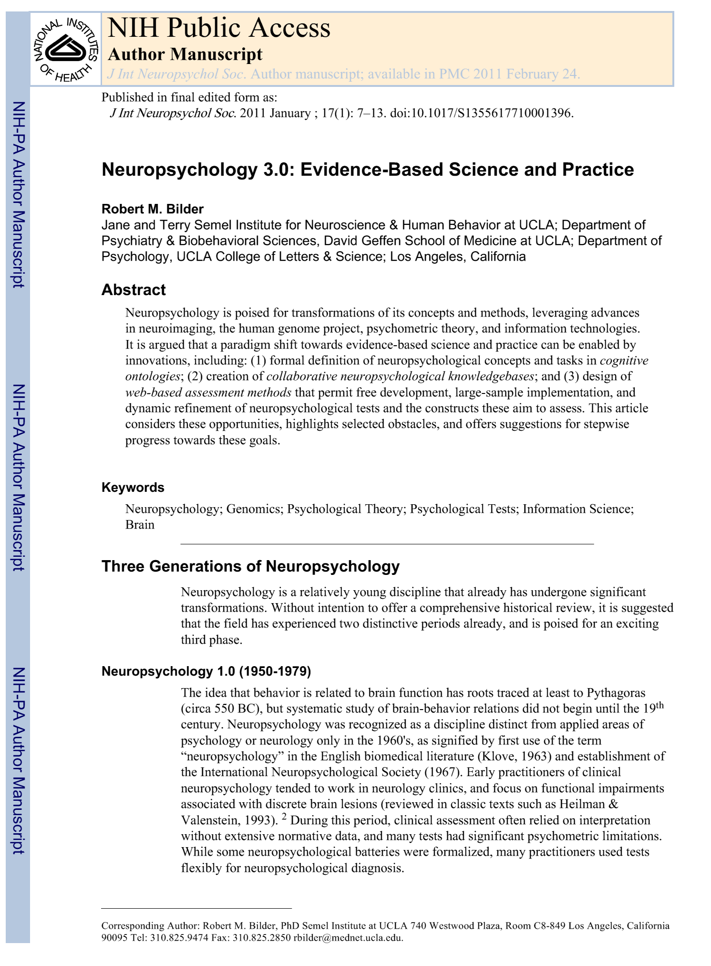
Evidence-Based Neuropsychology 3.0
Bilder in 2011 argued that “Neuropsychology is poised for transformations of its concepts and methods, leveraging advances in neuroimaging, the human genome project, psychometric theory, and information technologies.”

Slide 10
Evidence-Based Neuropsychology 3.0
A paradigm shift is moving neuropsychology towards evidence-based science including:
(1) formal definitions of neuropsychological concepts and tasks in cognitive ontologies;
(2) creation of collaborative neuropsychological knowledge bases; and
3) design of web-based assessment methods that permit free development, large-sample implementation, and dynamic refinement of neuropsychological tests and the constructs these aim to assess.

Slide 11
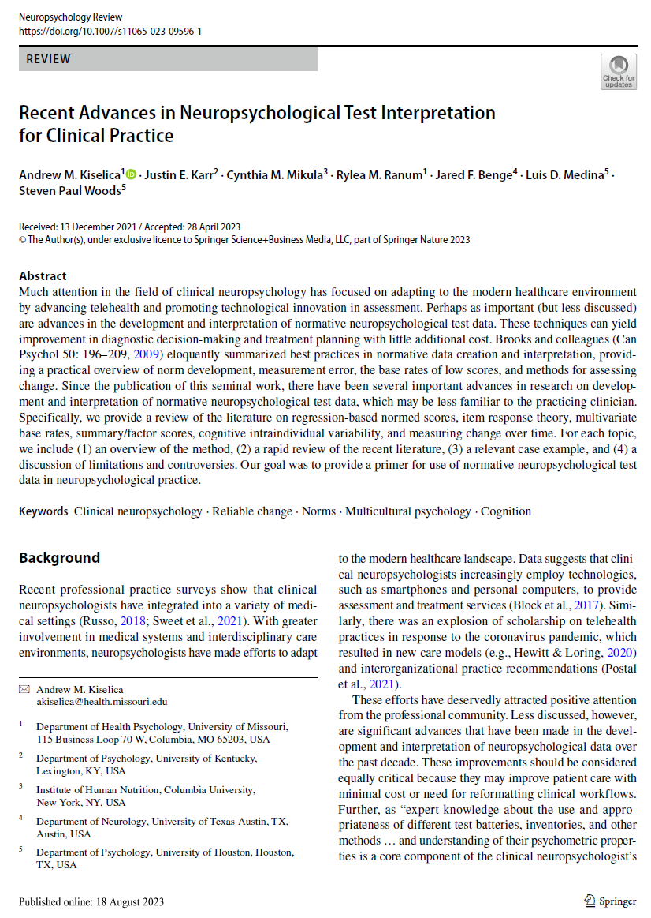
Recent Advances in Neuropsychological Test Interpretation for Clinical Practice
In 2023, Kiselica et al. reviewed developments in neuropsychology including the development of:
regression-based normed scores
item response theory,
multivariate base rates,
summary/factor scores,
cognitive intraindividual variability,
and measuring change over time.

Slide 12
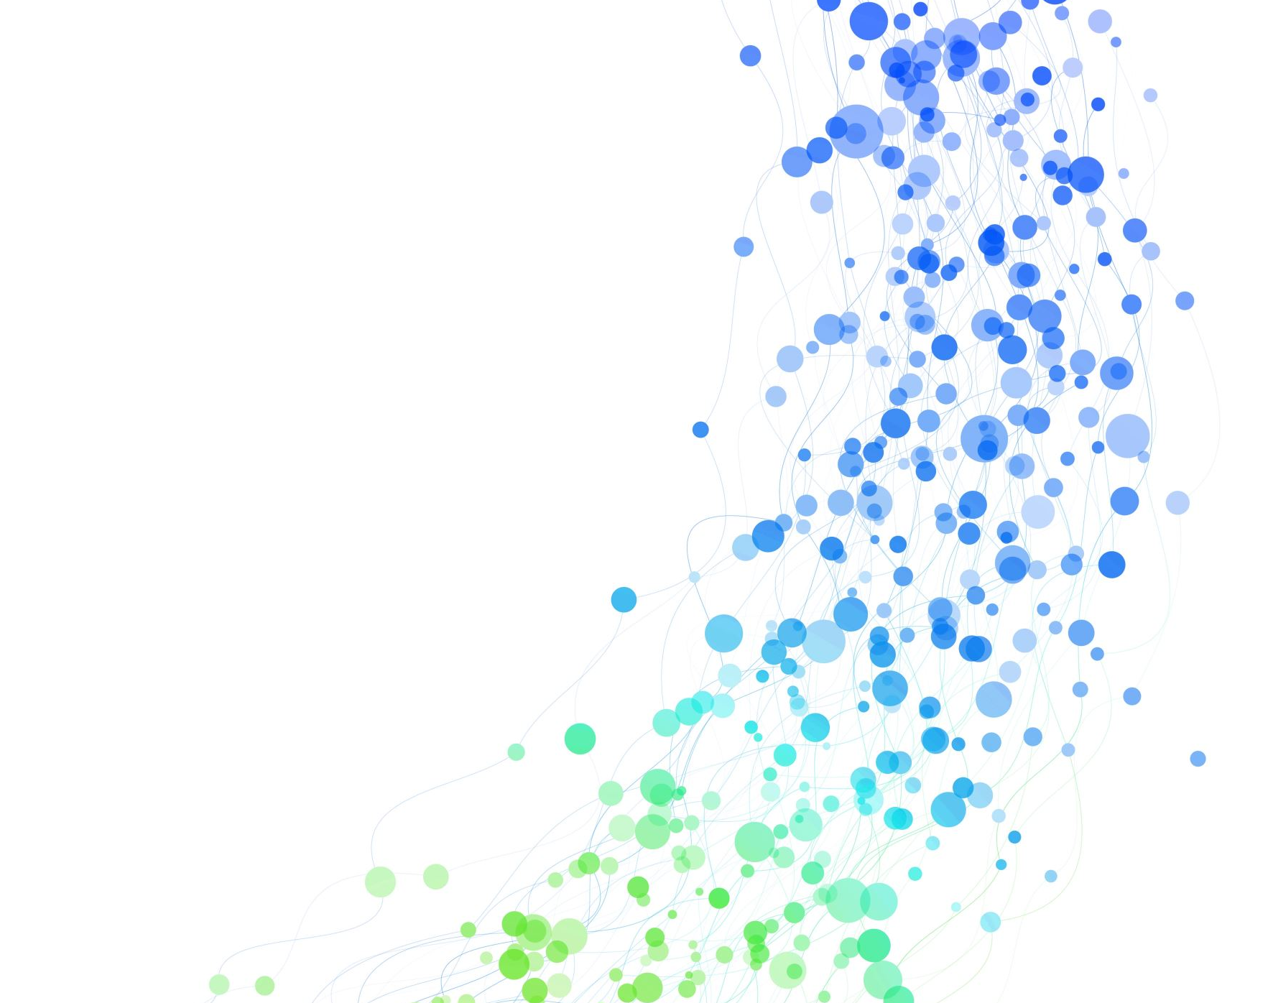
Bayesian Analysis
Priors and Posterior probability

Slide 13
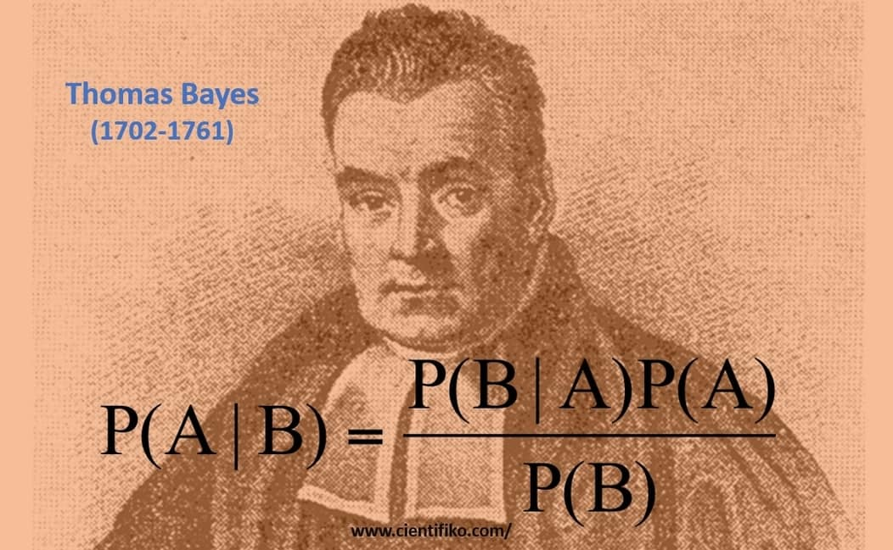
Bayesian Methods
Statistician and Presbyterian minister
Developed statistical methods that are now becoming mainstream and counter p. < 05 frequentist (or null hypothesis) approaches
Goal is to reduce or quantify uncertainty (in diagnosis).

Slide 14
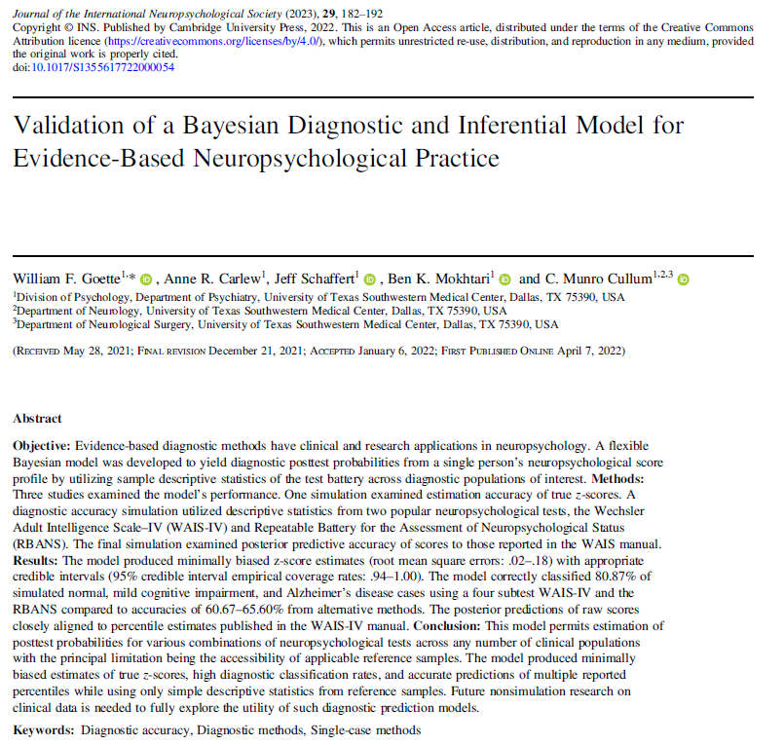
A seminal article on Bayesian multivariate analysis
Statistical procedures for determining diagnostic group membership based upon patterns of performance across multiple tests (multivariate) combined with pre-test probabilities.
Goette, W. F., Carlew, A. R., Schaffert, J., Mokhtari, B. K., & Cullum, C. M. (2022). Validation of a Bayesian diagnostic and inferential model for evidence-based neuropsychological practice. Journal of the International Neuropsychological Society, 29(2), 182–192. https://doi.org/10.1017/s1355617722000054

Slide 15
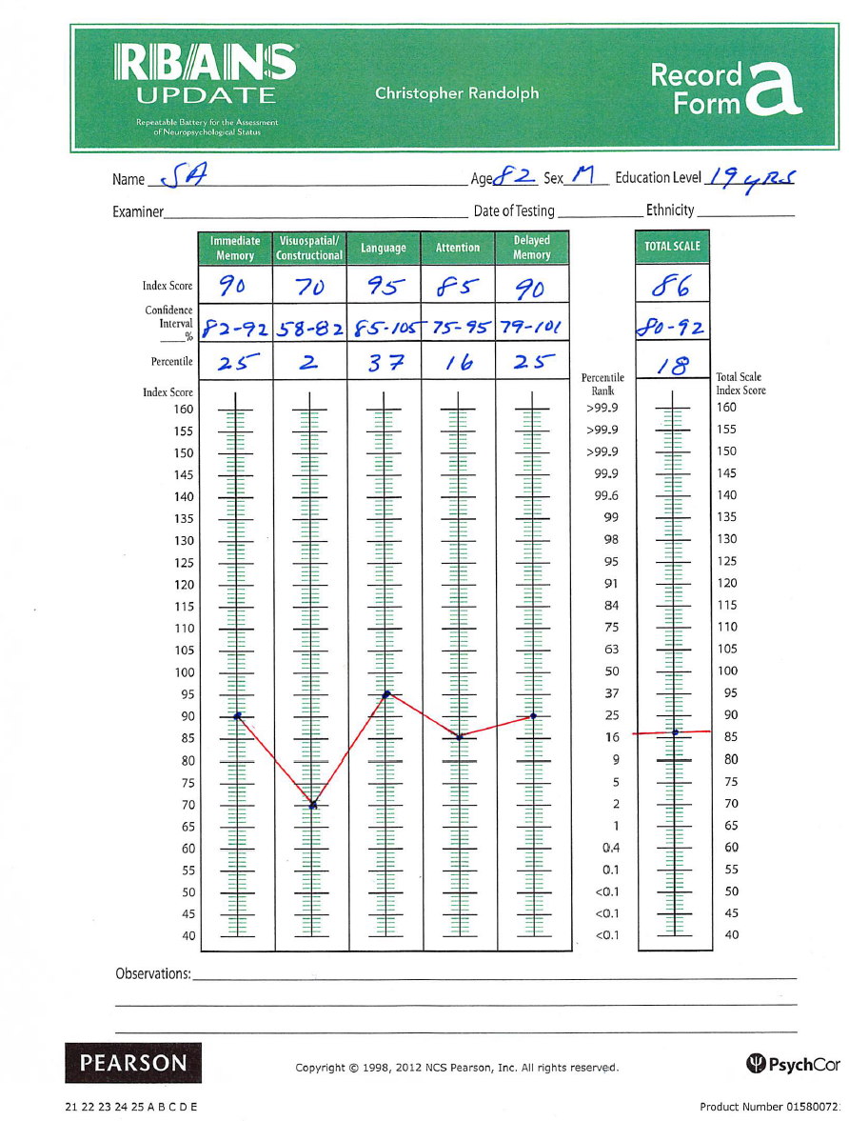
RBANS
86-year-old male attorney
Complaints of increased fatigue, mild anhedonia, and difficulty concentrating.
WAIS-R Full Scale IQ = 102
WMS-R Verbal Memory = 100
WMS-R Attention/Conc. = 85
Mild motor problems
Elevated cholesterol
Randolph, C. (2012). RBANS Update: Repeatable Battery for the assessment of neuropsychological status. PsychCorp.

Slide 16
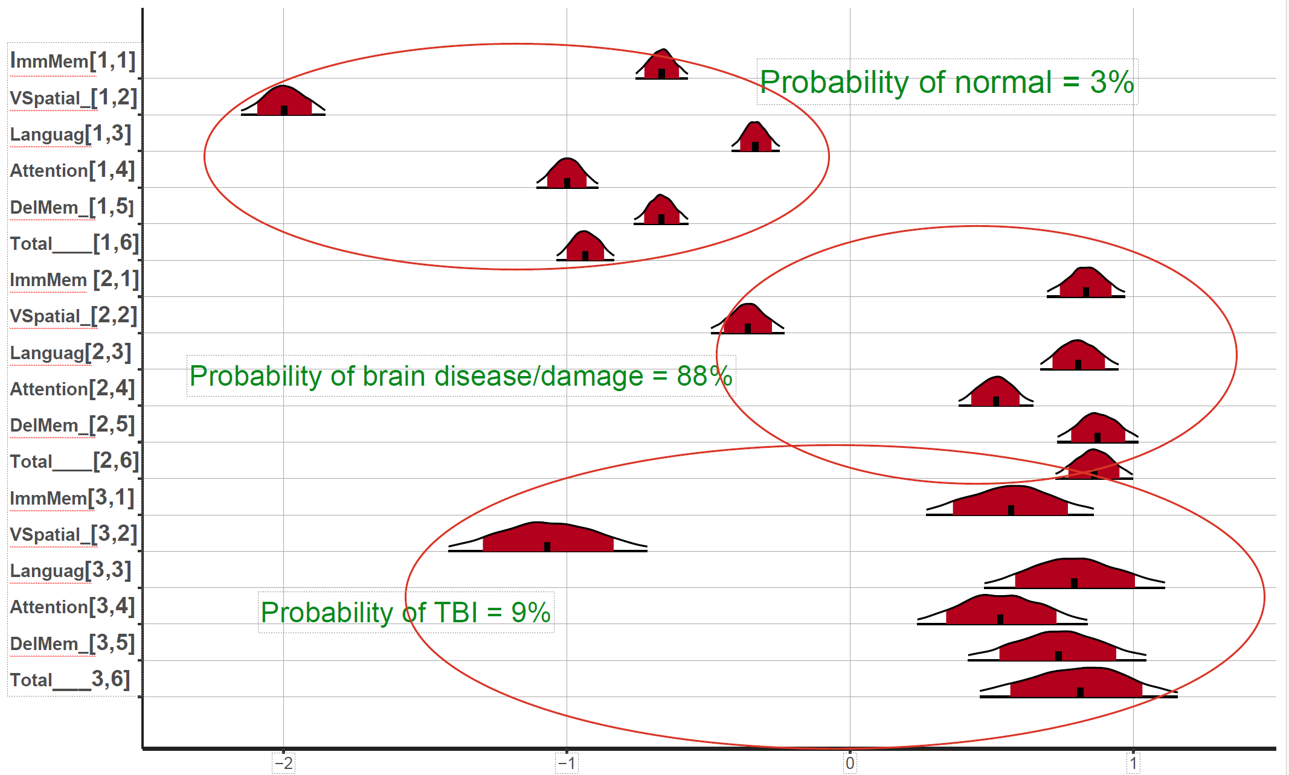
Multivariate Bayesian Analysis of the RBANS

Slide 17
RBANS: Early Vascular Dementia Profile
Referred for an MRI.
MRI: Hyperintensities in subcortical white matter, basal ganglia, and thalamus.
Diagnosed with vascular dementia.
Randolph, C. (2012). RBANS Update: Repeatable Battery for the assessment of neuropsychological status. PsychCorp.

Slide 18
The Role of Neuropsychology in Capital Litigation

Slide 19
Neuropsychology in criminal cases
Neuropsychology addresses the ability of individuals to function (behaviorally and cognitively).
Addresses issues of mitigation, competency, insanity, ability to form intent.

Slide 20
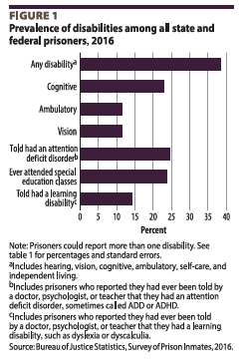
Bureau of Justice Statistics
A 2016 survey of prison inmates by the U.S. Department of Justice reported that “About a quarter of state prisoners reported a cognitive disability (24%)…”
U.S. Department of Justice. (n.d.). Disabilities reported by prisoners - survey of prison inmates, 2016. Bureau of Justice Statistics. Retrieved February 10, 2023, from https://bjs.ojp.gov/content/pub/pdf/drpspi16st.pdf

Slide 21
Bureau of Justice Statistics
“Cognitive disability” describes a variety of medical conditions affecting different mental tasks, such as problem-solving, reading comprehension, attention, and remembering.
U.S. Department of Justice. (n.d.). Disabilities reported by prisoners - survey of prison inmates, 2016. Bureau of Justice Statistics. Retrieved February 10, 2023, from https://bjs.ojp.gov/content/pub/pdf/drpspi16st.pdf

Slide 22
Center for Disease Control (CDC)
Studies have found that 25-87% of inmates report having experienced a head injury or TBI as compared to 8.5% in a general population reporting a history of TBI.
This gives an odds ratio of about 3:1 to 10:1
Center for Disease Control. (n.d.). Traumatic Brain Injury in Prisons and Jails: An Unrecognized Problem. Retrieved July 17, 2019, from https://www.cdc.gov/traumaticbraininjury/pdf/prisoner_tbi_prof-a.pdf

Slide 23
Neuropsychological Impairment and Risk Characteristics of Offenders
Lim, E. (2003). Neuropsychological Impairment and Risk Characteristics of Offenders (Unpublished doctoral dissertation). Alliant International University/ California School of Professional Psychology. Retrieved February 14, 2014.
Death penalty offenders demonstrated higher levels of neuropsychological impairment than the norm.
Notes:
Death penalty offenders have more impairment than the norm.
However, the mean of about 29 only falls in the mildly impaired range.

Slide 24
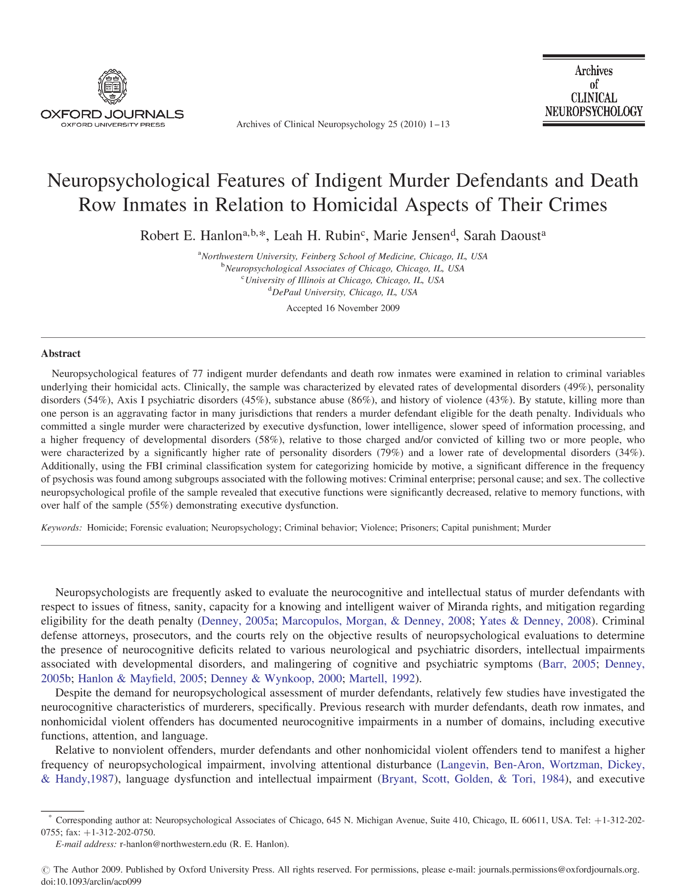
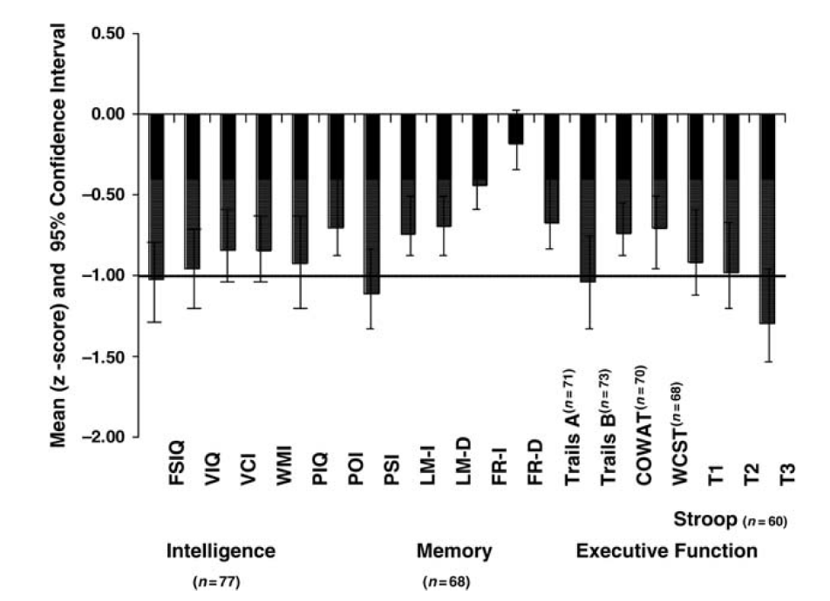
Neuropsychological Profiles Indigent Murder Defendants
Hanlon, R. E., Rubin, L. H., Jensen, M., & Daoust, S. (2009). Neuropsychological features of indigent murder defendants and death row inmates in relation to homicidal aspects of their crimes. Archives of Clinical Neuropsychology, 25(1), 1-13. doi:10.1093/arclin/acp099
Notes:
Hanlon et al. examined 77 murder defendants. They reported generalized impairment falling at about one standard deviation below the mean.

Slide 25
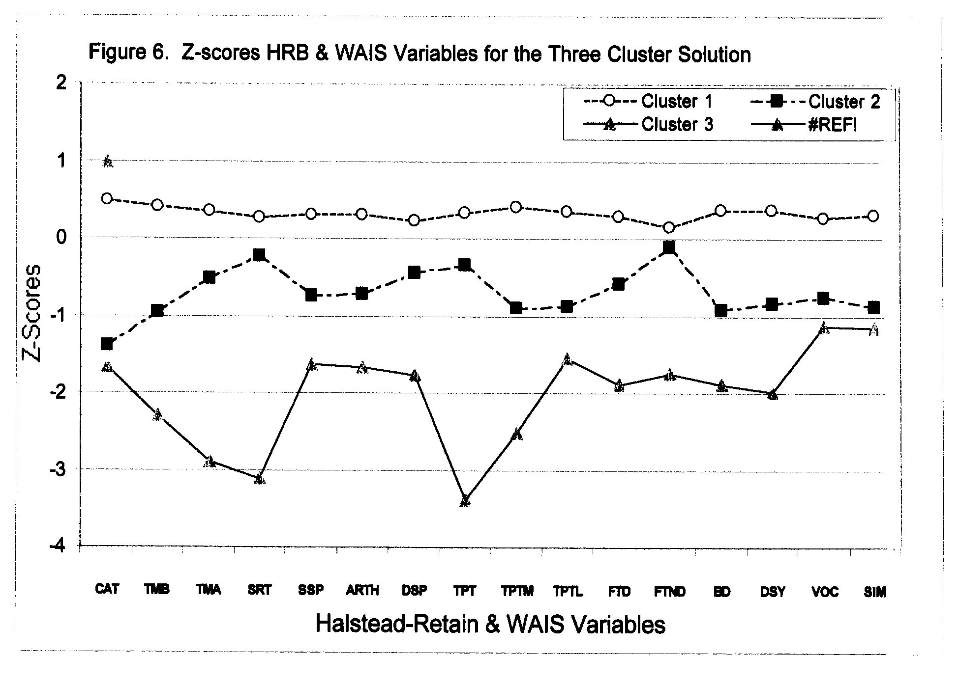
Cognitive Heterogeneity in Murderers
Warnick, E. K. (2003). Cognitive heterogeneity in murderers (Unpublished doctoral dissertation). University of Nevada.
Notes:
The most impaired test was the Tactual Performance Test or TPT, a measure of complex problem solving requiring intact planning abilities of the frontal lobes, as well as sensory and motor capacities, and spatial mapping capacities of posterior brain regions. Attentional capacities as measured by the Seashore Rhythm Test were also markedly impaired.

Slide 26
HRB Average Impairment Rating (AIR) Heaton’s Normals and Brain Damaged and Capital Def./App.
Adapted from Heaton et al. (2004) with Watson data
Notes:
The most impaired test was the Tactual Performance Test or TPT, a measure of complex problem solving requiring intact planning abilities of the frontal lobes, as well as sensory and motor capacities, and spatial mapping capacities of posterior brain regions. Attentional capacities as measured by the Seashore Rhythm Test were also markedly impaired.

Slide 27
The evolution of intelligence testing
WAIS-5 / WJ 5

Slide 28
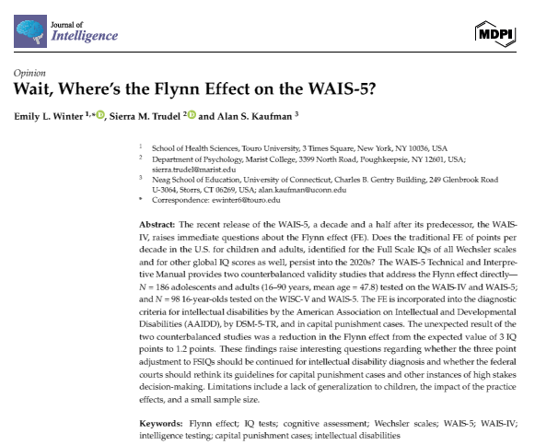
What is intelligence?
“Broadly defined, intelligence is a person’s ability to learn from their experience, adapt, influence, and choose environments.”
“At the heart of intelligence is an individual’s problem-solving skills and capacity for knowledge acquisition.”
These abilities “influence an individual’s ability to think, act, and learn within their environment.
Winter, Emily L., Sierra M. Trudel, and Alan S. Kaufman. 2024. Wait, Where’s the Flynn Effect on the WAIS-5? Journal of Intelligence 12: 118. https://doi.org/10.3390/jintelligence12110118
Winter, Emily L., Sierra M. Trudel, and Alan S. Kaufman. 2024. Wait, Where’s the Flynn Effect on the WAIS-5? Journal of Intelligence 12: 118. https://doi.org/10.3390/jintelligence12110118

Slide 29
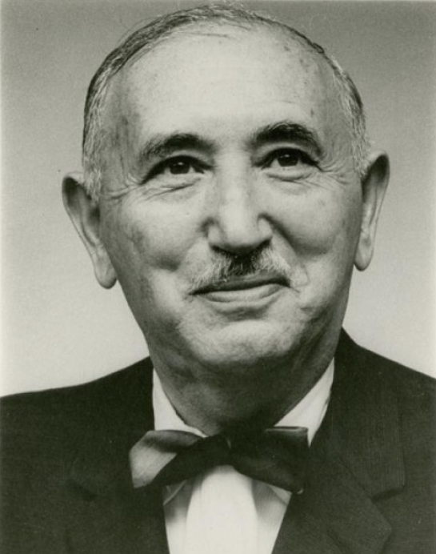
What is intelligence?
David Wechsler told us that “What we measure with tests is not what tests measure – not information, not spatial perception, not reasoning ability. These are only a means to an end. What intelligence tests measure is something much more important: the capacity of an individual to understand the world about him and his resourcefulness to cope with its challenges.“
Wechsler, 1975 cited by Wechsler, D., Raiford, S. E., & Presnell, K. (2024). Wechsler Adult Intelligence Scale: Technical and interpretive manual (5th ed.). NCS Pearson, p. 4).

Slide 30
What intelligence predicts
Academic achievement and educational attainment
Job performance
Mental and physical health

Slide 31
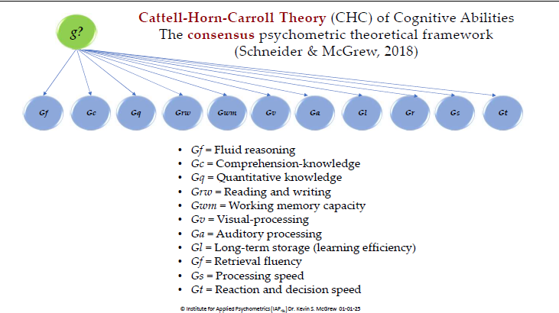
Cattell-Horn-Carroll (CHC) Theory of Intelligence

Slide 32
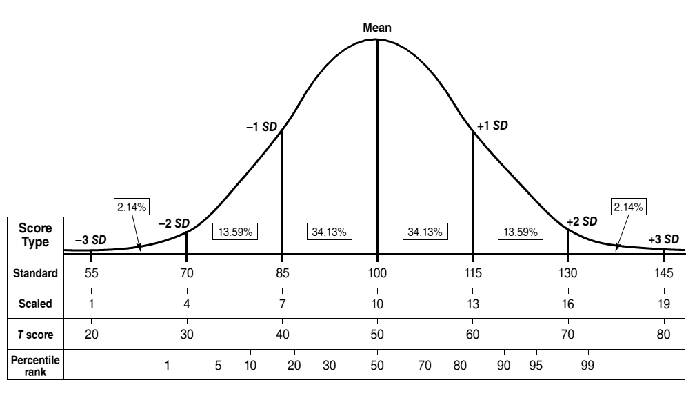
Normal Curve
Psychological Assessment Resources (PAR)

Slide 33
Wechsler Adult Intelligence Scale, 5th Edition
WAIS 5

Slide 34
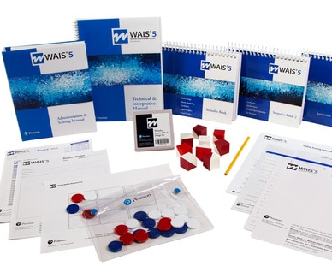
Wechsler Adult Intelligence Scale, Fifth Edition (WAIS 5)
Published 2024
Normed between February 2023 and January 2024
Normative Sample Size = 2,020
Age Range = 16:0 – 90:11
Matched to 2022 U.S. Census Bureau data within each age group for education, race/ethnicity, region, & sex.

Slide 35
General Cognitive Ability (g)
Visual Spatial
Block Design
Visual Puzzles
Working Memory
Digit Sequencing
Running Digits
Digits Forward
Letter-Number Sequencing
Symbol Span
Spatial Addition
Verbal Comprehension
Fluid Reasoning
Processing Speed
Similarities
Vocabulary
Information
Comprehension
Matrix Reasoning
Figure Weights
Arithmetic
Set Relations
Coding
Symbol Search
Naming Speed Quantity

Slide 36
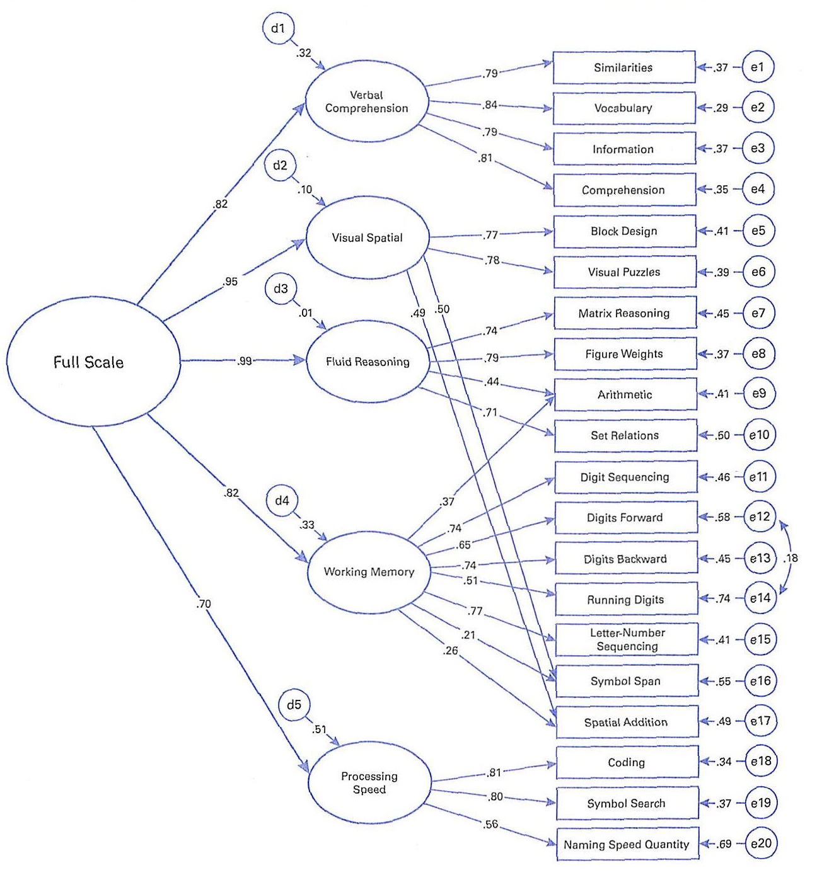
5 Factor Confirmatory Factor Model for the WAIS 5
Error or unique variance
0.70 x 0.70 = 49%
Unique Variance

Slide 37
Full Scale IQ (FSIQ)
FSIQ, which is a composite of seven subtests—Vocabulary, Similarities, Block Design, Matrix Reasoning, Figure Weights, Digit Sequencing, and Coding.
The mean reliability of the FSIQ averaged 0.97 across the age range;
The stability coefficient was 0.93 for 201 individuals aged 16–90 that were tested twice (average interval = 29 days).
Winter, Emily L., Sierra M. Trudel, and Alan S. Kaufman. 2024. Wait, Where’s the Flynn Effect on the WAIS-5? Journal of Intelligence 12: 118. https://doi.org/10.3390/jintelligence12110118

Slide 38
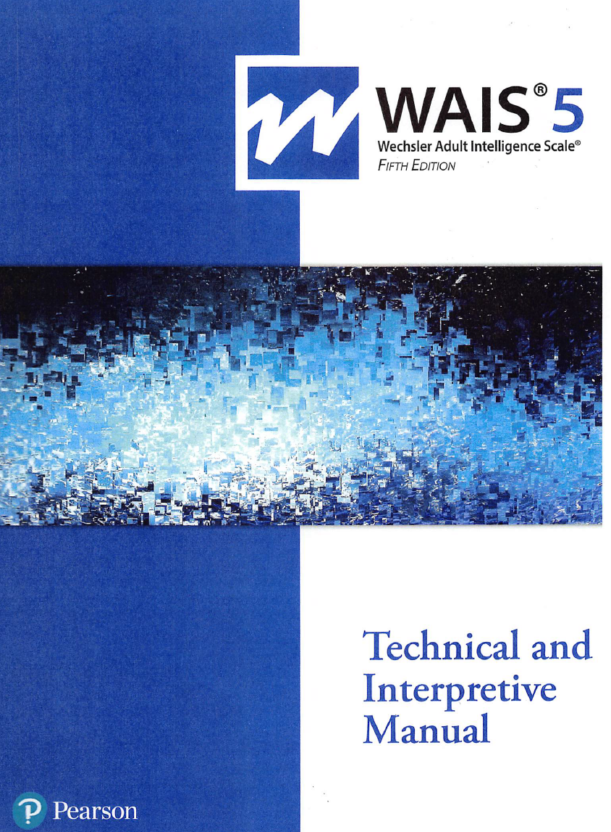
Bias Assessment
“All subtests and items were reviewed by internal and external reviewers for potential bias, cultural obsolescence, content relevance, and clinical utility.”
“Experts in cross-cultural research and/or intelligence testing conducted formal reviews.”
Reviewers from multiple countries evaluated translations and cultural fairness.
Statistical item analysis was conducted to eliminate problematic items across racial/ethnic groups.
English language learners were compared to matched controls finding no differences.

Slide 39
Age Ranges
Age | N = | Age | N =
16:0 – 17:11 | 180 | 55:0 – 64:11 | 180
18:0 – 19:11 | 180 | 65:0 – 69:11 | 180
20:0 – 24:11 | 180 | 70:0 – 74:11 | 100
25:0 – 29:11 | 180 | 75:0 – 79:11 | 100
30:0 – 34:11 | 180 | 80:0 – 84:11 | 100
35:0 – 44:11 | 180 | 85:0 – 90:11 | 100
45:0 – 54:11 | 180

Slide 40
Education
Education Levels
< 8 years of school (< 8)
9 – 12 years of school, no diploma (9 – 11)
High school diploma or equivalent (12)
Some college or technical school, associate degree (13 – 15)
Bachelor’s degree (> 16)

Slide 41
Race/Ethnicity
Race/Ethnicity
African American
Asian
Hispanic
White
Non-Hispanic multiracial, Native Americans, Alaska Natives, Pacific Islanders, and others

Slide 42
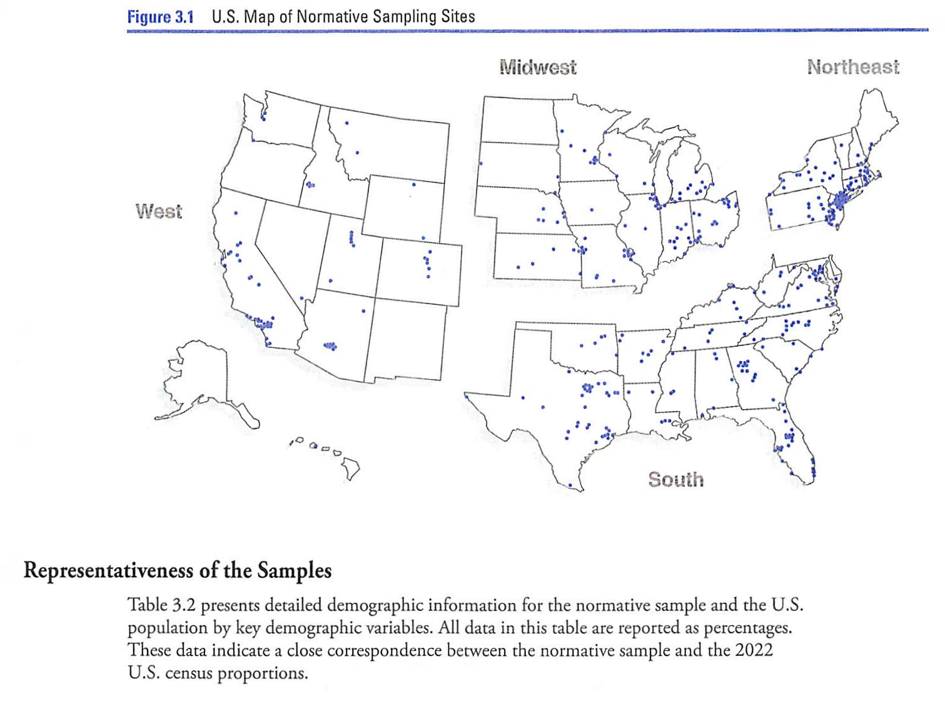
Region
Wechsler, D., Raiford, S. E., & Presnell, K. (2024). Wechsler Adult Intelligence Scale: Technical and interpretive manual (5th ed.). NCS Pearson, p. 46.

Slide 43
WAIS 5 Exclusionary Criteria (a “normal” sample!)
Primary language is not English
Primarily nonverbal or uncommunicative
Insufficient compliance
Previous IQ test within six months
Graduate psychology training
Uncorrected visual impairment
Uncorrected hearing loss
Upper extremity disability
Hospitalized
Medication affecting cognition
History of ECT
Chemotherapy last two months
Loss of consciousness >20”
Recent loss of function
Medical conditions affecting brain including stroke, tbi, mood disorders (except diabetes, hypothyroidism, & hypertension)

Slide 44
WAIS 5 Platforms
Paper and pencil (in person)
Q-Global (remote)
Q-Interactive (i-Pad to i-Pad in person)

Slide 45
Standard Error of Measurement (SEM)
No test is perfect
The SEM is an estimate of the amount of error in an individual’s obtained test score.
Based upon the reliability of the score (which increases with larger sample sizes).

Slide 46
Standard Error of Measurement (SEM)
Average WAIS 5 FSIQ across age groups = 2.57
So, a FSIQ of 70 will have a 95% confidence range of 65 to 75.
If a 45-year-old examinee obtained an FSIQ score of 70, the practitioner can be 95% confident that the individual’s true FSIQ falls in the range of 65-75 (because the 95% confidence interval is 70 + 1.96 SEM, where the SEM is 2.57).

Slide 47
Standard Error of Estimate (SEE)
The WAIS 5 uses the Standard Error of the Estimate (SEE) to calculate confidence ranges.
“…because the composite score reliability estimates ae relatively high, confidence intervals calculated with the SEM centered on the obtained score and those calculated with the SEE centered on the estimated true score will be very close.”
“When differences are observed, they occur at the extreme high and low ends of the distribution due to greater regression to the mean effects at the ends of a distribution of scores.”

Slide 48
Woodcock Johnson Tests of Cognitive Abilities, Fifth Edition
WJ 5

Slide 49
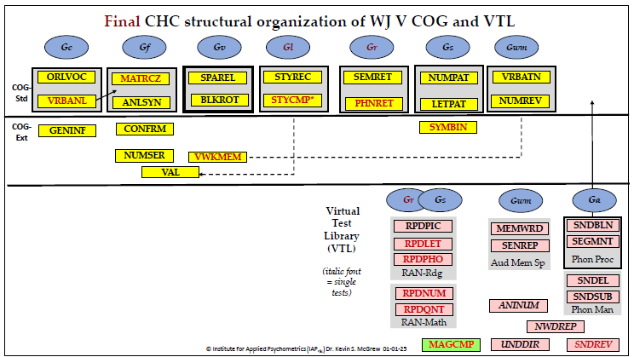
WJ 5 Measurement based on CHC Theory

Slide 50
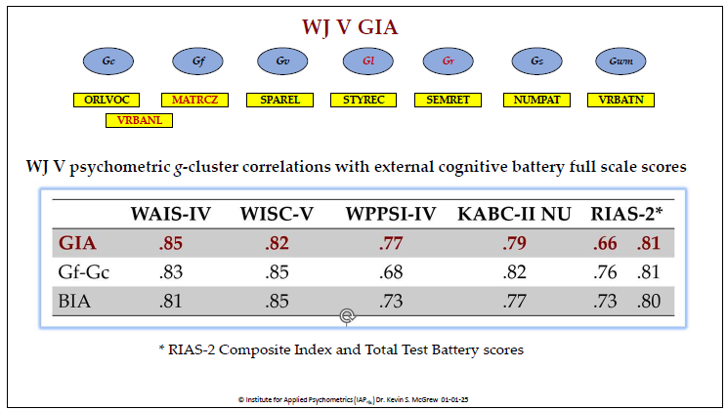
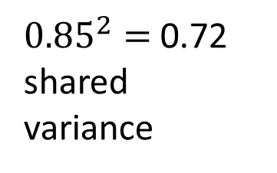
WJ V – WAIS-IV Correlation
${0.85}^{2}=$0.72 shared variance

Slide 51
Limitations of the WJ 5
Administration of the WJ 5 is exclusively on a laptop and tablet.
Currently, the WJ 5 requires an active internet connection.
Problematic for use in prison settings.
Discussions about creating an app-based version.

Slide 52
Practice Effects

Slide 53
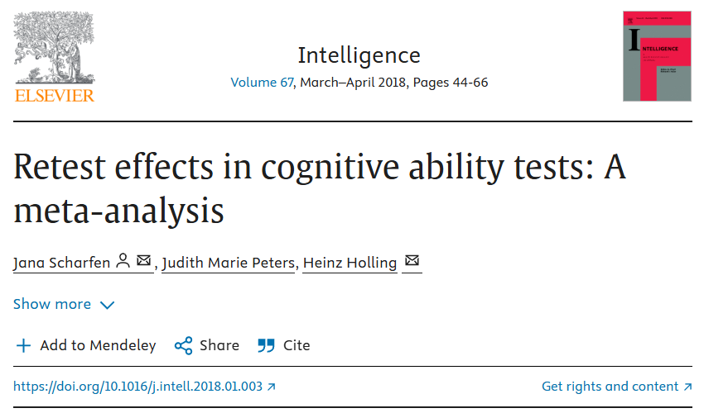
Re-Test Effect
Scharfen et al. (2018) conducted a meta-analysis on the effect of taking a test multiple times.
Scharfen, J., Peters, J. M., & Holling, H. (2018b). Retest effects in cognitive ability tests: A meta-analysis. Intelligence, 67, 44–66. https://doi.org/10.1016/j.intell.2018.01.003

Slide 54
Re-Test Effect
“A gain in test scores of almost a third standard deviation for a mere repetition of a cognitive ability test without any further intervention between measurements has an impact on how we should deal with retesting and test experience in the future.”
Scharfen, J., Peters, J. M., & Holling, H. (2018b). Retest effects in cognitive ability tests: A meta-analysis. Intelligence, 67, 44–66. https://doi.org/10.1016/j.intell.2018.01.003

Slide 55
Re-Test Effect
“To illustrate, a person that achieved an IQ score of 100 in a first test, would be predicted to attain 105 IQ points when retested with a second test. An increase in test scores of half a standard deviation for the third and fourth test were revealed. Taking the example above, the person would be predicted to score 107 IQ points in a third and 108 in a fourth test. Nonetheless, in the light of the context of simply repeating a cognitive ability test, which occurs fairly often, this effect should not be neglected.”

Slide 56
Re-Test Effect
“The length of the test-retest interval had a significant influence on retest effects for up to four test administrations: The longer the test-retest interval between administrations, the smaller the retest effects.” p. 57.

Slide 57
Re-Test Effect
However, the retest effect decreased very slowly.
“To illustrate, increasing the test-retest interval by 50 weeks would lead to a decrease of the retest effect by 0.0008 x 50 = 0.04 standard deviations” (0.6 points).

Slide 58
Re-Test Effect
“In order to control for retest effects, the recommendation of using parallel, instead of identical test forms was supported by our results, as long as only a few retest are administered.
However, the finding that the administration of alternate test versions also leads to retest effects suggest that any earlier experience with a similar cognitive ability test can account for higher scores, which should be taken seriously as well.” p. 59.

Slide 59
The “Flynn Effect” updated

Slide 60
The Flynn Effect in Retrospect
Older norms tend to produce spuriously high IQs because they become increasingly “soft” as time goes by.
IQ scores become artificially inflated and should be corrected by subtracting 0.3 points from the FSIQ per year from the norming date.

Slide 61
The Flynn Effect In Retrospect
In the United States, IQs have increased about 3 IQ points every ten years.
“The Flynn effect suggests that younger generations score higher on IQ tests than those prior (Dworak et al. 2023).”

Slide 62
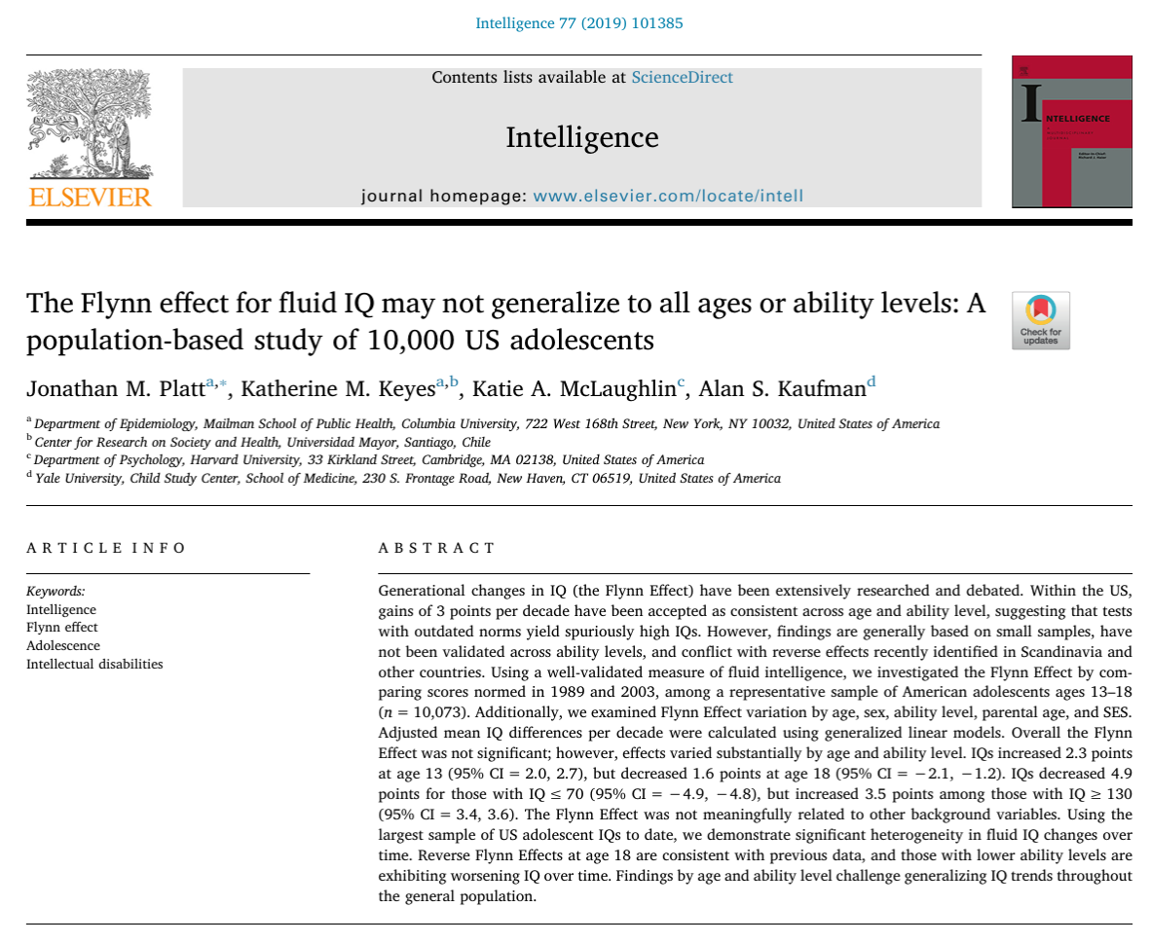
The anti-Flynn Effect (Reversal)
Previous data suggest that, since the end of the 20th century, IQs may be decreasing in recent birth cohorts, especially in Europe.
It is unknown whether a similar reversal of the Flynn Effect occurred in the US during this time.

Slide 63
The anti-Flynn Effect (Reversal)
Platt et a. (2019) used the Kaufman Brief Intelligence Test (K-BIT) to study non-verbal adolescent IQs in the U.S. finding no Flynn Effect overall.
However, studies using other tests (e.g., Wechsler scales) did find substantial Flynn Effects (Pietschnig & Voracek, 2015; Trahan et al., 2014).

Slide 64
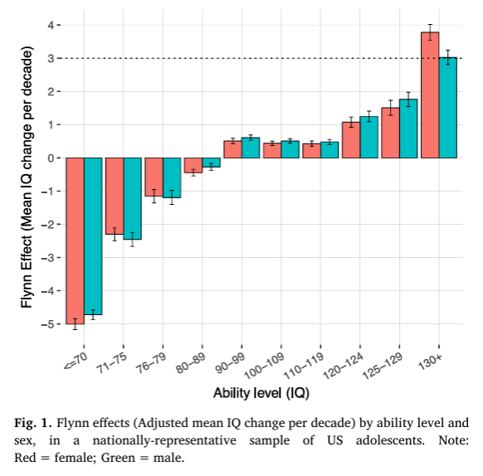
The anti-Flynn Effect (Reversal)
The negative values at low ability levels suggest reverse Flynn Effects; that is, those at low ability levels test lower using 1989 norms than they would have using 2003 norms.
In contrast, those at high ability levels test higher using 1989 norms than they would have using 2003 norms.

Slide 65
The anti-Flynn Effect (Reversal)
A widening disparity in the US in terms of cognitive ability, with those at the lower end of the ability dimension not only exhibiting less gains than those at the higher ends, but reversing direction entirely.
Second, these results have implications for considering demographic differences when adjusting IQ test scores in the population.

Slide 66
WAIS IV / WAIS 5 Comparisons
Comparing the WAIS IV and WAIS 5, the increase in score points per decade for the FSIQ was 1.3 points (p. 86).
Smaller than the 3 points traditionally accepted.

Slide 67
Validity of the “New” Flynn Effect
The WAIS IV data were collected pre-pandemic and the WAIS 5 data were post-pandemic.
The number of subtests required for the FSIQ dropped from 10 to 7.
“Processing Speed Index and Working Memory Index comprised 40% of the WAIS-IV Full Scale, a value that was reduced to 28.6% on the WAIS-5.”

Slide 68
Intra-Individual Variability (IIV)
“Unusualness” or Test Scatter

Slide 69
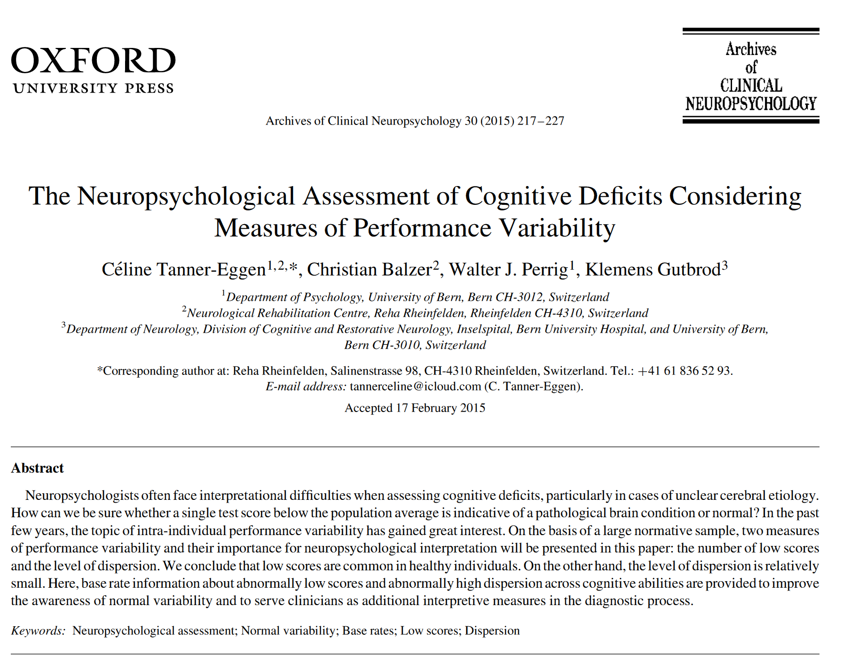
Dispersion within cognitive profiles
Recent research has suggested that the dispersion of scores (scatter) within a profile may be associated with greater cognitive impairments.
Used Intra-individual Standard Deviation (ISD) as measure of scatter.

Slide 70
Dispersion within cognitive profiles
“Marked IIV (Intra-Individual Variability) is often associated with acquired neurocognitive deficits.
In this case, it is assumed that an abnormal brain condition interferes with a person’s ability to perform at a characteristic level of neuropsychological functioning.”
The loss of top-down (executive) control leads to greater variability in performance.
Tanner-Eggen, C., Balzer, C., Perrig, W. J., & Gutbrod, K. (2015). The neuropsychological assessment of cognitive deficits considering measures of performance variability. Archives of Clinical Neuropsychology, 30(3), 217–227. https://doi.org/10.1093/arclin/acv008

Slide 71
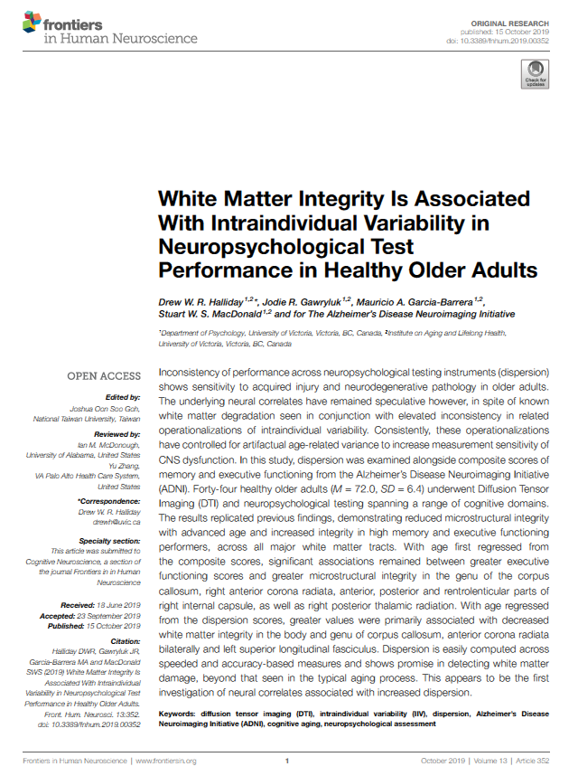
Intraindividual Test Score Variability Associated with White Matter Integrity
Halliday et al. (2019) found that “inconsistency across neuropsychological test performance is associated with white matter integrity in multiple brain regions.
This may be especially important for individuals who do not present with marked deficits on any one particular task, but instead present with multiple, mild deficits that may otherwise go unnoticed.”
Halliday, D. W., Gawryluk, J. R., Garcia-Barrera, M. A., & MacDonald, S. W. (2019). White matter integrity is associated with intraindividual variability in neuropsychological test performance in Healthy Older Adults. Frontiers in Human Neuroscience, 13. https://doi.org/10.3389/fnhum.2019.00352

Slide 72
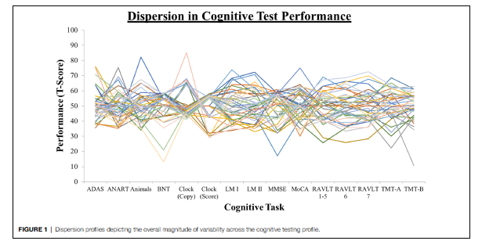
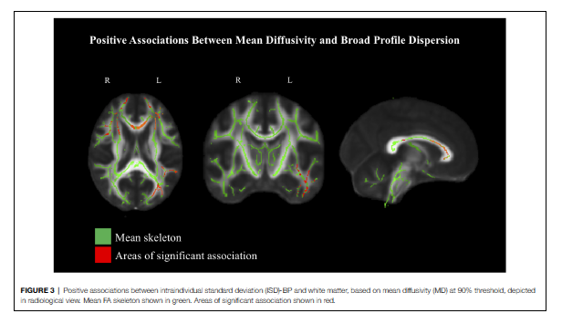
Dispersion and white matter correlations (using Diffusion Tensor Imaging (DTI))
Halliday, D. W., Gawryluk, J. R., Garcia-Barrera, M. A., & MacDonald, S. W. (2019). White matter integrity is associated with intraindividual variability in neuropsychological test performance in Healthy Older Adults. Frontiers in Human Neuroscience, 13. https://doi.org/10.3389/fnhum.2019.00352

Slide 73
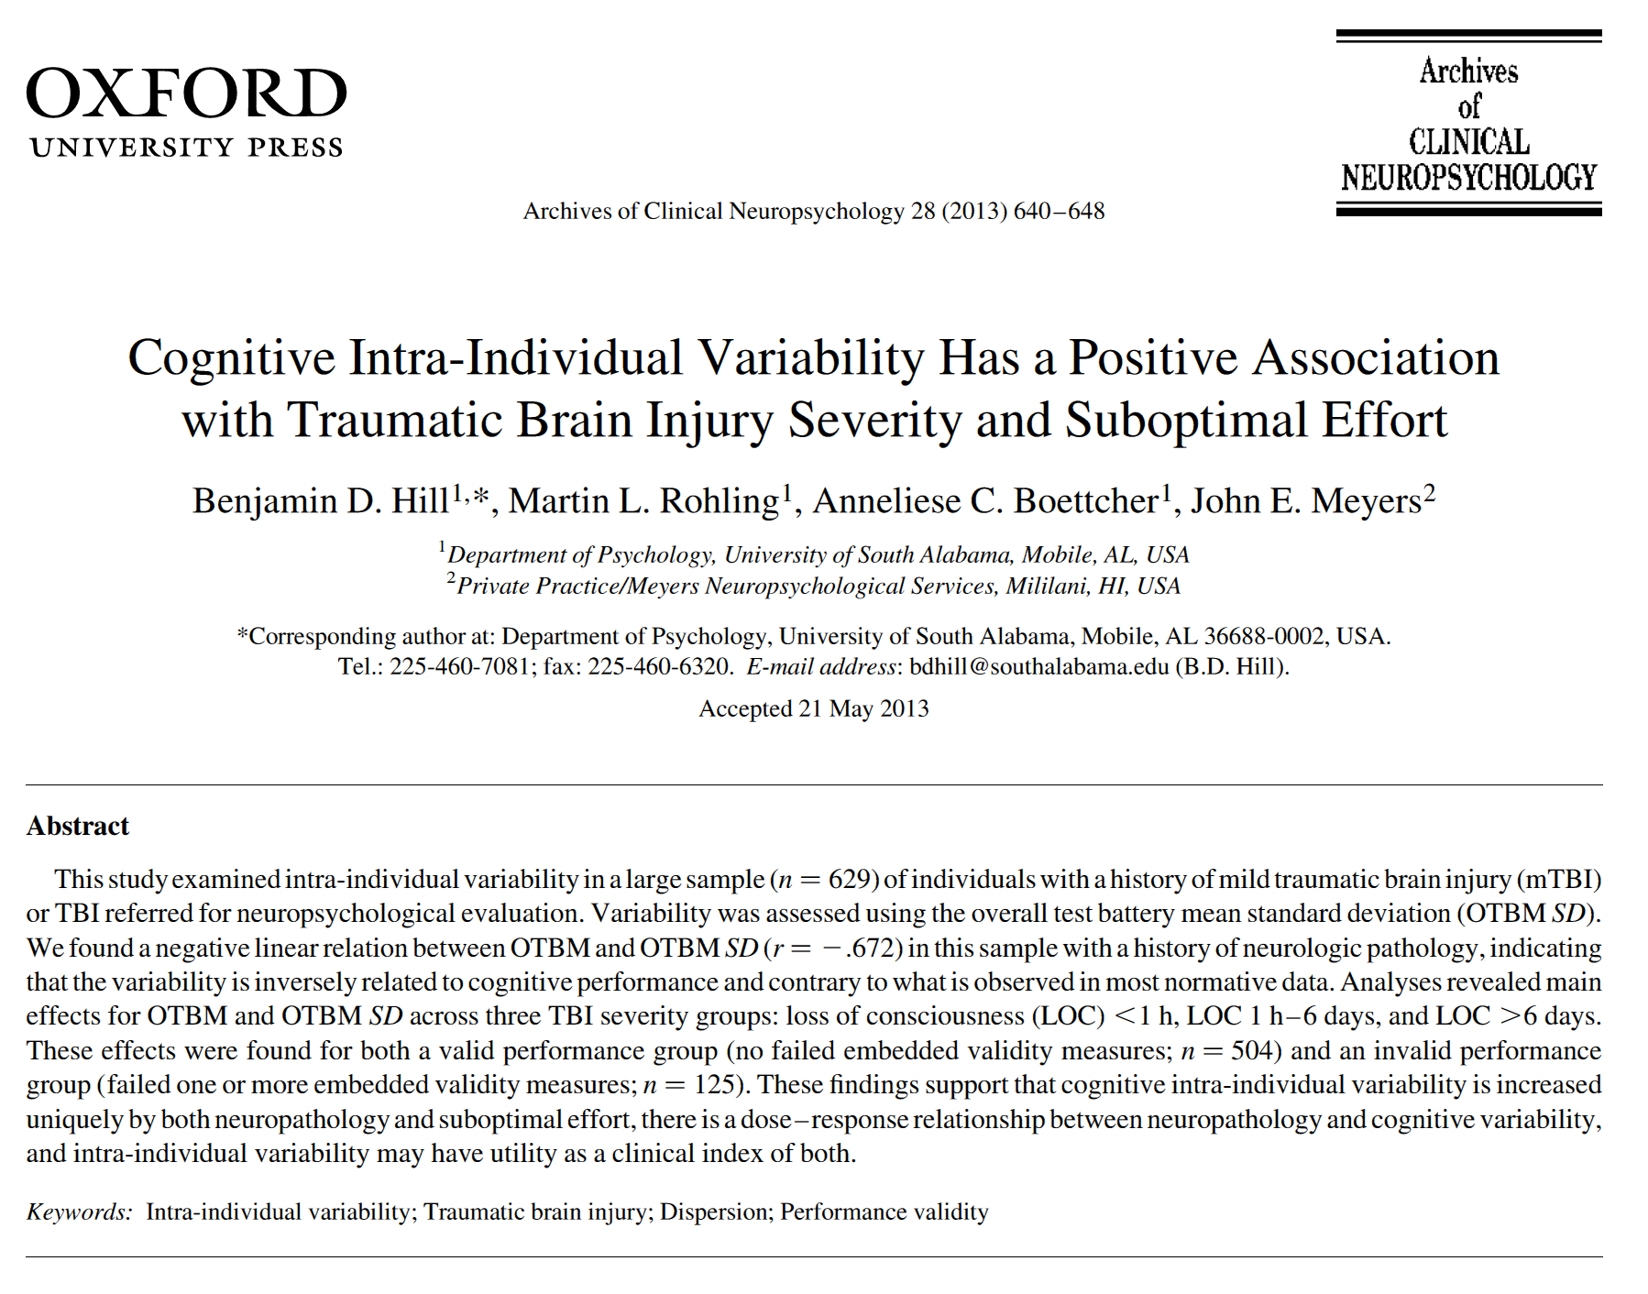
Intra-Individual Variability in Traumatic Brain Injury (TBI)
Hill et al. (2013) found greater intra-individual variability (IIV) in those with traumatic brain injury – demonstrating a dose-response relationship on the standard deviation of the Overall Test Battery Mean (OTBM) from Meyers Neuropsychological Battery (MNB).
More severe TBI resulted in greater variability.
Hill, B. D., Rohling, M. L., Boettcher, A. C., & Meyers, J. E. (2013). Cognitive intra-individual variability has a positive association with traumatic brain injury severity and suboptimal effort. Archives of Clinical Neuropsychology, 28(7), 640–648. https://doi.org/10.1093/arclin/act045

Slide 74
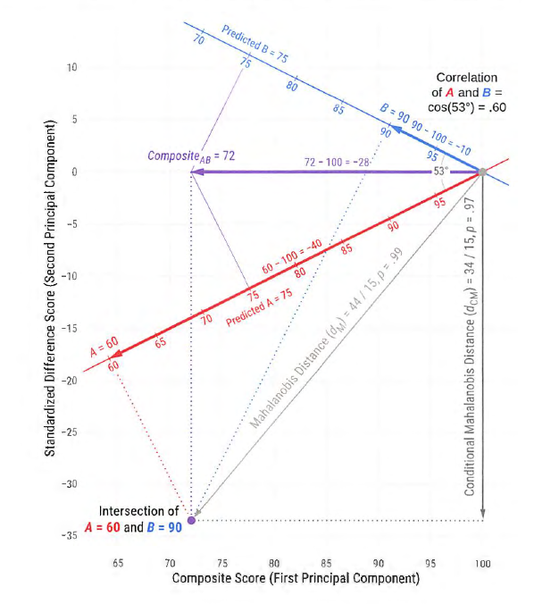
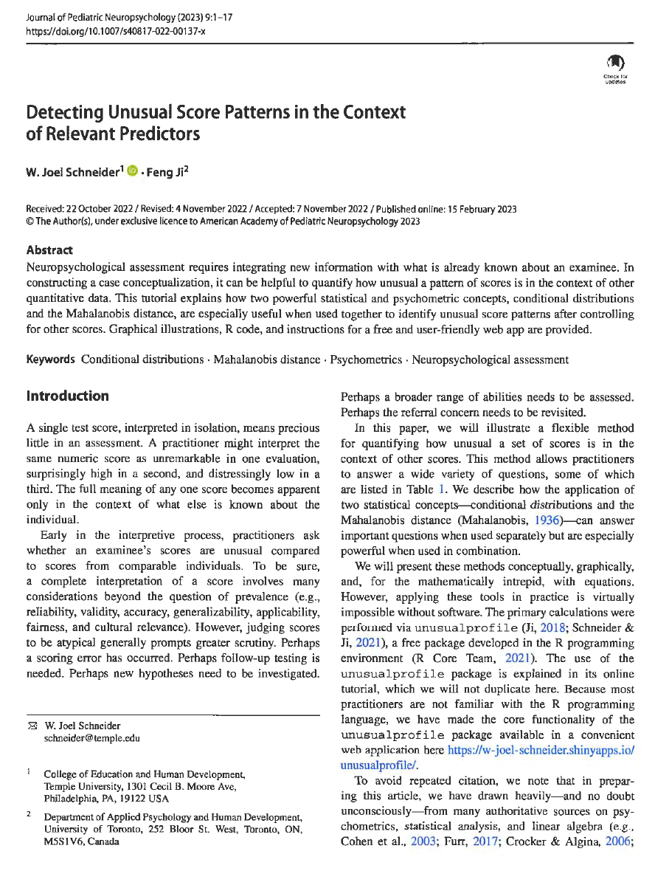
Graphic of calculations for “Unusualness”
Schneider, W. J., & Ji, F. (2023). Detecting unusual score patterns in the context of relevant predictors. Journal of Pediatric Neuropsychology, 9(1), 1–17. https://doi.org/10.1007/s40817-022-00137-x

Slide 75
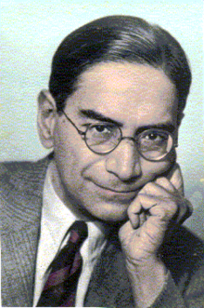
Prasanta Chandra Mahalanobis (1893-1972)
Mahalanobis is best know for developing the Mahalanobis distance, which is one of the most widely used metrics to find how much a point diverges from a distribution, based on measurements in multiple dimensions. It is widely used in the field of cluster analysis and classification (Wikipedia).

Slide 76
RBANS: Early Vascular Dementia Profile
86-year-old male attorney
Complaints of increased fatigue, mild anhedonia, and difficulty concentrating.
WAIS-R Full Scale IQ = 102
WMS-R Verbal Memory = 100
WMS-R Attention/Conc. = 85
Mild motor problems
Elevated cholesterol
MRI: Hyperintensities in subcortical white matter, basal ganglia, and thalamus
Randolph, C. (2012). RBANS Update: Repeatable Battery for the assessment of neuropsychological status. PsychCorp.

Slide 77
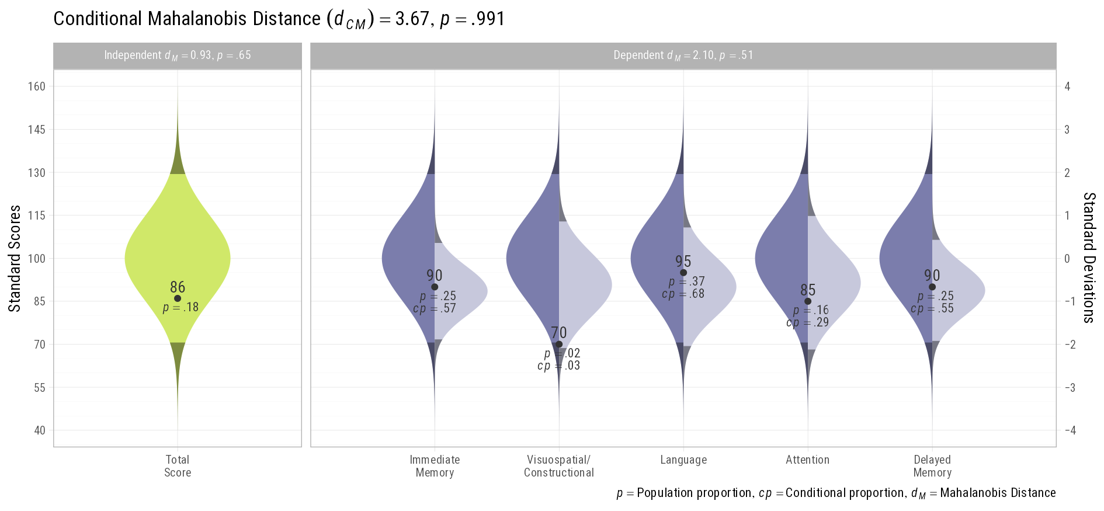
RBANS: Early Vascular Dementia Profile
https://w-joel-schneider.shinyapps.io/unusualprofile/

Slide 78
In Summary…
There have been significant developments in the field of neuropsychology that is moving towards evidenced-based interpretation
New methods of testing are being developed that depend more upon digital administration and scoring of tests
New statistical approaches are also being developed that allow for more accurate analysis and interpretation of test data
There is a shift being made from p < .05 hypothesis testing to Bayesian and multivariate models that integrate what is known before testing (base-rates) with pattern analysis of test results

Slide 79
Resources

Slide 80
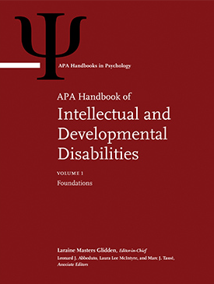
APA Handbook of Intellectual and Developmental Disabilities
Farmer, R. G., Farmer, R. L., Schneider, W. J., & McGrew, K. S. (2021). Theories of measurement of intelligence. In L. M. Glidden, L. Abbeduto, L. L. McIntyre, & M. J. Tassé (Eds.), APA Handbook of Intellectual and Developmental Disabilities (Vol. 1, pp. 385–424). American Psychological Association.

Slide 81
APA Handbook of Intellectual and Developmental Disabilities
Wachs, T. D., & Gorman, K. S. (2021). Linking poverty and developmental disabilities. In L. M. Glidden, L. Abbeduto, L. L. McIntyre, & M. J. Tassé (Eds.), APA handbook of intellectual and developmental disabilities (Vol. 1, pp. 323–354). American Psychological Association.

Slide 82
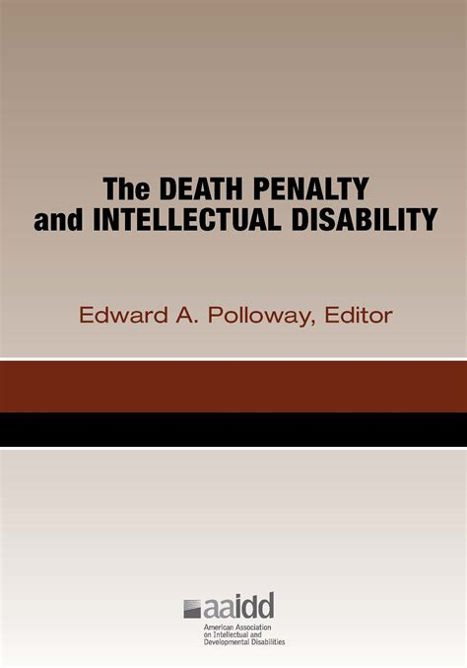
Are these scores statistically different?
E. A. Polloway (Ed.), The death penalty and intellectual disability American Association on Intellectual and Developmental Disabilities.

Slide 83
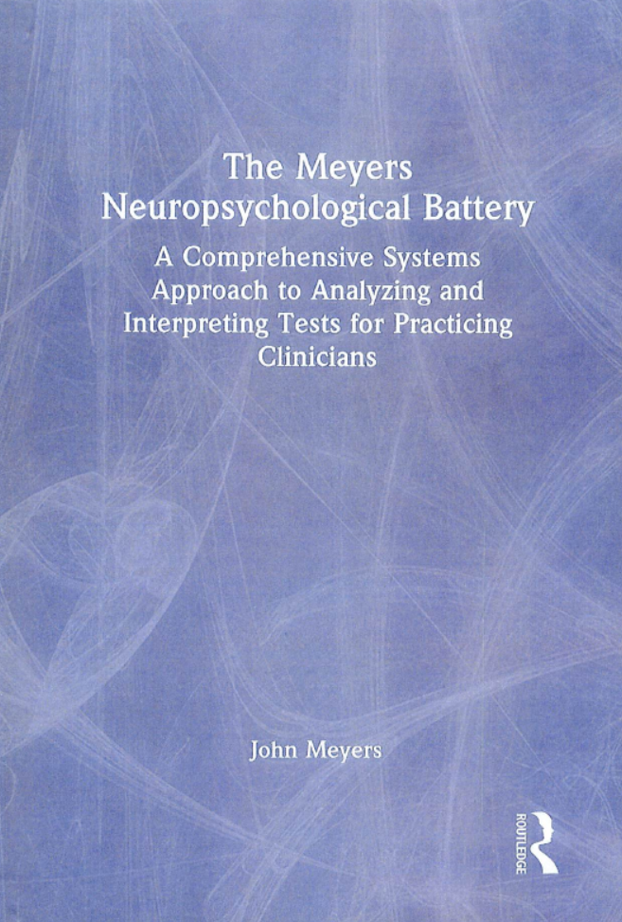
Meyers Neuropsychological Battery
Meyers, J. (2025). The Meyers Neuropsychological Battery: A Comprehensive Systems Approach to Analyzing and Interpreting Tests for Practicing Clinicians. Routledge.
https://www.meyersneuropsychological.com/

Slide 84

W. Joel Schneider
https://assessingpsyche.wordpress.com/about-me/
https://osf.io/nyxfg/
https://wjschne.github.io/
https://www.temple.edu/about/faculty-staff/w-joel-schneider-tuh42402

Slide 85

Kevin McGrew
http://www.iqscorner.com/
First author of the Woodcock Johnson 5

Slide 86
Dale G. Watson, Ph.D.
3377 Deer Valley Road, PMB 310
Antioch, CA 94531
watson.dale@comcast.net
866-536-5301
Questions?

