Slide 1
Traumatic Brain Injury (TBI)
Dale G. Watson, Ph.D. and Amy Armstrong, Esq.
2025 Capital Case Defense Seminar
February 16, 2025
San Diego, CA

Slide 2
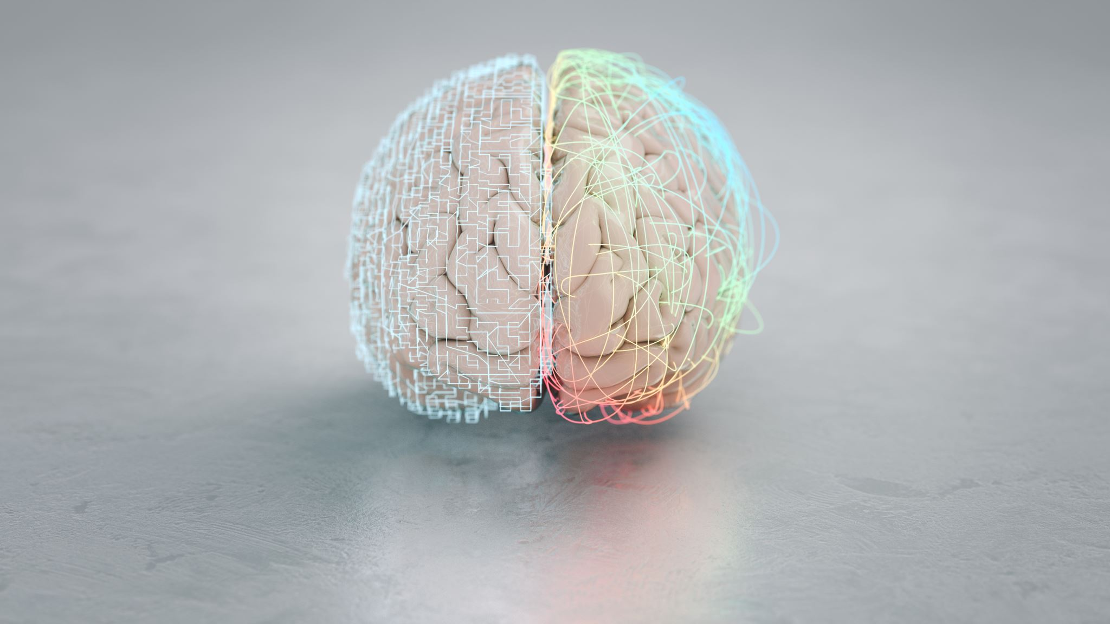
DSM5 Diagnostic Criteria
Major and Mild Neurocognitive Disorder Due to Traumatic Brain Injury

Slide 3
DSM5: Major Neurocognitive Disorder
Evidence of significant cognitive decline from a previous level of performance in one or more cognitive domains (complex attention, executive function, learning and memory, language, perceptual-motor, or social cognition) based on:
Concern of the individual, a knowledgeable informant, or the clinician that there has been a significant decline in cognitive function; and
A substantial impairment in cognitive performance, preferably documented by standardized neuropsychological testing or, in its absence, another quantified clinical assessment.

Slide 4
DSM5: Major Neurocognitive Disorder
The cognitive deficits interfere with independence in everyday activities (i.e., at a minimum, requiring assistance with complex instrumental activities of daily living such as paying bills or managing medications).
The cognitive deficits do not occur exclusively in the context of a delirium.
The cognitive deficits are not better explained by another mental disorder (e.g., major depressive disorder, schizophrenia).

Slide 5
DSM5: Mild Neurocognitive Disorder
Evidence of modest cognitive decline from a previous level of performance in one or more cognitive domains (complex attention, executive function, learning and memory, language, perceptual-motor, or social cognition) based on:
Concern of the individual, a knowledgeable informant, or the clinician that there has been a mild decline in cognitive function; and
A modest impairment in cognitive performance, preferably documented by standardized neuropsychological testing or, in its absence, another quantified clinical assessment.

Slide 6
DSM5: Mild Neurocognitive Disorder
The cognitive deficits do not interfere with independence in everyday activities (i.e., complex instrumental activities of daily living such as paying bills or managing medications are preserved, but greater effort, compensatory strategies, or accommodation may be required).
The cognitive deficits do not occur exclusively in the context of a delirium.
The cognitive deficits are not better explained by another mental disorder (e.g., major depressive disorder, schizophrenia).

Slide 7
Major of Mild Neurocognitive Disorder Due to Traumatic Brain Injury
The criteria are met for major or mild neurocognitive disorder.
There is evidence of a traumatic brain injury – that is, an impact to the head or other mechanisms of rapid movement or displacement within the skull, with one or more of the following:
Loss of consciousness.
Posttraumatic amnesia.
Disorientation and confusion.
Neurological signs (e.g., neuroimaging demonstrating injury; a new onset of seizures; a marked worsening of a preexisting seizure disorder; visual field cuts; anosmia; hemiparesis).
The neurocognitive disorder presents immediately after the occurrence of the traumatic brain injury or immediately after recovery of consciousness and persists past the acute post-injury period.

Slide 8
Severity ratings for traumatic brain injury
Injury Characteristics | Mild TBI | Moderate TBI | Severe TBI
Loss of Consciousness | < 30 minutes | 30 minutes – 24 hours | > 24 hours
Posttraumatic Amnesia | < 24 hours | 24 hours – 7 days | > 7 days
Disorientation and Confusion (Glascow Coma Scale at initial assessment) | 13-15 (not below 13 at 30 minutes) | 9-12 | 3-8

Slide 9
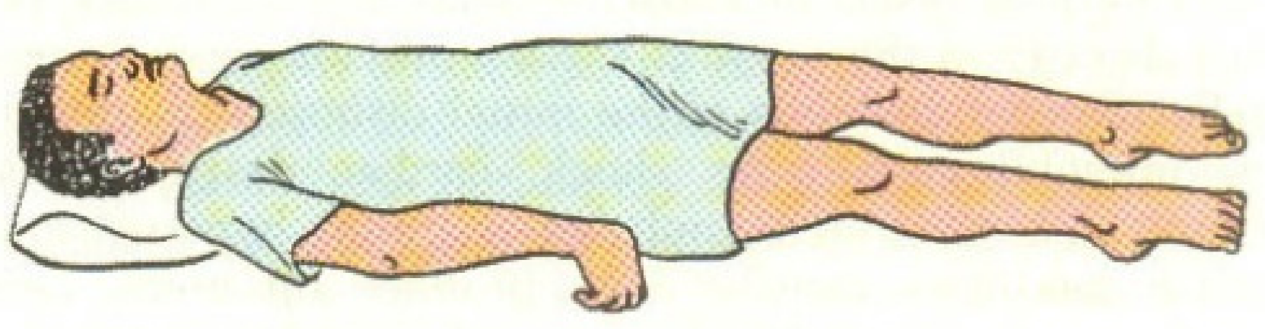
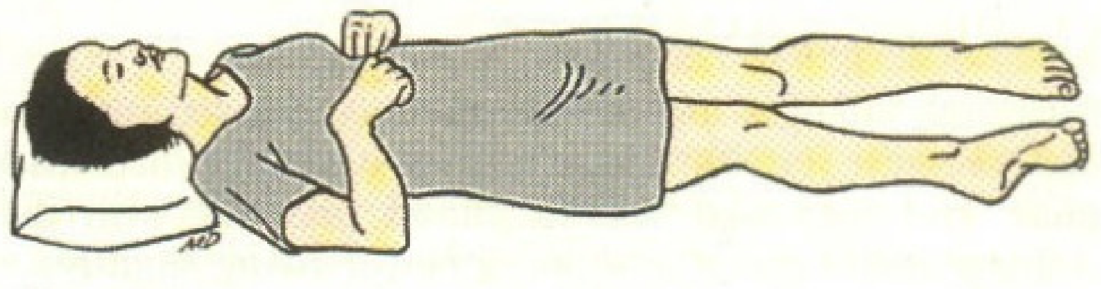
Glascow Coma Scale
 | 1 | 2 | 3 | 4 | 5 | 6
Eyes | Does not open eyes | Opens eyes in response to painful stimuli | Opens eyes in response to voice | Open eyes spontaneously | N/A | N/A
Verbal | Makes no sounds | Incomprehensible sounds | Utters inappropriate words | Confused, disoriented | Oriented, converses normally | N/A
Motor | Makes no movements | Extension to painful stimuli (decerebrate response) | Abnormal flexion to painful stimuli (decorticate response) | Flexion / Withdrawal to painful stimuli | Localizes painful stimuli | Obeys commands

Slide 10
Glascow Coma Scale
Total GCS Score
Range: 3 to 15
Interpretation:
13–15: Mild brain injury to normal
9–12: Moderate brain injury
3–8: Severe brain injury (a score of 8 or less is often considered a coma)

Slide 11
Types of Traumatic Brain Injury
Injury | Characteristics
Mild Traumatic Brain Injury (mTBI) | Concussion / Mild Head Injury
mTBI with complications | Mild with evidence of neurological dysfunction (Post Concussion Syndrome)
Moderate / Severe TBI | See injury characteristics
Diffuse Axonal Injury (DAI) | Widespread tearing of neuronal axons
Chronic Traumatic Encephalopathy (CTE) | Result of multiple concussive episodes

Slide 12
Prevalence of Traumatic Brain Injury (TBI)
From concussion to chronic traumatic encephalopathy

Slide 13
Updated cdc website information
CDC’s website is being modified to comply with President Trump’s Executive Orders.

Slide 14
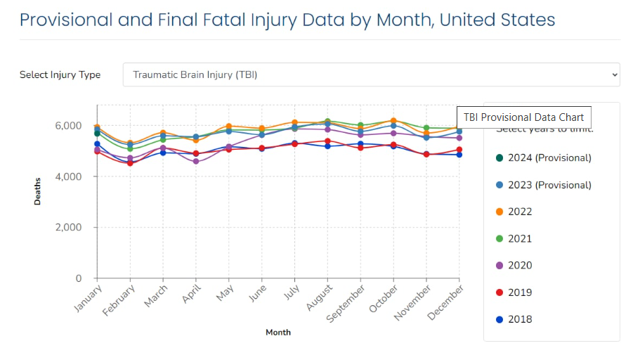
https://www.cdc.gov/traumatic-brain-injury/data-research/index.html

Slide 15
Prevalence of Traumatic Brain Injury
There were approximately 214,110 TBI-related hospitalizations in 2020 and 69,473 TBI-related deaths in 2021.
This represents more than 586 TBI-related hospitalizations and 190 TBI-related deaths per day.
TBI was a diagnosis in more than 280,000 hospitalizations and 2.2 million ED visits.
https://www.cdc.gov/traumatic-brain-injury/data-research/facts-stats/index.html

Slide 16
Prevalence of Traumatic Brain Injury
Males were nearly two times more likely to be hospitalized (79.9 age-adjusted rate versus 43.7) and three times more likely to die from a TBI than females (28.3 versus 8.4).
Estimated 25% of TBIs do not seek medical care and go unreported
https://www.cdc.gov/traumatic-brain-injury/data-research/index.html

Slide 17
Groups at increased risk of tbi
Racial and ethnic minorities
Service members and veterans
People who experience homelessness
People who are in correctional and detention facilities
Many people in correctional or detention facilities have a history of one or more TBIs
TBI symptoms may contribute to situations that increase the chance for disciplinary action
Survivors of intimate partner violence
People living in rural areas
https://www.cdc.gov/traumatic-brain-injury/data-research/facts-stats/index.html

Slide 18
Mild TBI (mTBI)
The average incidence of mTBI was 503.1/100 000
Peaks among males (590/100 000)
American Indians/Alaska Natives (1,026/100 000)
There are approximately 100,000 to 300,000 concussive episodes occurring in the game of American football alone each year.
Bazarian, J. J., Mcclung, J., Shah, M. N., Cheng, Y. T., Flesher, W., & Kraus, J. (2005). Mild traumatic brain injury in the United States, 1998–2000. Brain Injury, 19(2), 85-91. doi: 10.1080/02699050410001720158 ; Lakhan, S. E., & Kirchgessner, A. (2012). Chronic traumatic encephalopathy: the dangers of getting “dinged.” SpringerPlus, 1, 2. http://doi.org/10.1186/2193-1801-1-2

Slide 19
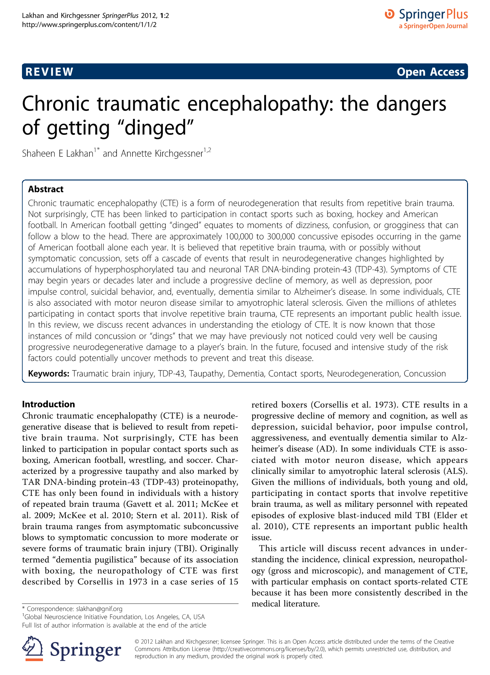
In college football, running backs and quarterbacks suffer the hardest and most severe blows to the head.
Linemen and linebackers suffer more head impacts during a game than players in other positions.

Slide 20
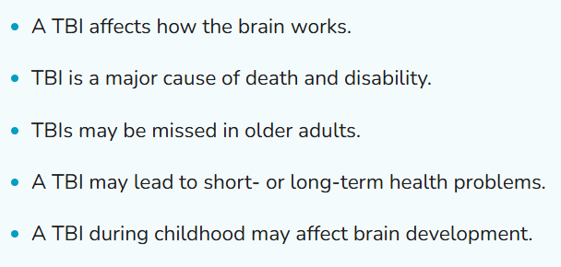

Slide 21
Causes of Traumatic Brain Injury

Slide 23
TBI and Blast Injuries
Large surveys suggest that an estimated 15% to 23% of OEF/ OIF personnel experienced a TBI, with the majority being mild TBI (mTBI).
Bogdanova, Y., & Verfaellie, M. (2012). Cognitive Sequelae of Blast-Induced Traumatic Brain Injury: Recovery and Rehabilitation. Neuropsychology Review, 22(1), 4-20. doi:10.1007/s11065-012-9192-3

Slide 24
TBI and Blast Injuries
The most common types of TBI, after concussion, are diffuse axonal injury, contusion, and subdural hemorrhage.
Diffuse axonal injuries are very common following closed head injuries. They result when shearing, stretching, and/or angular forces pull on axons and small vessels. Impaired axonal transport leads to focal axonal swelling and (after several hours) may result in axonal disconnection.
Bogdanova, Y., & Verfaellie, M. (2012). Cognitive Sequelae of Blast-Induced Traumatic Brain Injury: Recovery and Rehabilitation. Neuropsychology Review, 22(1), 4-20. doi:10.1007/s11065-012-9192-3

Slide 25
Mechanics of Traumatic Brain Injury (TBI)
Mechanics and Kinematics

Slide 26
Mechanics of TBI
A TBI is caused by a bump, blow, or jolt to the head or a penetrating head injury that disrupts the normal function of the brain.
Not all blows or jolts to the head result in a TBI.
Center for Disease Control. (2015, January 12). Traumatic Brain Injury in the United States: Fact Sheet. Retrieved from http://www.cdc.gov/traumaticbraininjury/get_the_facts.html

Slide 27
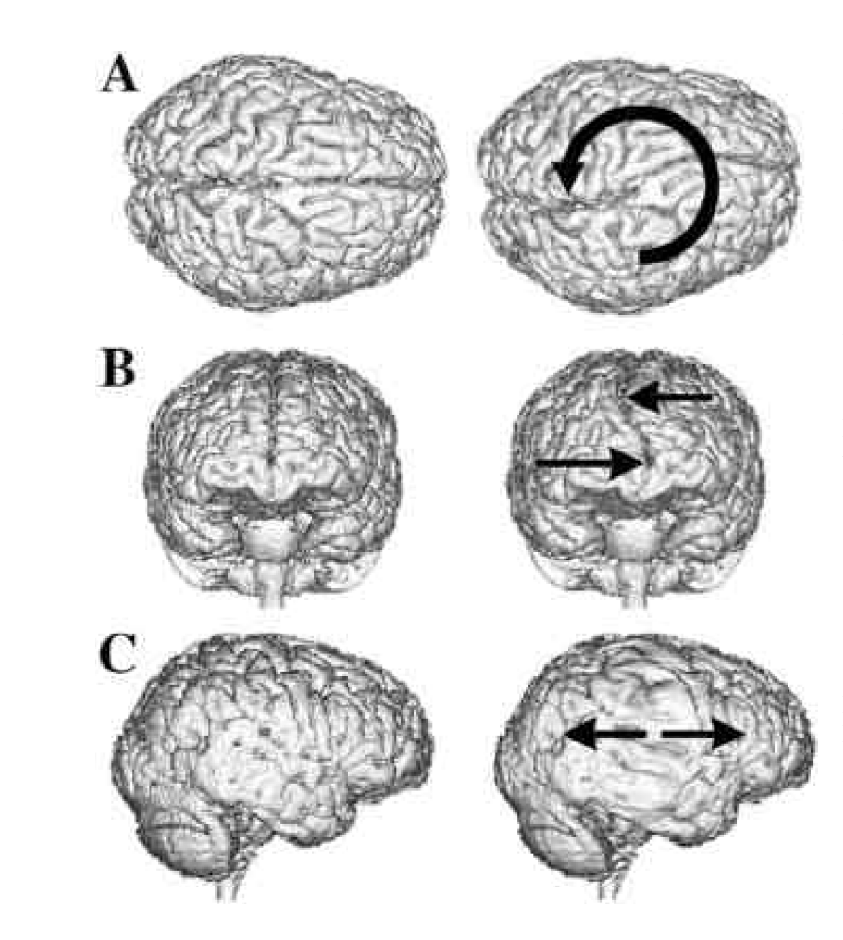
Biomechanics of Head Trauma
Translational Forces
Rotational twisting (A & B)
Stretching (C)
> Potential axonal sheering

Slide 28
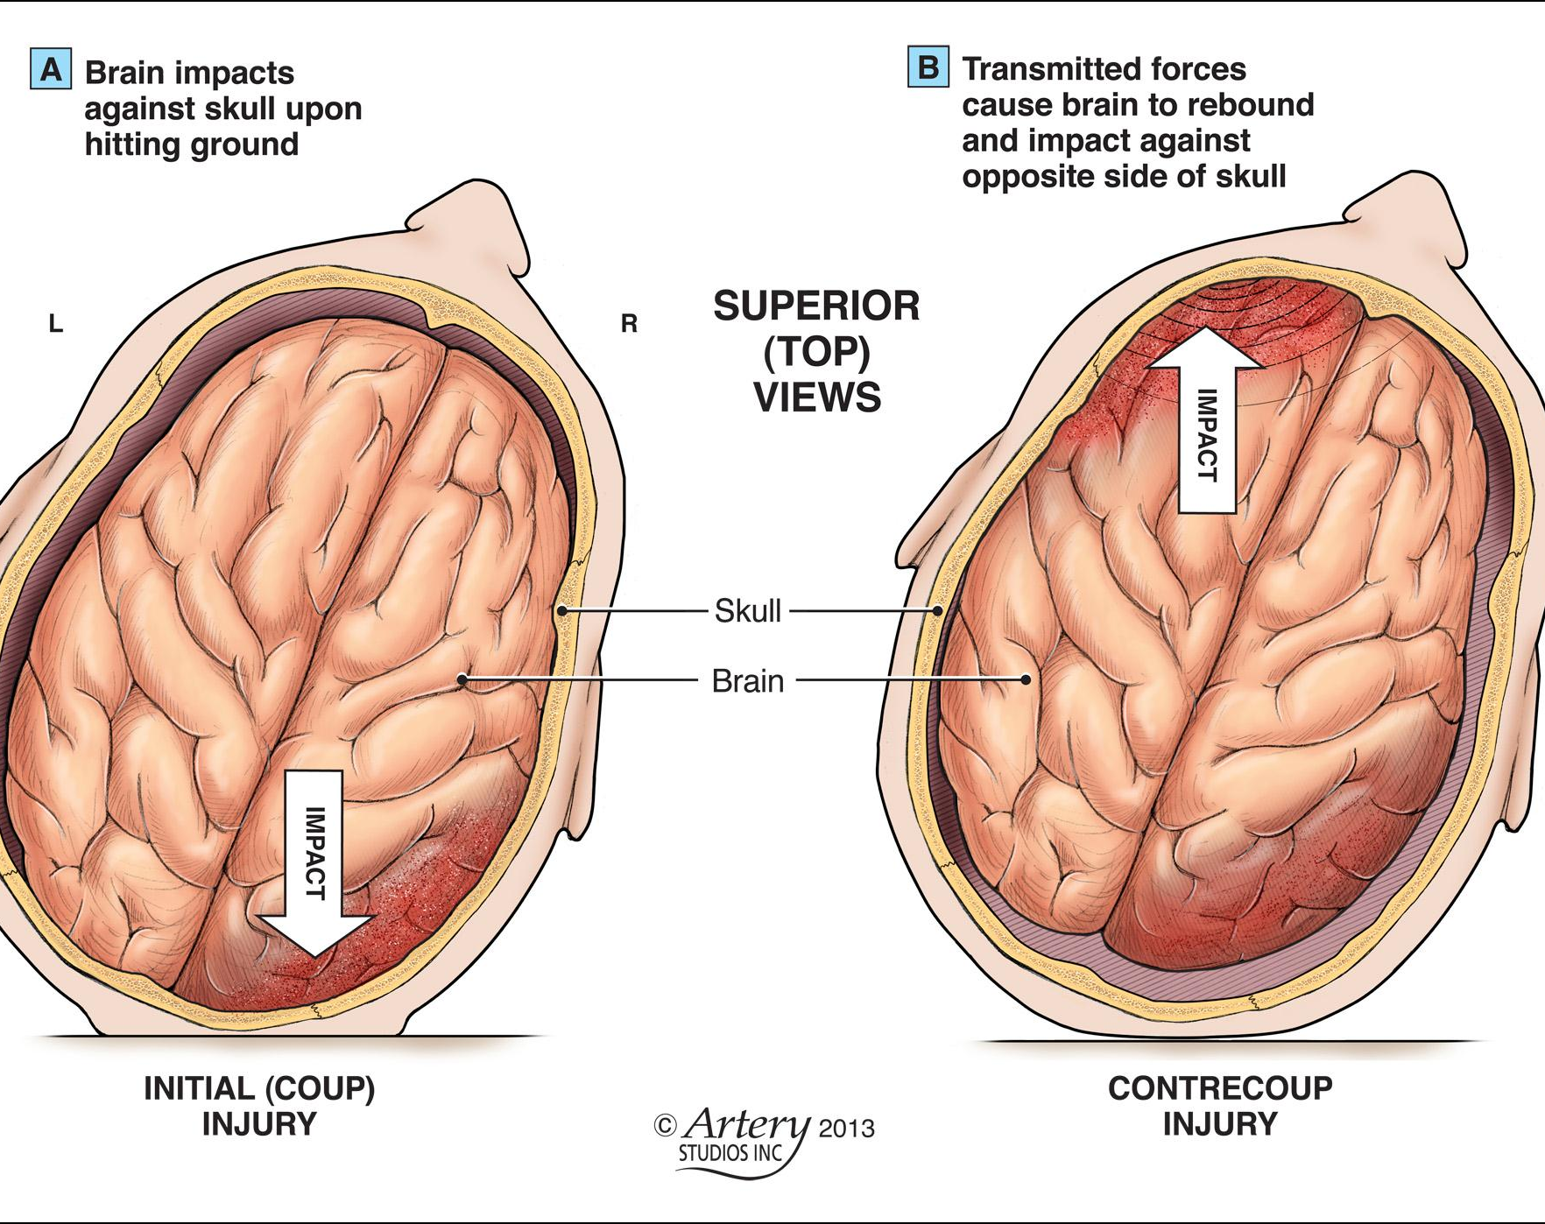
Coup-Contra Coup Injuries in Acceleration-Deceleration Accidents
Most severe injury is typically at the initial site of impact with less severe impairment on the opposite side
Brain Injury Series Part 2: The Ways a Brain Can Be Injured. (n.d.). The Toronto Critical Injury Law Blog of McLeish Orlando LLP, Toronto Personal Injury Lawyers. Retrieved from http://blog.mcleishorlando.com/blog/cat/medical-news/

Slide 29
Force required for brain injury
In a roller coaster a person withstands about 4.5 g.
Jet fighter pilots can withstand up to 9.0 g.
Ways the Brain is Injured. (n.d.). Retrieved February 03, 2016, from http://www.braininjury.com/injured.shtml

Slide 30

Force required for brain injury
The force of a professional boxer's fist is equivalent to being hit with a 13-pound bowling ball traveling 20 miles per hour, about 52 g’s.
Irish boxer John Cooney died from an intracranial hemorrhage.
Ways the Brain is Injured. (n.d.). Retrieved February 03, 2016, from http://www.braininjury.com/injured.shtml

Slide 31
Force required for brain injury
In football the majority of impacts fall between 20 g and 25 g. But hits of 50g to 120 g are common, and some approach 200 g.
This does not mean that accelerations over 50 g's have to cause permanent brain damage. Football players are subjected to 200 g's, and Indy race car drivers have been subjected to 80 g's without permanent injury, but they were wearing helmets.
Ways the Brain is Injured. (n.d.). Retrieved February 03, 2016, from http://www.braininjury.com/injured.shtml

Slide 32
Translational and Rotational Acceleration
The suggested tolerable reversible brain injury level was less than 85 g, for translational (linear) acceleration.
For the rotational (twisting) acceleration, it was about 55g.
Zhang, L., Yang, K. H., & King, A. I. (2004). A Proposed Injury Threshold for Mild Traumatic Brain Injury. Journal of Biomechanical Engineering J. Biomech. Eng., 126(2), 226. doi:10.1115/1.1691446

Slide 33
TBI Injury Mechanisms
Neurometabolic Cascade

Slide 34
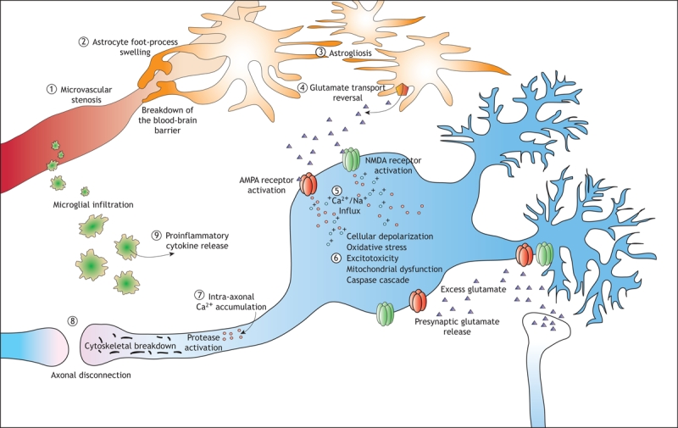
https://www.ncbi.nlm.nih.gov/pmc/articles/PMC2292762/
Notes:
Figure 1: The major pathways associated with the progression of secondary injury after a traumatic brain injury. Microcirculatory derangements involve stenosis (1) and loss of microvasculature, and the blood–brain barrier may break down as a result of astrocyte foot processes swelling (2). Proliferation of astrocytes (“astrogliosis”) (3) is a characteristic of injuries to the central nervous system, and their dysfunction results in a reversal of glutamate uptake (4) and neuronal depolarization through excitotoxic mechanisms. In injuries to white and grey matter, calcium influx (5) is a key initiating event in a molecular cascades resulting in delayed cell death or dysfunction as well as delayed axonal disconnection. In neurons, calcium and zinc influx though channels in the AMPA and NMDA receptors results in excitotoxicity (6), generation of free radicals, mitochondrial dysfunction and postsynaptic receptor modifications. These mechanisms are not ubiquitous in the traumatized brain but are dependent on the subcellular routes of calcium influx and the degree of injury. Calcium influx into axons (7) initiates a series of protein degradation cascades that result in axonal disconnection (8). Inflammatory cells also mediate secondary injury, through the release of proinflammatory cytokines (9) that contribute to the activation of cell-death cascades or postsynaptic receptor modifications.

Slide 35
Neurometabolic Cascade
Nonspecific depolarization and initiation of action potentials.
Release of excitatory neurotransmitters (Glutamate).
Massive outpouring of potassium.
Membrane ionic pumps to restore homeostasis.
Increase of glucose.
Lactate accumulation
Massive calcium influx into cell.
Decreased energy (ATP) production
Cell apoptosis (death)

Slide 36
Secondary Injury
Secondary injury events include damage to the blood–brain barrier, release of factors that cause inflammation, free radical overload, excessive release of the neurotransmitter glutamate (excitotoxicity), influx of calcium and sodium ions into neurons, and dysfunction of mitochondria.

Slide 37
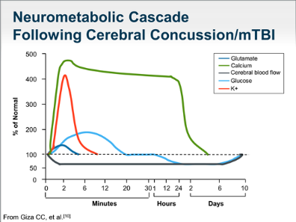
Notes:
Nonspecific depolarization and initiation of action potentials.
Release of excitatory neurotransmitters (Glutamate).
Massive outpouring of potassium.
Membrane ionic pumps to restore homeostasis.
Increase of glucose.
Lactate accumulation
Massive calcium influx into cell.
Decreased energy (ATP) production
Cell apoptosis (death)

Slide 38
Concussion
Mild Traumatic Brain Injury (TBI)

Slide 39
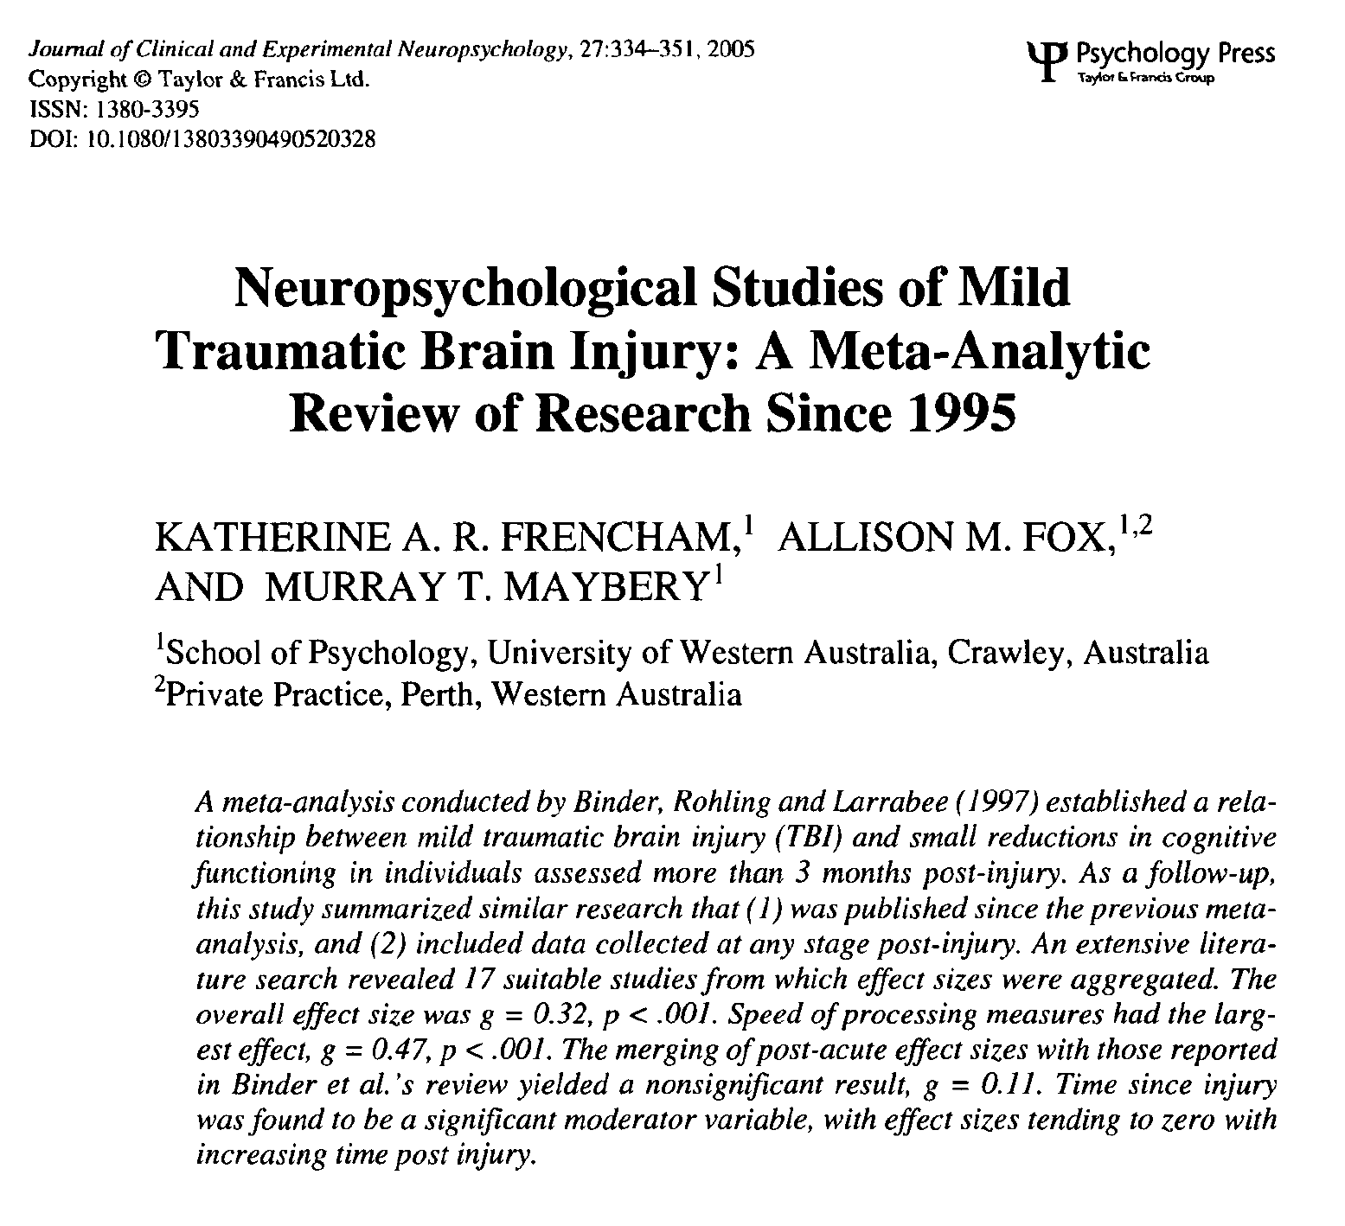
Clinical Wisdom: mTBI Resolves in 3 months
“The main part of recovery after mTBI occurs within the first three months, with any subsequent changes in performance being of limited statistical and clinical significance.”
Frencham, K. A., Fox, A. M., & Maybery, M. T. (2005). Neuropsychological Studies of Mild Traumatic Brain Injury: A Meta-Analytic Review of Research Since 1995. Journal of Clinical and Experimental Neuropsychology, 27(3), 334-351. doi: 10.1080/13803390490520328

Slide 40
McCrea, M. (2008). Mild traumatic brain injury and postconcussion syndrome: The new evidence base for diagnosis and treatment. Oxford: Oxford University Press.
Notes:
Effect sizes less than 0.3 should be considered very small and difficult to detect in individual patients because the patient and control groups largely overlap.

Slide 41
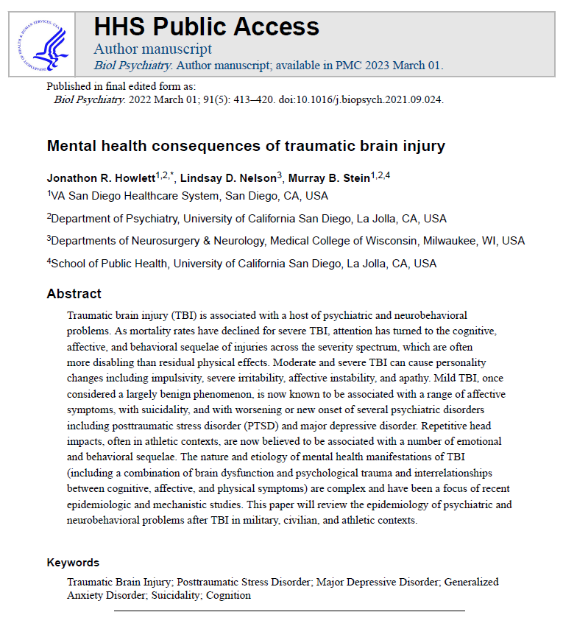
Mental health consequences of Mild tbi
The vast majority (>80%) of TBIs are classified as “mild” (mTBI), with diverse injury severity characteristics and outcomes within the mTBI. population.
Mild TBI is increasingly recognized as a diverse injury spectrum including Complicated Mild TBI.

Slide 42
Mental health consequences of Mild tbi
“Mild TBI, once considered a largely benign phenomenon, is now known to be associated with a range of affective symptoms, with suicidality, and with worsening or new onset of several psychiatric disorders including posttraumatic stress disorder (PTSD) and major depressive disorder.”

Slide 43
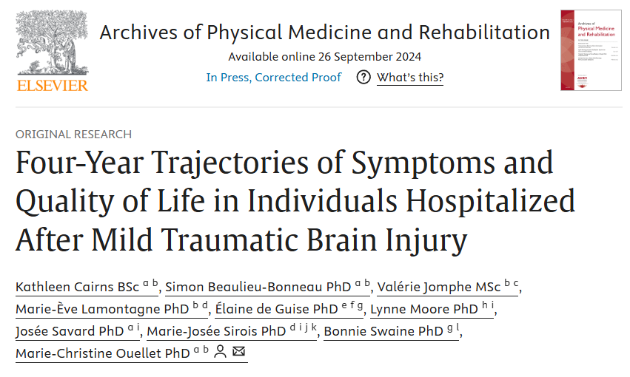
Persisting symptoms from mild tbi
“Mild traumatic brain injury (mTBI) is increasingly being recognized as a condition with the potential to provoke long-term consequences.”

Slide 44
Persisting symptoms from mild tbi
“Several studies report the presence of multiple symptoms and/or functional impairments in nearly half of people 1 year after injury.”

Slide 45
Persisting symptoms from mild tbi
“A growing number of studies demonstrate that symptoms (such as anxiety and headaches) can be present 4 to 5 years after mTBI, with effects on quality of life (QoL).”

Slide 46
Symptoms of Concussion
Thinking/ Remembering | Physical | Emotional/ Mood | Sleep
Difficulty thinking clearly | Headache Fuzzy or blurry vision | Irritability | Sleeping more than usual
Feeling slowed down | Nausea or vomiting (early on) Dizziness | Sadness | Sleep less than usual
Difficulty concentrating | Sensitivity to noise or light Balance problems | More emotional | Trouble falling asleep
Difficulty remembering new information | Feeling tired, having no energy | Nervousness or anxiety
Center for Disease Control. (2015, January 12). Traumatic Brain Injury in the United States: Fact Sheet. Retrieved from http://www.cdc.gov/traumaticbraininjury/get_the_facts.html

Slide 47
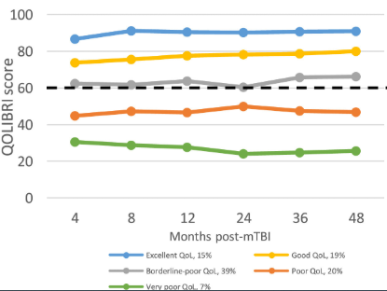
Persisting symptoms from mild tbi (after Hospitalization)
Up to 4 years out:
62% for subjective cognitive issues
54% for fatigue
44% for anxiety
43% for insomnia
27% for depression
23% for headaches
17% for dizziness
66% had persistently poor Quality of Life (QoL)

Slide 48
Mental health consequences of Mild tbi
Diverse symptoms occur commonly after TBI and may include:
Somatic symptoms (e.g., nausea, dizziness, headache, blurred vision, hearing changes, fatigue).
Cognitive complaints (including deficits in memory and executive functions).
Emotional and behavioral problems (such as emotional lability, irritability, depression, and anxiety).

Slide 49
Moderate to Severe TBI
Brain damage

Slide 50
Types of Severe TBI
Closed – an injury to the brain caused by movement of the brain within the skull. Causes may include falls, motor vehicle crash, or being struck by or with an object.
Penetrating – an injury to the brain caused by a foreign object entering the skull. Causes may include firearm injuries or being struck with a sharp object.
Center for Disease Control. (2015, January 12). Traumatic Brain Injury in the United States: Fact Sheet. Retrieved from http://www.cdc.gov/traumaticbraininjury/get_the_facts.html

Slide 51
Diffuse Axonal Injury (DAI)

Slide 52
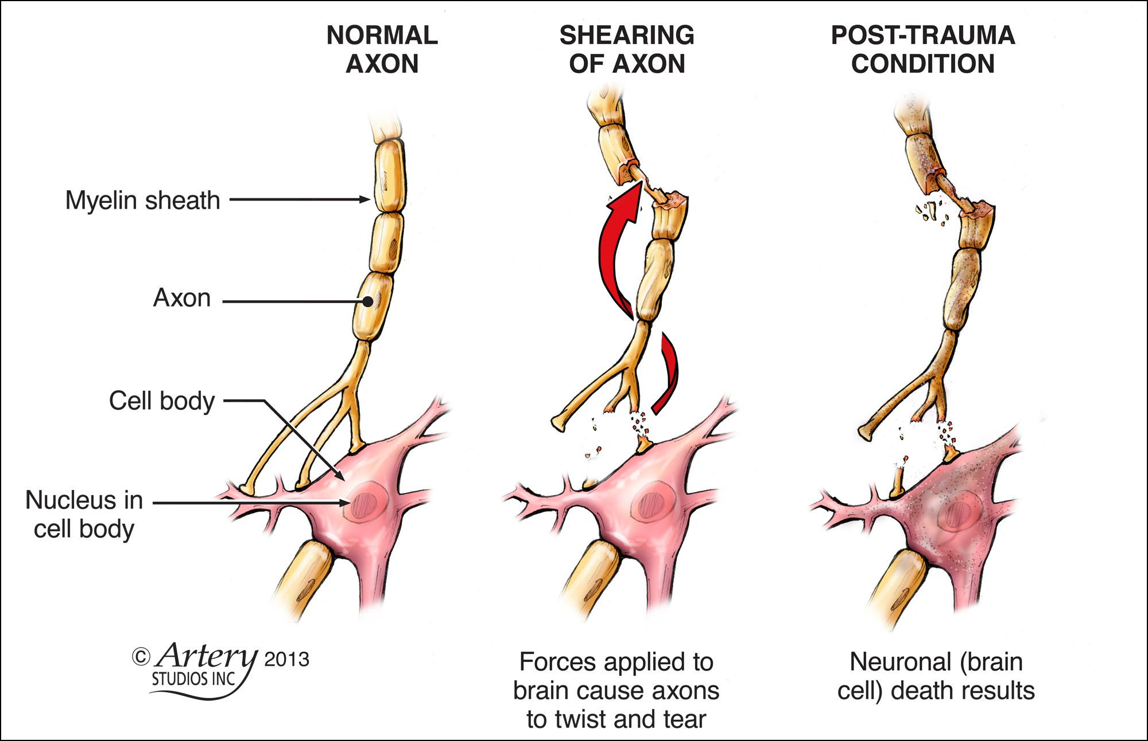
Diffuse Axonal Injury (DAI)
Widespread stretching and tearing of the white-mater (axonal) tracts of the brain typically caused by acceleration-deceleration injuries (VandenBos, 2007).
Brain Injury Series Part 2: The Ways a Brain Can Be Injured. (n.d.). The Toronto Critical Injury Law Blog of McLeish Orlando LLP, Toronto Personal Injury Lawyers. Retrieved from http://blog.mcleishorlando.com/blog/cat/medical-news/

Slide 53
Chronic Traumatic Encephalopathy (CTE) and Traumatic Encephalopathy Syndrome (TES)
Secondary to repeated blows to the head (Formerly Dementia Pugilistica)

Slide 54
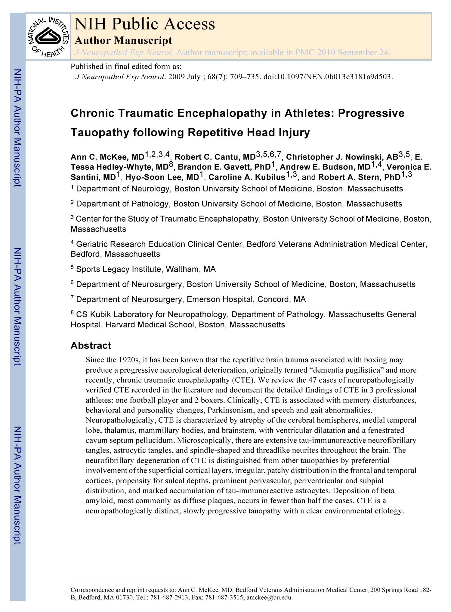
Chronic Traumatic Encephalopathy in Athletes: Progressive Tauopathy following Repetitive Head Injury
CTE seen in:
Football
Soccer
Boxing
Physical Abuse
Autistic Head Banging
Wrestling
Epilepsy
Circus Clown

Slide 55
The frequency of CTE in professional boxers is estimated to be 0.8 brain injuries per 10 round.
Approximately 20% of retired professional boxers developed CTE.

Slide 56
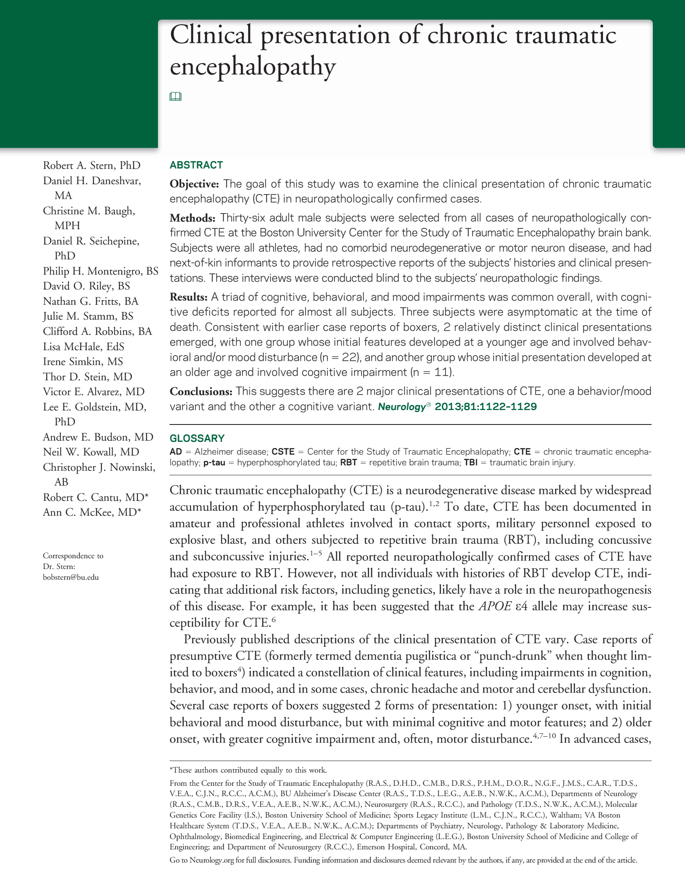
Clinical presentation of chronic traumatic encephalopathy
Boston University’s Center for the Study of Traumatic Encephalopathy found:
Of the 85 brains donated by the families of deceased veterans and athletes with histories of repeated head trauma, they found CTE in 68 of them.

Slide 57
Clinical presentation of chronic traumatic encephalopathy
Of those, 34 were professional football players, nine others played college football and six played only high school football.
Of the 35 professional football players' brains donated, only one had no evidence of the disease, according to the study.

Slide 58
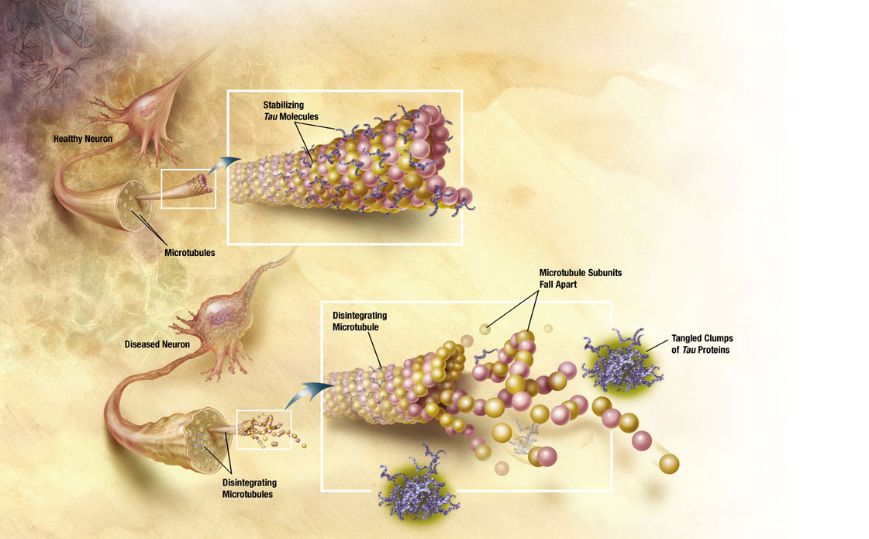
Tau proteins and microtubules

Slide 59
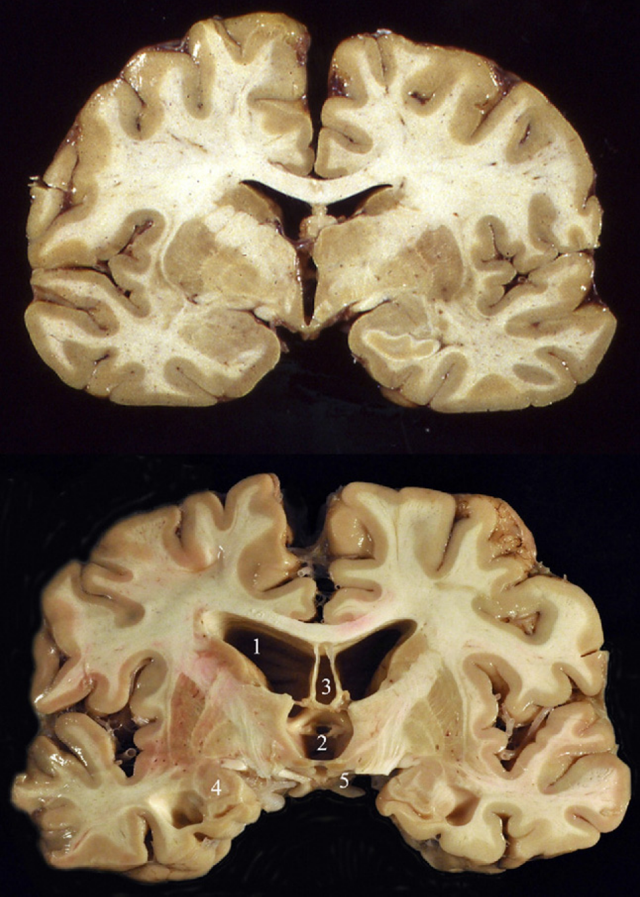
Gross Pathology of CTE
Top: Coronal section of a normal human brain.
Bottom: Coronal section of a brain from a retired professional football player.
(1) severe dilatation of lateral ventricle and
(2) third ventricle,
(3) cavum septum pellucidum,
(4) marked atrophy of the medial temporal lobe structures, and
(5) shrinkage of the mammillary bodies.

Slide 60
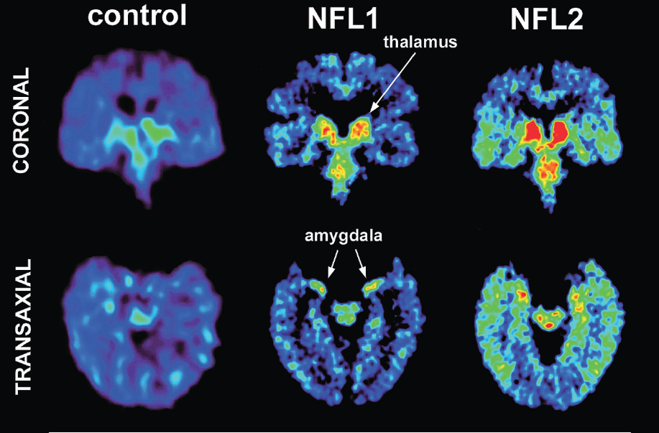
PET Scanning of Brain Tau in Retired National Football League Players: Preliminary Findings
Left image shows a normal brain scan; middle and right images show scans of pro football players.
Green and red colors demonstrate the higher level of tau protein found in the brain.
The players’ scans show consistently high signals in the amygdala and subcortical regions.
Notes:
NFL1: 59-year-old linebacker with MCI, who experienced momentary loss of consciousness after each of two
concussions;
NFL2: 64-year-old quarterback with age-consistent memory impairment, who experienced momentary loss of
consciousness and 24-hour amnesia following one concussion;

Slide 61
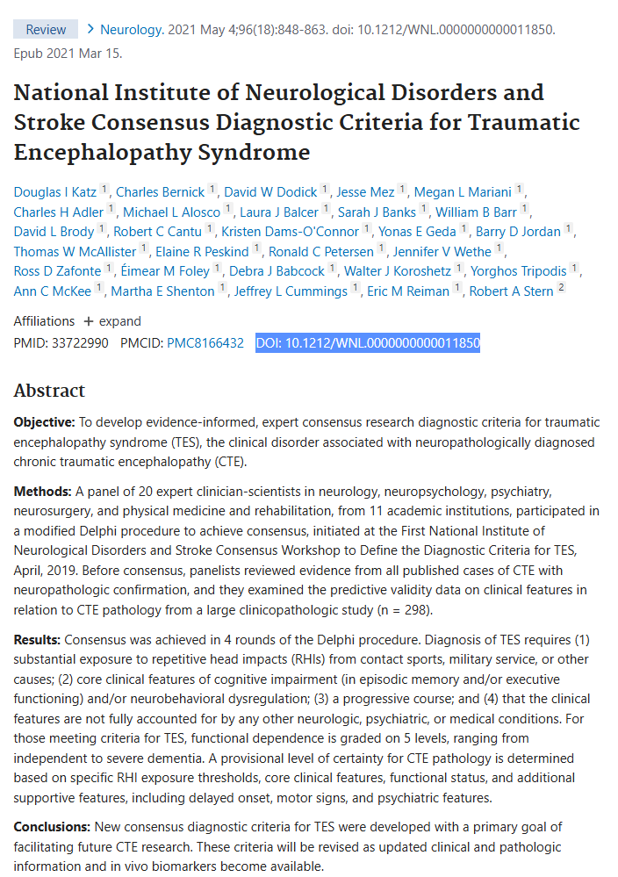
National Institute of Neurological disorders and stroke Consensus Diagnostic criteria for Traumatic encephalopathy syndrome (2021)
Traumatic Encephalopathy Syndrome (TES)

Slide 62
Variants of TES
Behavioral/Mood Group
Early onset
Disinhibited behavior
Cognitive Group
Late onset
Dementia Type

Slide 63
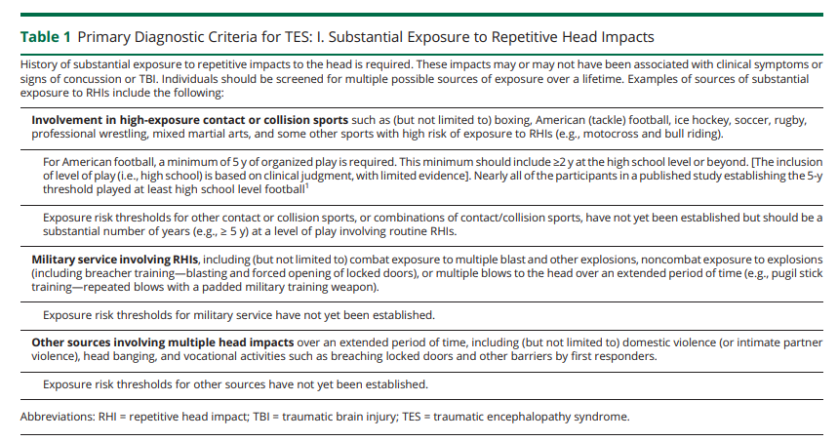

Slide 64
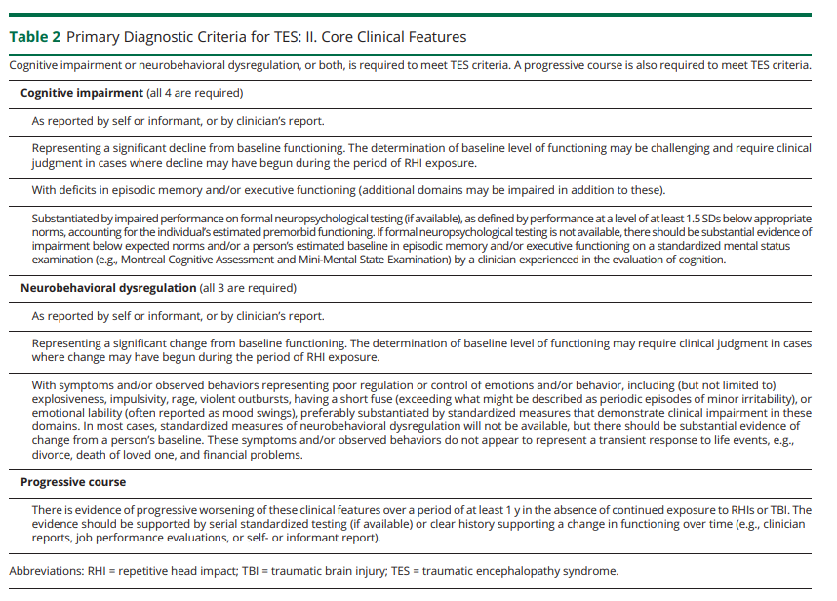

Slide 65
TBI on Death Row

Slide 66
TBI in Prison Populations
Over 60% reported ‘Head Injuries’ (Total n = 196).
Reports consistent with TBI of various severities were given by 65%.
Of the overall sample, 16% had experienced moderate-to-severe TBI
48% mild TBI
Williams, W. H., Mewse, A. J., Tonks, J., Mills, S., Burgess, C. N., & Cordan, G. (2010). Traumatic brain injury in a prison population: Prevalence and risk. Brain Injury, 24(10), 1184-1188. doi: 10.3109/02699052.2010.495697

Slide 67
Neuropsychological Impairment and Risk Characteristics of Offenders
Death penalty offenders displayed more signs of neuropsychological deficits on the GNDS (M = 29.58) than the heterogeneous normative sample (M = 17.20).
Death penalty offenders performed one standard deviation worse than 50 control subjects in a cross-validation study of the GNDS (M = 19.66, SD = 8.87).
Death penalty offenders demonstrated higher levels of neuropsychological impairment than the norm.
Lim, E. (2003). Neuropsychological Impairment and Risk Characteristics of Offenders (Unpublished doctoral dissertation). Alliant International University/ California School of Professional Psychology. Retrieved February 14, 2014.

Slide 68
Case Example of severe tbi
“Fred” – a pseudonym.
Data used with permission.

Slide 69
Background
History of febrile seizures as a child with hospitalization.
Placed in Special Education in 2nd grade.
Run over by a car at 9 years of age (normal neurological exam).
Subsequent onset of auditory hallucinations.
Graduate high school.
Convicted of non-capital crimes and sentenced to nearly 60 years in prison.
Lim, E. (2003). Neuropsychological Impairment and Risk Characteristics of Offenders (Unpublished doctoral dissertation). Alliant International University/ California School of Professional Psychology. Retrieved February 14, 2014.

Slide 70
Background
While incarcerated, Fred was assaulted by another inmate.
“Patient was not responsive to me at all. Security reported to me that when asked, patient would intermittently attempt to squeeze their hand. I only had maybe 1-2 minutes of evaluation time before EMS arrived so I was not able to evaluate Pupil activity. Patient was posturing intermittently (emphasis added) and had to be restrained when placed on Backboard by EMS.”
In hospital his Glascow Coma Scale (GCS) score was 6 (intubated) improving to 12 on discharge.
Hospitalized @ 15 days.
Lim, E. (2003). Neuropsychological Impairment and Risk Characteristics of Offenders (Unpublished doctoral dissertation). Alliant International University/ California School of Professional Psychology. Retrieved February 14, 2014.

Slide 71
Background
MRI revealed “Scattered subarachnoid hemorrhage as well as small subdural hematoma versus contusions seen of the right cerebellar hemisphere as well as the right temporal lobe. There are foci of diffusion restriction seen of the corpus callosum at the splenium as well as in the left frontal region which could be related to diffuse axonal injury in appropriate clinical setting versus acute infarcts. There could be additional diffuse exam injury in the right frontal lobe as well as that seen the right parietal lobe. Trace subdural hematoma may be present in the right posterior fossa as well as the left posterior parietal region.
Lim, E. (2003). Neuropsychological Impairment and Risk Characteristics of Offenders (Unpublished doctoral dissertation). Alliant International University/ California School of Professional Psychology. Retrieved February 14, 2014.

Slide 72
Neuropsychological evaluation

Slide 73
Behavioral observations
Fred was alert, cooperative, and diligent.
He was oriented to person and circumstance but not to place except that it was a jail or prison, nor to time.
Mood was euthymic and affect was within normal limits.
His speech was normal in terms of tone, rate, volume, and prosody.
He seemed to be remarkably slow to process information and had difficulty grasping information.
He was severely amnestic with impairment of both recent and remote memory. He did not recall my seeing him the day before.
He also appeared perseverative – repeating stories that he had told previously.
There were frequent signs of restlessness, motor agitation, and a near constant bouncing of his leg.
There was “past pointing” on the left on finger-to-nose movements, suggestive of motor dysfunction. Heal-toe waking was very impaired with him being unable to maintain his balance. Rapid alternating movements were performed awkwardly.
Fred related that he had problems sleeping – “I keep waking up at this place and I don’t understand.”

Slide 74
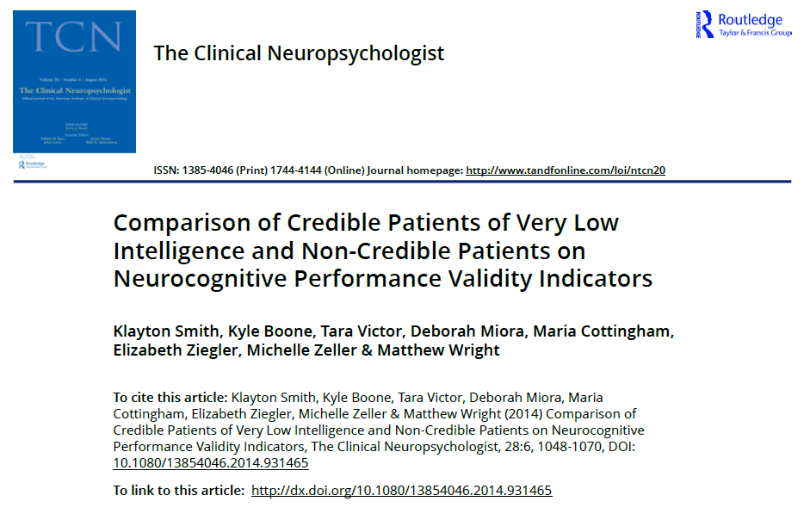
Performance validity
Measure | Finding
Test of Memory Malingering (TOMM) | WNL
b-Test | WNL
Dot Counting Test | WNL adjusted
8 of 8 Estimated Domain Scores from the Meyers Neuropsychological Battery (MNB)* | Passed
Lim, E. (2003). Neuropsychological Impairment and Risk Characteristics of Offenders (Unpublished doctoral dissertation). Alliant International University/ California School of Professional Psychology. Retrieved February 14, 2014.

Slide 75
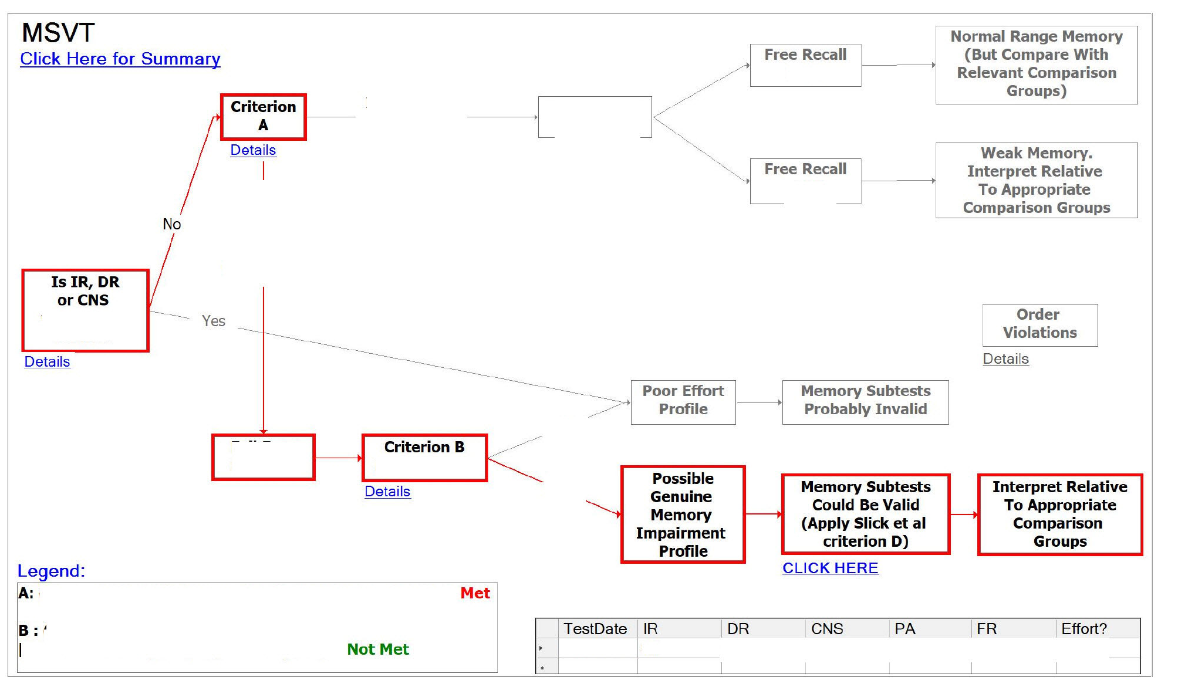
Green’s medical symptom validity test
Lim, E. (2003). Neuropsychological Impairment and Risk Characteristics of Offenders (Unpublished doctoral dissertation). Alliant International University/ California School of Professional Psychology. Retrieved February 14, 2014.

Slide 76
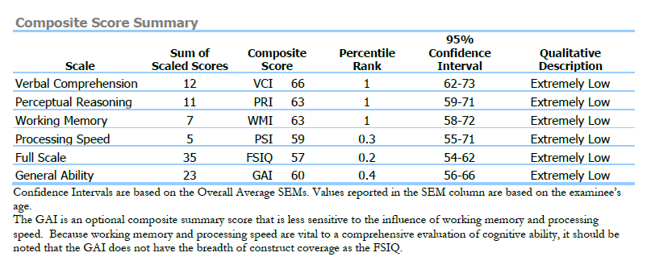
Wechsler Adult Intelligence Scale (WAIS-IV)
Lim, E. (2003). Neuropsychological Impairment and Risk Characteristics of Offenders (Unpublished doctoral dissertation). Alliant International University/ California School of Professional Psychology. Retrieved February 14, 2014.

Slide 77
Test of premorbid function (topf)
Composite | Actual | Predicted | Difference | Critical Value | Significant Differences | Base Rate
FSIQ | 57 | 71 | -14 | 5.31 | Y | 4.7
VCI | 66 | 70 | -4 | 6.81 | N | 35.6
PRI | 63 | 83 | -20 | 7.06 | Y | 2.3
WMI | 63 | 72 | -9 | 7.19 | Y | 22.9
PSI | 59 | 80 | -21 | 10.8 | Y | 8.1
Lim, E. (2003). Neuropsychological Impairment and Risk Characteristics of Offenders (Unpublished doctoral dissertation). Alliant International University/ California School of Professional Psychology. Retrieved February 14, 2014.

Slide 78
Comparison to prior evaluation
Composite | Prior | Watson | Watson Predicted | Difference | Critical Value | Significant Differences | Base Rate
FSIQ | 63 | 57 | 66 | -9 | 5.73 | Y | 2-5%
VCI | 61 | 66 | 64 | 2 | 8.11 | N
PRI | 73 | 63 | 76 | -13 | 8.67 | Y | 5%
WMI | 71 | 63 | 68 | -5 | 9.59 | N
PSI | 71 | 59 | 73 | -14 | 12.26 | Y | 2-5%
Lim, E. (2003). Neuropsychological Impairment and Risk Characteristics of Offenders (Unpublished doctoral dissertation). Alliant International University/ California School of Professional Psychology. Retrieved February 14, 2014.

Slide 79
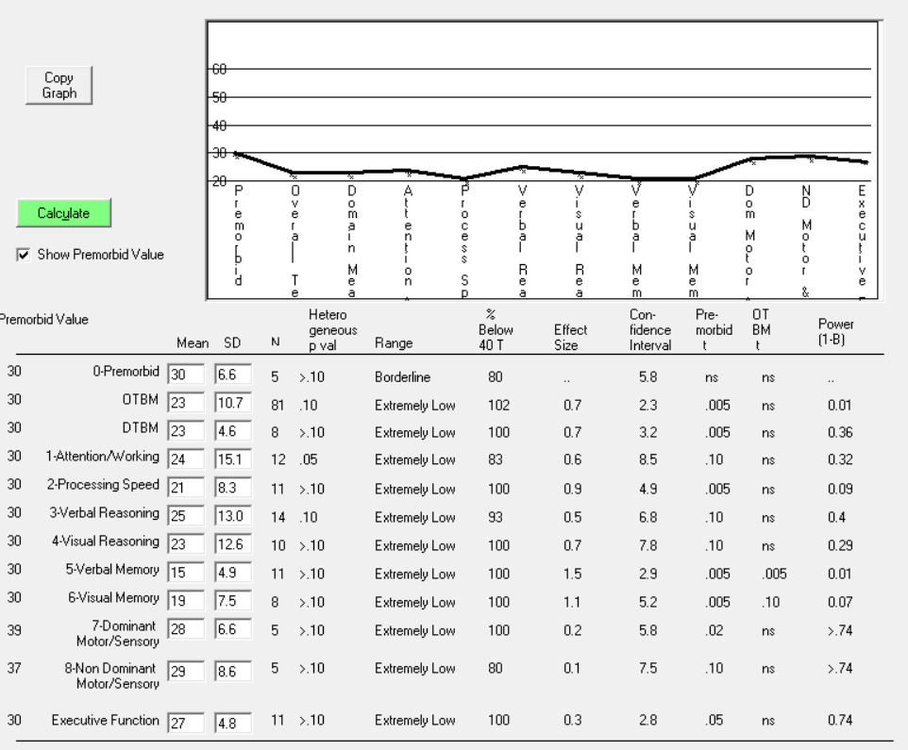

Meyers Neuropsychological Battery (MNB)

Slide 80
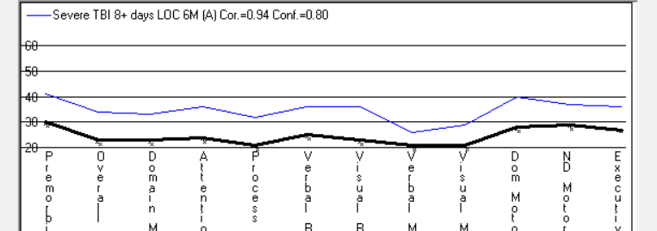
Meyers Neuropsychological Battery (MNB)

Slide 81
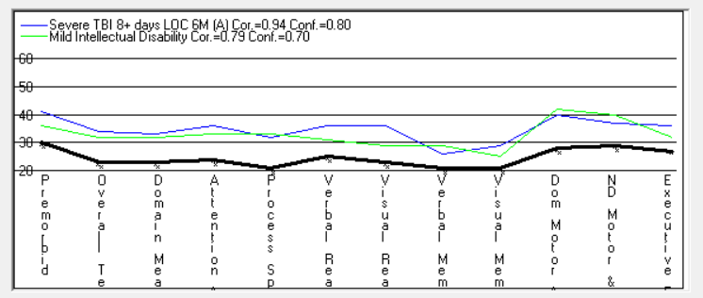
Meyers Neuropsychological Battery (MNB)

Slide 82
Wechsler memory scale – iv (flexible)
Scale | WAIS-IV GAI | Index Score | Difference | Base Rate | %ile | Qualitative Descriptor
Immediate Memory | 60 | 40 | 20 | 6.6 | <0.1 | Extremely Low
Delayed Memory | 60 | 40 | 20 | 9.3 | <0.1 | Extremely Low
Auditory Memory | 60 | 40 | 20 | 11.2 | <0.1 | Extremely Low
Visual Memory | 60 | 40 | 20 | 7.8 | <0.1 | Extremely Low
Lim, E. (2003). Neuropsychological Impairment and Risk Characteristics of Offenders (Unpublished doctoral dissertation). Alliant International University/ California School of Professional Psychology. Retrieved February 14, 2014.

Slide 83
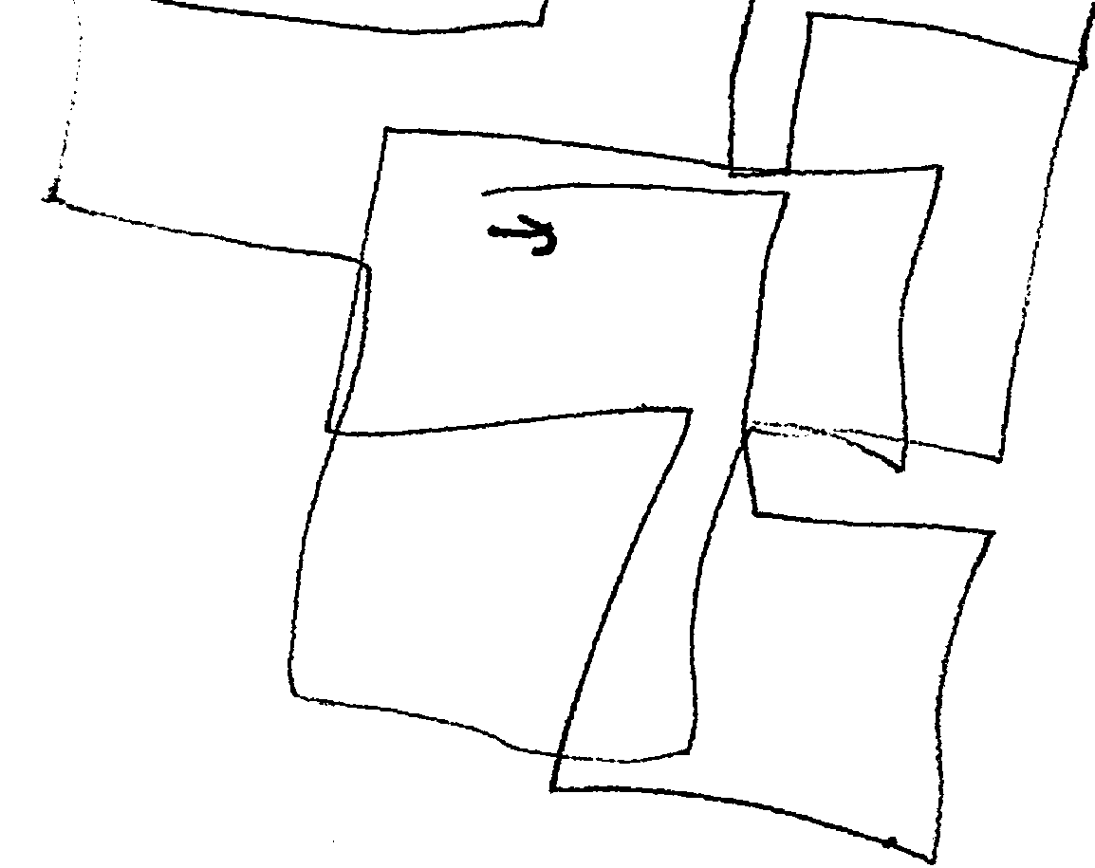
Visual Spatial: Cross drawing

Slide 84
diagnoses
1) 294.11 Major neurocognitive disorder (dementia) due to traumatic brain injury, severe, with behavioral disturbance secondary to the (date) brain injury (primary);
2) 317 Intellectual disability, mild, by history;
3) 295.90 Schizophrenia, continuous;
4) 315.00 Specific learning disability with impairment in reading, by history;
5) 315.39 Language disorder, by history.

Slide 85
Outcome
A jury found custodial staff not civilly responsible for Fred’s injuries.
Despite not having served his lengthy prison sentence, Fred was released to the care of his parents.
He remains significantly disabled.

Slide 86
Questions?
Dale G. Watson, Ph.D.
3377 Deer Valley Road, PMB 310
Antioch, CA 94531
watson.dale@comcast.net
866-536-5301

