Slide 1
Wechsler Adult Intelligence Scale,
5th Edition (WAIS 5)
Dale G. Watson, Ph.D.
Habeas Corpus Resource Center
March 19, 2025 June 12, 2025

Slide 2
Cal. Code Regs. Tit. 16, § 1396.3 - Test Security
“A psychologist shall not reproduce or describe in public or in publications subject to general public distribution any psychological tests or other assessment devices, the value of which depends in whole or in part on the naivete of the subject, in ways that might invalidate the techniques; and shall limit access to such tests or devices to persons with professional interests who will safeguard their use.”

Slide 3
Types of Information
Tests: Actual tests, test booklets, and stimuli.
Raw Test Data: Test booklets, times, responses.
Protected Test Data: Raw test data, score summaries.
Test Data: Raw scores, percentiles, numerical test data do not contain protected materials.

Slide 4
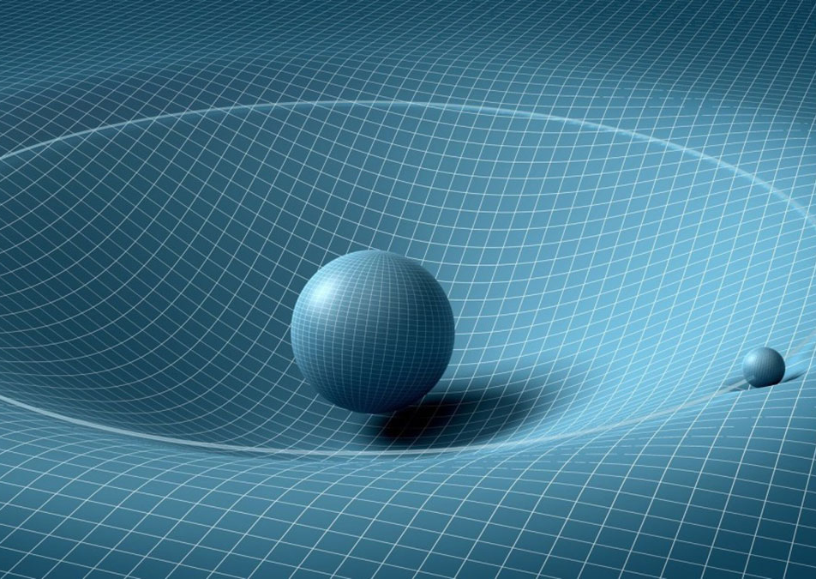
What is intelligence?
Intelligence is like gravity – you can’t touch it, but you know its there.
An IQ score is a proxy for the latent construct of g

Slide 5
Positive manifold: Psychometric g
g represents the general factor of intelligence
“A rising tide floats all boats.”
Represents all the variability shared amongst broad cognitive abilities.

Slide 6
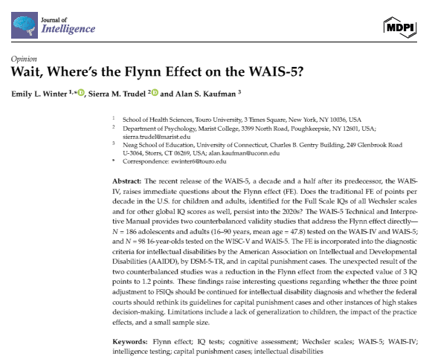
Intelligence Defined
“Broadly defined, intelligence is a person’s ability to learn from their experience, adapt, influence, and choose environments.”
“At the heart of intelligence is an individual’s problem-solving skills and capacity for knowledge acquisition.”
These abilities “influence an individual’s ability to think, act, and learn within their environment.”
Winter, Emily L., Sierra M. Trudel, and Alan S. Kaufman. 2024. Wait, Where’s the Flynn Effect on the WAIS-5? Journal of Intelligence 12: 118. https://doi.org/10.3390/jintelligence12110118

Slide 7
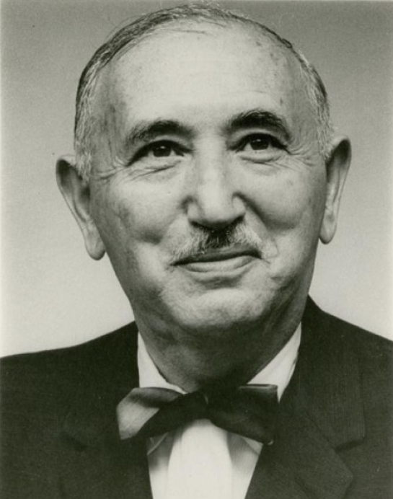
What is intelligence?
David Wechsler told us that “What we measure with tests is not what tests measure – not information, not spatial perception, not reasoning ability. These are only a means to an end. What intelligence tests measure is something much more important: the capacity of an individual to understand the world about him and his resourcefulness to cope with its challenges.“
Wechsler, 1975 cited by Wechsler, D., Raiford, S. E., & Presnell, K. (2024). Wechsler Adult Intelligence Scale: Technical and interpretive manual (5th ed.). NCS Pearson, p. 4).

Slide 8
Intelligence predicts…
Academic achievement and educational attainment
Job performance
Mental and physical health
Intelligence is a protective factor…
  - It protects against the vicissitudes of life.

Slide 9
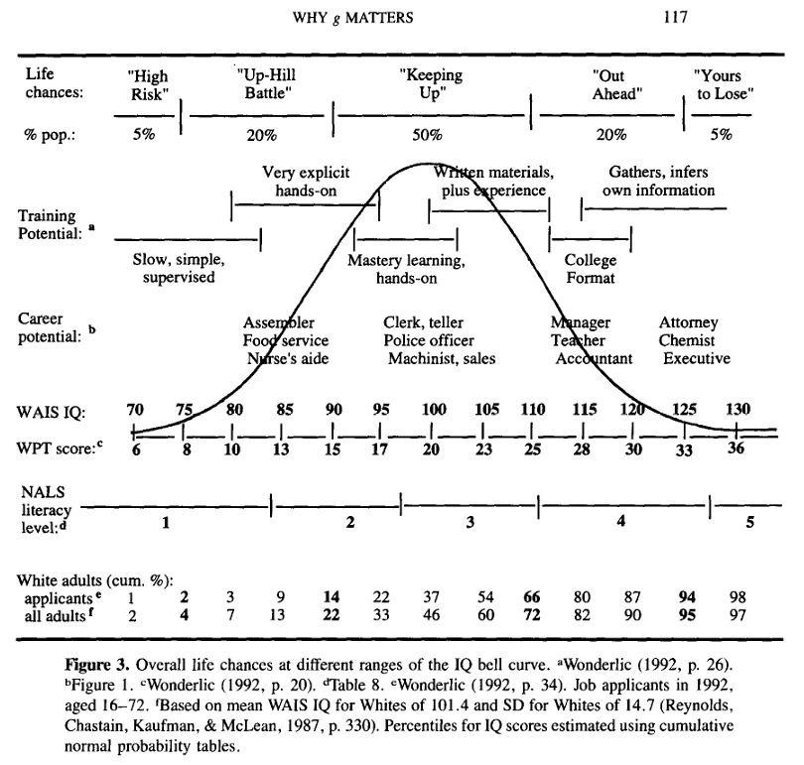
Gottfredson, L. S. (1997). Why G matters: The complexity of Everyday Life. Intelligence, 24(1), 79–132. https://doi.org/10.1016/s0160-2896(97)90014-3

Slide 10
Theories of Intelligence

Slide 11
CHC Theory
Catell, Horn, & Carroll

Slide 12
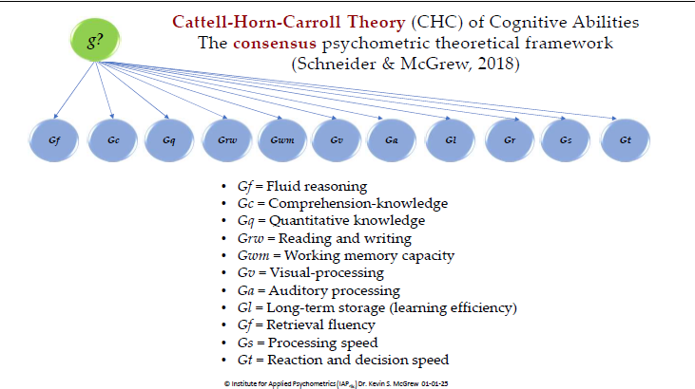
Cattell-Horn-Carroll (CHC) Theory of Intelligence: A psychometric theory

Slide 13
From localizationist to network theories

Slide 14
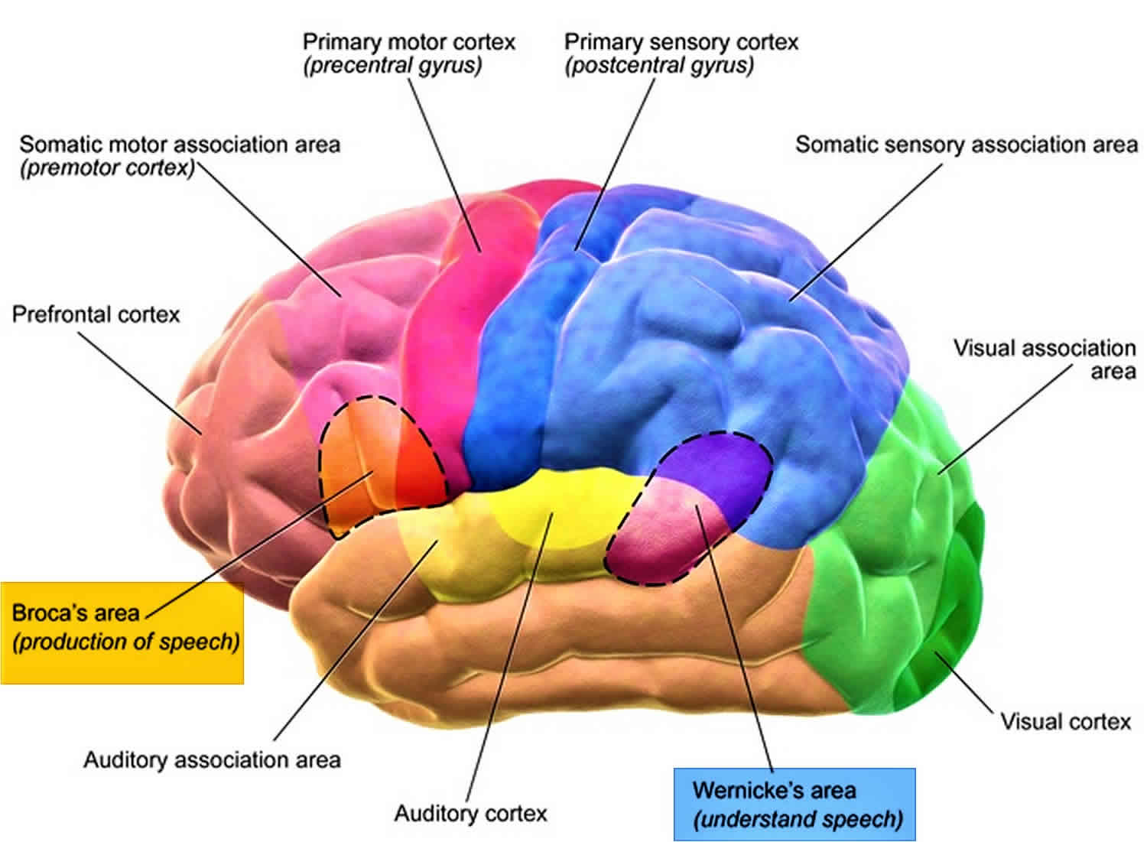

Slide 15
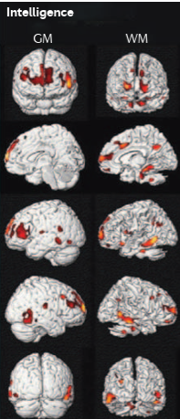
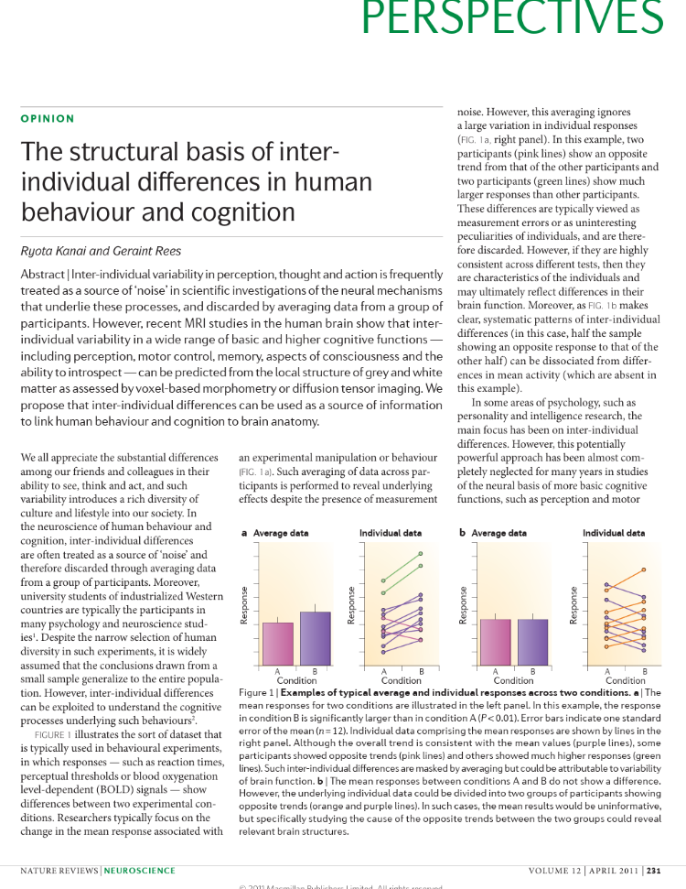
The structural basis of individual differences in intelligence
Grey matter (GM; left panel) and white matter (WM; right panel) correlates of general intelligence. Greater grey matter and white matter volumes in specific brain areas are associated with higher intelligence.

Slide 16

Network theory
“For network intelligence theories, the brain is viewed as a system of networks in which information flows through pathways that connect the various regions. Intelligence is thought to be related to individual differences in functioning of different areas and networks of the brain.”
Nodes = areas that link similar tasks
Hubs = major nodes that interlink with other brain areas
Edges = the links between areas
Wechsler, D., Raiford, S. E., & Presnell, K. (2024). Wechsler Adult Intelligence Scale: Technical and interpretive manual (5th ed.). NCS Pearson, p. 17).

Slide 17
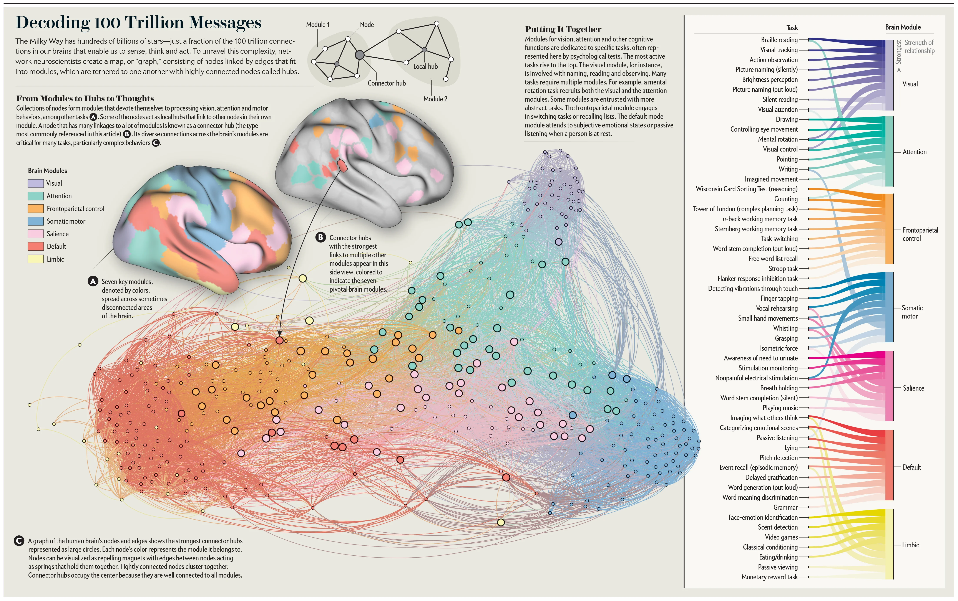

Slide 18
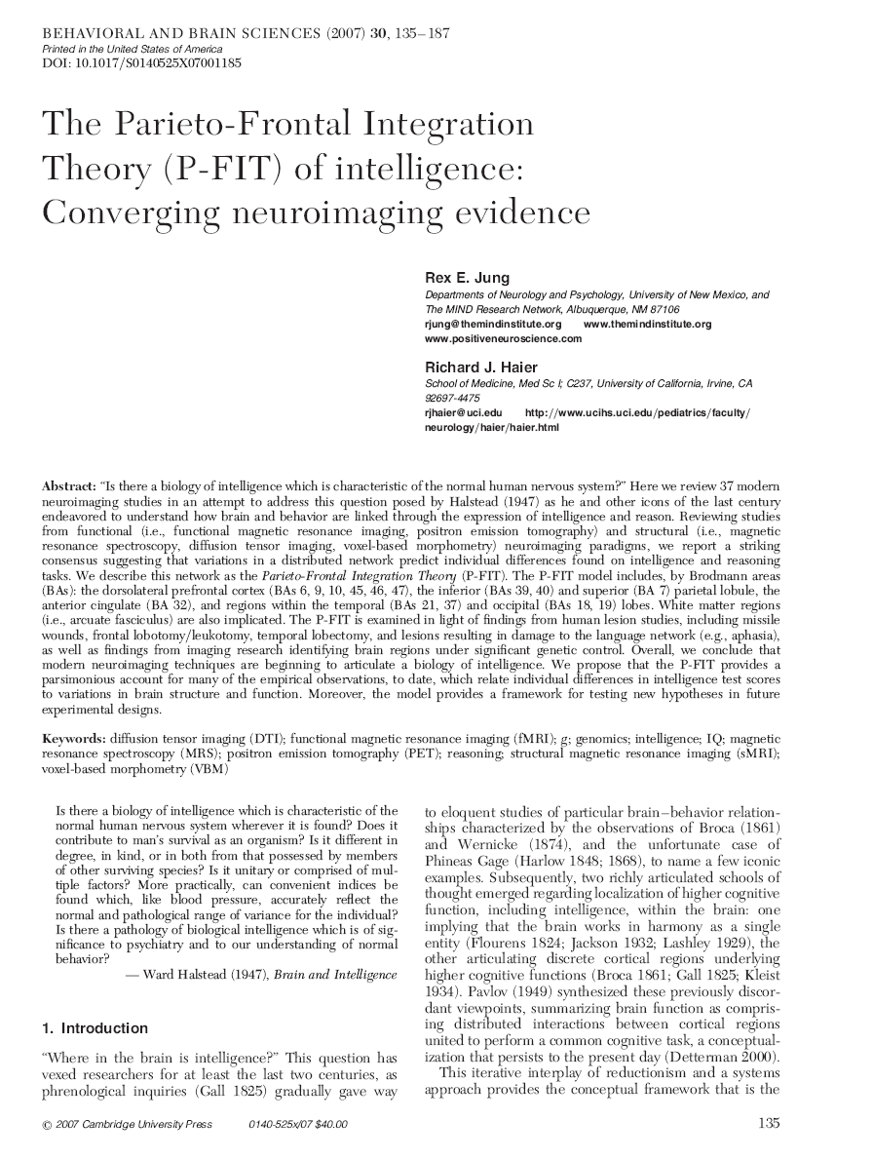
Frontal-Parietal Integration Theory (P-FIT)
A neurobiological theory that proposes that general intelligence emerges from the integration of brain networks, particularly:
Frontal Areas: Especially dorsolateral prefrontal cortex (working memory, executive control)
Parietal Areas: Particularly posterior parietal cortex (attention, spatial processing)
Temporal Areas: Including areas involved in language processing
Cingulate Cortex: Monitoring and conflict resolution

Slide 19
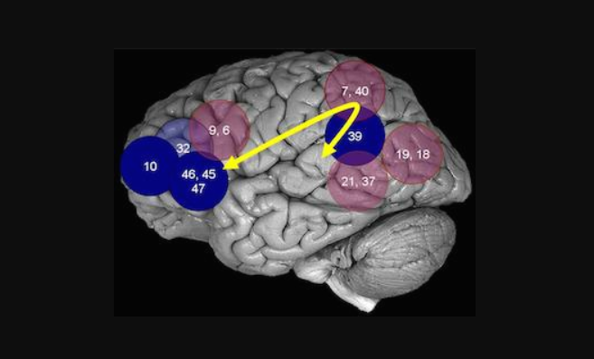
Frontal-Parietal Integration Theory (P-FIT)

Slide 20

The evolution of intelligence testing
From Binet-Simon (1905) to Modern Cognitive Assessment (2025) - 120 years of measurement science

Slide 21
History of the Adult Wechsler Scales
Test | Acronym | Date of Publication
Wechsler – Bellevue | WB | 1939
Wechsler Adult Intelligence Scale | WAIS | 1955
Wechsler Adult Intelligence Scale – Revised | WAIS-R | 1981
Wechsler Adult Intelligence Scale – Third Edition | WAIS-III | 1997
Wechsler Adult Intelligence Scale – Fourth Edition | WAIS-IV | 2008
Wechsler Adult Intelligence Scale – Fifth Edition | WAIS-5 | 2024

Slide 22
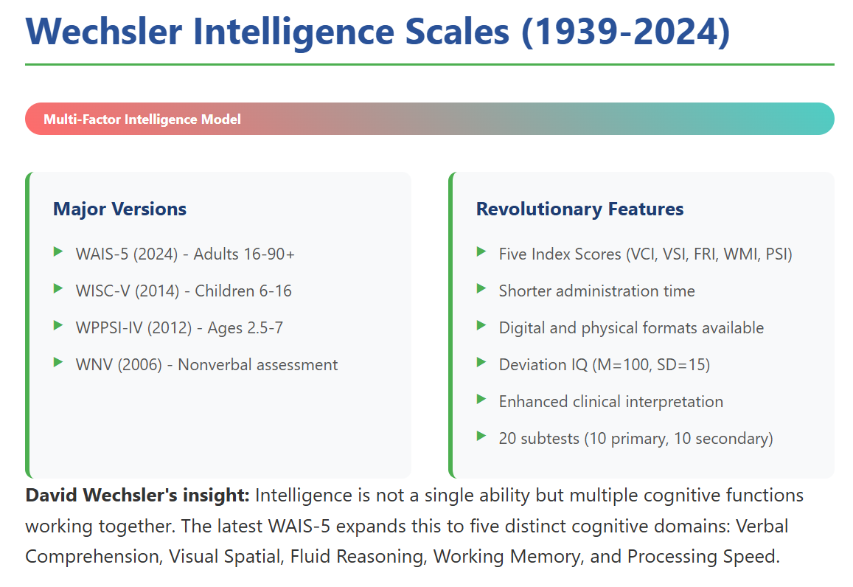

Slide 23
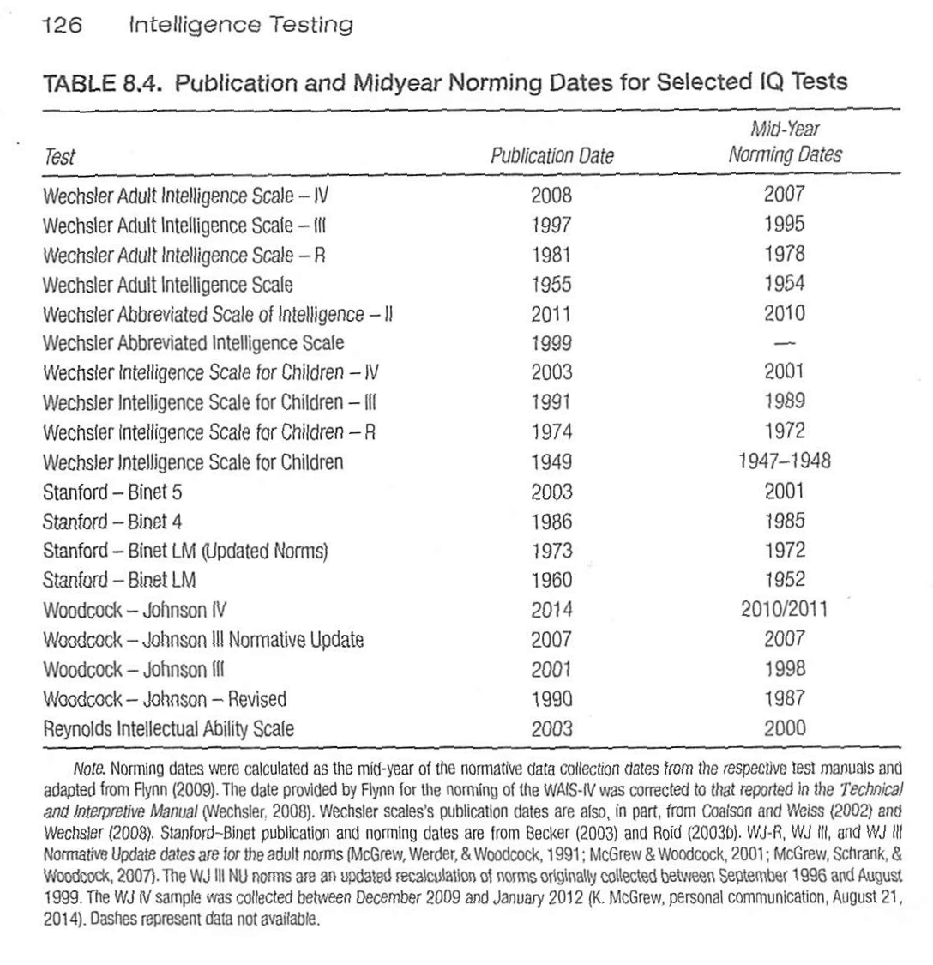
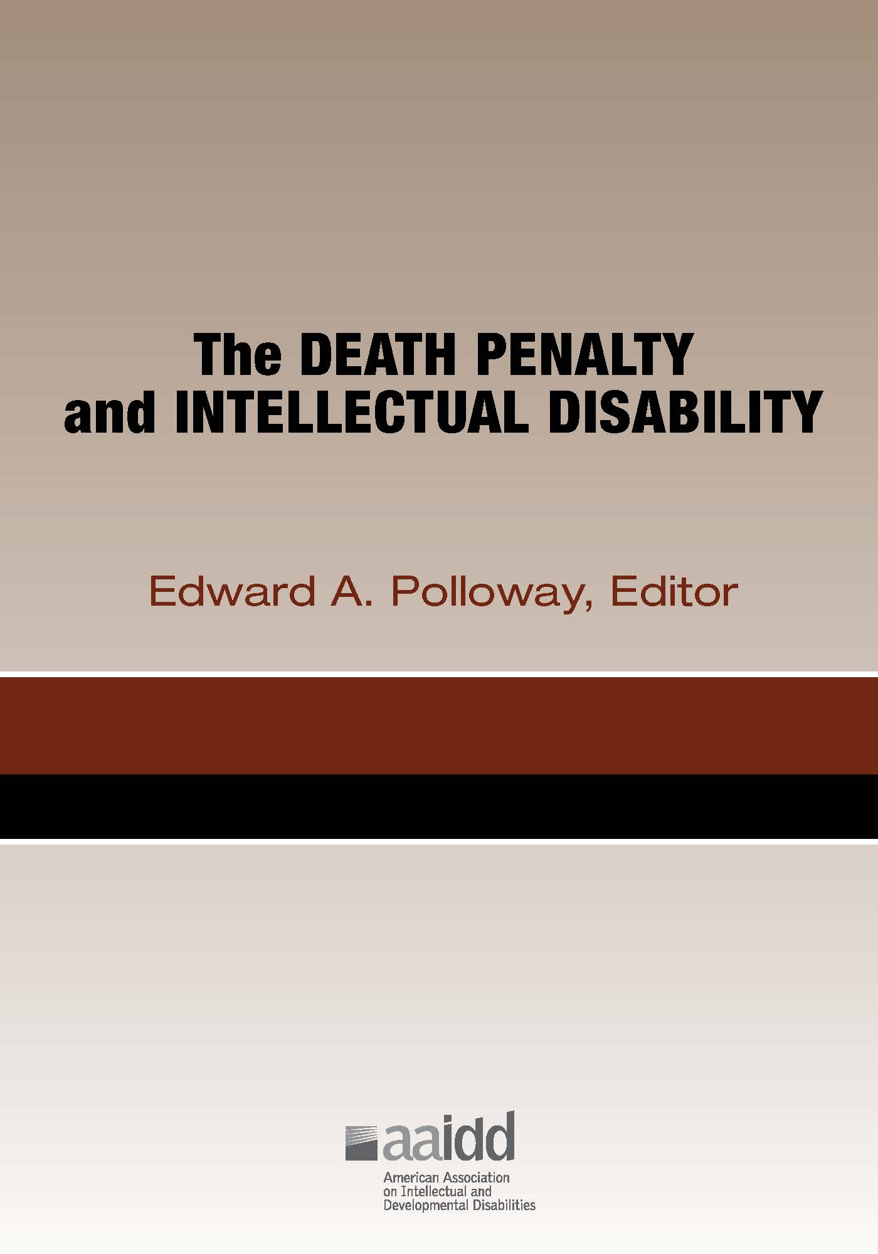
Midyear Norming Dates
Watson, D. G. (2015). Intelligence Testing. In E. A. Polloway (Ed.), The death penalty and intellectual disability (pp. 113–140). Chapter, American Association on Intellectual and Developmental Disabilities.

Slide 24
WAIS 5 Normative Study

Slide 25
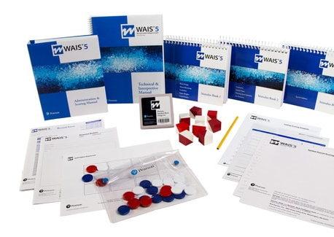
Wechsler Adult Intelligence Scale, Fifth Edition
(WAIS 5)
Published 2024
Normed between February 2023 and January 2024
Normative Sample Size = 2,020
Age Range = 16:0 – 90:11
Matched to 2022 U.S. Census Bureau data within each age group for education, race/ethnicity, region, & sex

Slide 26
Age Ranges
Age | N = | Age | N =
16:0 – 17:11 | 180 | 55:0 – 64:11 | 180
18:0 – 19:11 | 180 | 65:0 – 69:11 | 180
20:0 – 24:11 | 180 | 70:0 – 74:11 | 100
25:0 – 29:11 | 180 | 75:0 – 79:11 | 100
30:0 – 34:11 | 180 | 80:0 – 84:11 | 100
35:0 – 44:11 | 180 | 85:0 – 90:11 | 100
45:0 – 54:11 | 180

Slide 27
Education
Education Levels
< 8 years of school (< 8)
9 – 12 years of school, no diploma (9 – 11)
High school diploma or equivalent (12)
Some college or technical school, associate degree (13 – 15)
Bachelor’s degree (> 16)

Slide 28
Race/Ethnicity
Race/Ethnicity
African American
Asian
Hispanic
White
Non-Hispanic multiracial, Native Americans, Alaska Natives, Pacific Islanders, and others

Slide 29
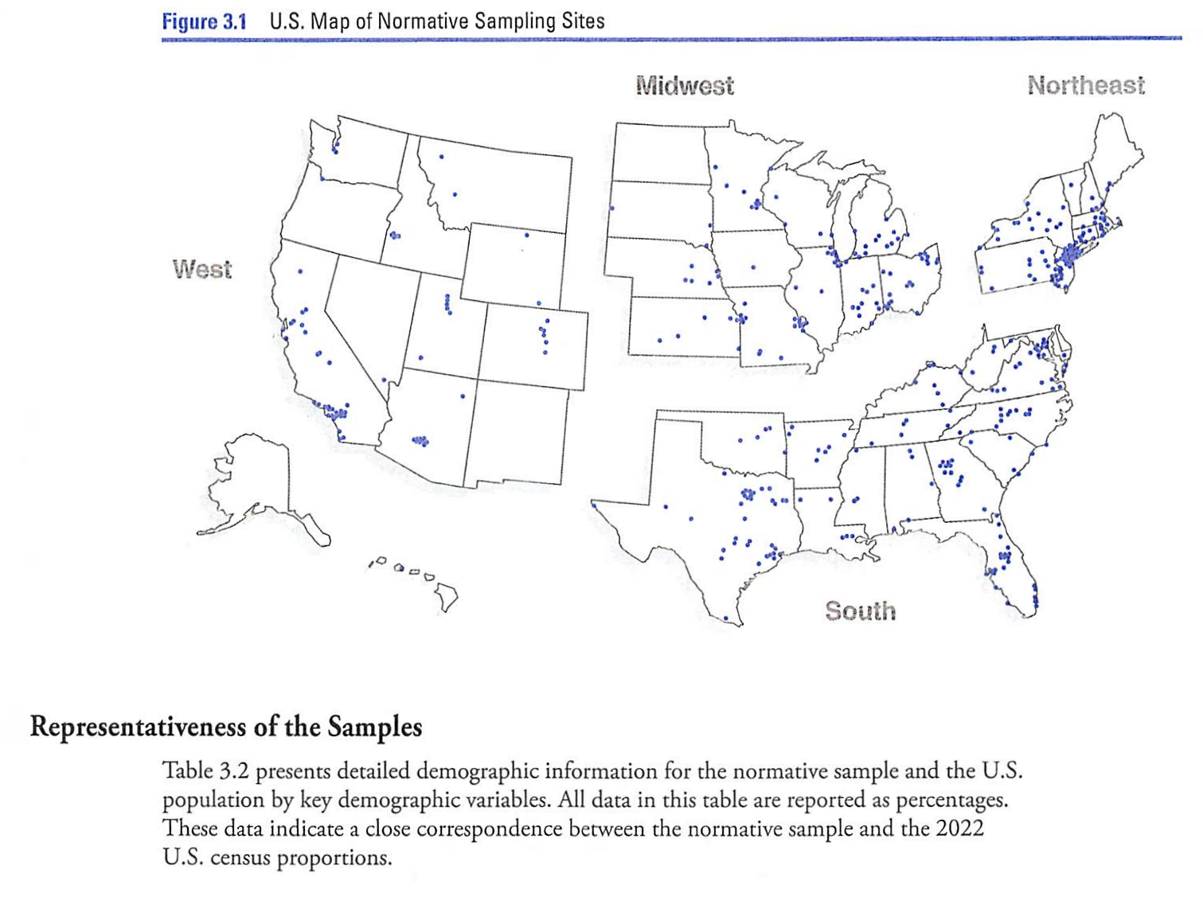
Region
Wechsler, D., Raiford, S. E., & Presnell, K. (2024). Wechsler Adult Intelligence Scale: Technical and interpretive manual (5th ed.). NCS Pearson, p. 46.

Slide 30
Norms Collection
Normative data collected between February 2023 and January 2024
Only post-Covid data retained

Slide 31
WAIS 5 Exclusionary Criteria (a “normal” sample!)
Primary language is not English
Primarily nonverbal or uncommunicative
Insufficient compliance
Previous IQ test within six months
Graduate psychology training
Uncorrected visual impairment
Uncorrected hearing loss
Upper extremity disability
Hospitalized
Medication affecting cognition
History of ECT
Chemotherapy last two months
Loss of consciousness >20”
Recent loss of function
Medical conditions affecting brain including stroke, tbi, mood disorders (except diabetes, hypothyroidism, & hypertension)

Slide 32
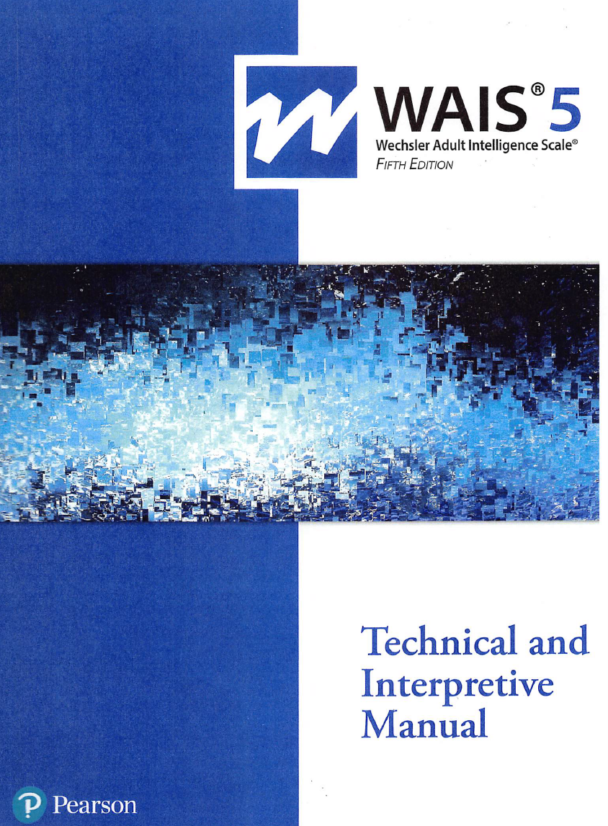
Bias Assessment
“All subtests and items were reviewed by internal and external reviewers for potential bias, cultural obsolescence, content relevance, and clinical utility.”
“Experts in cross-cultural research and/or intelligence testing conducted formal reviews.”
Reviewers from multiple countries evaluated translations and cultural fairness.
Statistical item analysis was conducted to eliminate problematic items across racial/ethnic groups.
English language learners were compared to matched controls finding no differences.

Slide 33
Low SES
The WAIS-5 is effective across ethnic groups but shows differences in scores for individuals from low socioeconomic status. This is important in forensic settings with low SES individuals.

Slide 34
WAIS 5 Platforms
Paper and pencil (in person)
Q-Global (remote)
Q-Interactive (i-Pad to i-Pad in person)
  “Q-interactive was praised for its ability to automate scoring, allowing examiners to focus more on behavioral observations. It was noted that this tool helps in quicker and more accurate administration, reducing clerical errors.” Claude

Slide 35
Platform Equivalence Study
For Q-interactive and paper and pencil versions “…format does not play a role in mean score differences observed between groups administered the WAIS-5 in differing formats.”
Raiford, S. E., & Courville, T. (2024, September). (PDF) equivalence of Q-Interactive ® and paper administration of Cognitive Tasks: WAIS ® -5 Q-Interactive Technical Report 16. pearsonassessment.com. https://www.researchgate.net/publication/384402526_Equivalence_of_Q-interactive_R_and_Paper_Administration_of_Cognitive_Tasks_WAIS_R_-5_Q-interactive_Technical_Report_16

Slide 36
WAIS 5 Structure

Slide 37
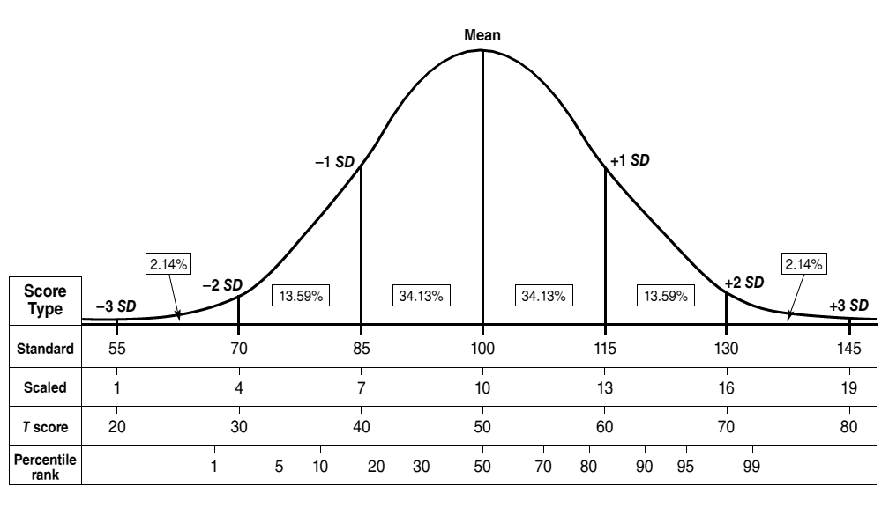
Normal Curve
Psychological Assessment Resources (PAR)

Slide 38
Range Descriptors
Composite Score Range | WAIS-5 Descriptive Classifications | Traditional Descriptive Classification | % Included
130 | Extremely High | Very Superior | 2.3
120 – 129 | Very High | Superior | 7.1
110 – 119 | Above Average | High Average | 16.6
90 – 109 | Average | Average | 49.9
80 – 89 | Below Average | Low Average | 15.8
70 – 79 | Very Low | Borderline | 6.0
< 69 | Extremely Low | Extremely Low | 2.2

Slide 39
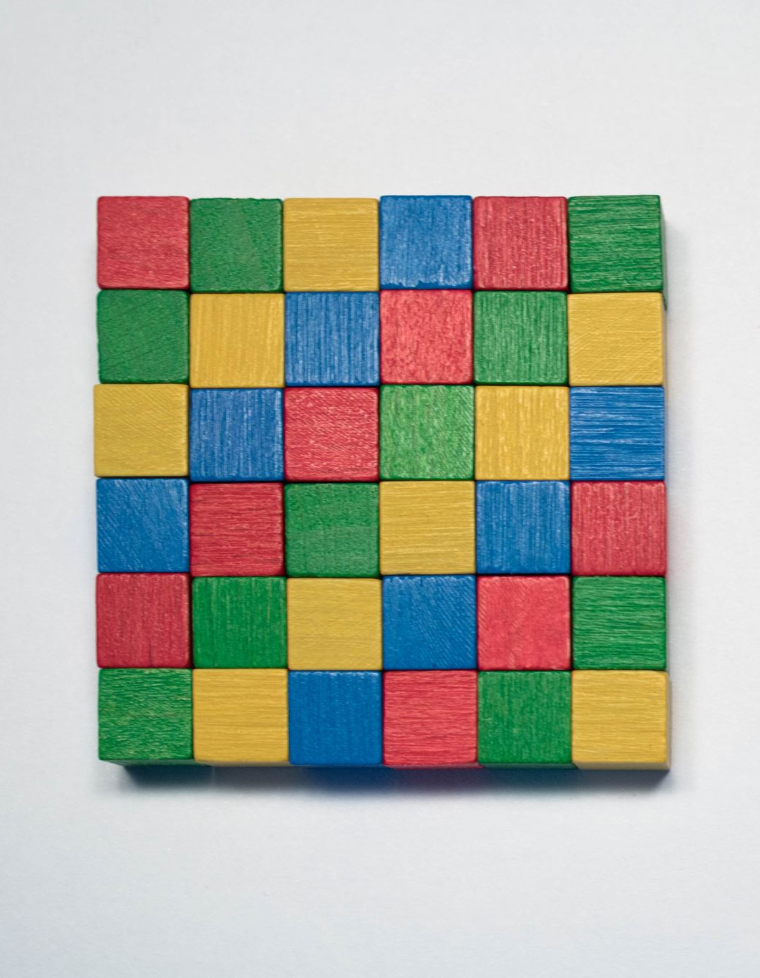
Full Scale IQ (FSIQ)
FSIQ, which is a composite of seven subtests—Vocabulary, Similarities, Block Design, Matrix Reasoning, Figure Weights, Digit Sequencing, and Coding.
The mean reliability of the FSIQ averaged 0.97 across the age range;
The stability coefficient was 0.93 for 201 individuals aged 16–90 that were tested twice (average interval = 29 days).
Winter, Emily L., Sierra M. Trudel, and Alan S. Kaufman. 2024. Wait, Where’s the Flynn Effect on the WAIS-5? Journal of Intelligence 12: 118. https://doi.org/10.3390/jintelligence12110118

Slide 40
General Cognitive Ability (g)
Visual Spatial
Block Design
Visual Puzzles
Working Memory
Digit Sequencing
Running Digits
Digits Forward
Letter-Number Sequencing
Symbol Span
Spatial Addition
Verbal Comprehension
Fluid Reasoning
Processing Speed
Similarities
Vocabulary
Information
Comprehension
Matrix Reasoning
Figure Weights
Arithmetic
Set Relations
Coding
Symbol Search
Naming Speed Quantity

Slide 41
Auxiliary Indices
Composite | Abbrev. |  | Composite | Abbrev.
Verbal (Expanded Crystalized) Index | VECI |  | Auditory Working Memory Index-Registration | AWMI-R
Verbal Reasoning Index | VRI |  | Auditory Working Memory Index-Manipulation | AWMI-M
Expanded Visual Spatial Index | EVSI |  | Expanded Processing Speed index | EPSI
Expanded Fluid Index | EFI |  | Motor-Reduced Processing Speed Index | MRPSI
Quantitative Reasoning Index | QRI |  | Nonverbal Index | NVI
Expanded Working Memory Index | EWMI |  | Nonmotor Index | NMI
Visual Working Memory Index | VWMI |  | General Ability Index | GAI
 |  |  | Cognitive Proficiency Index | CPI

Slide 42
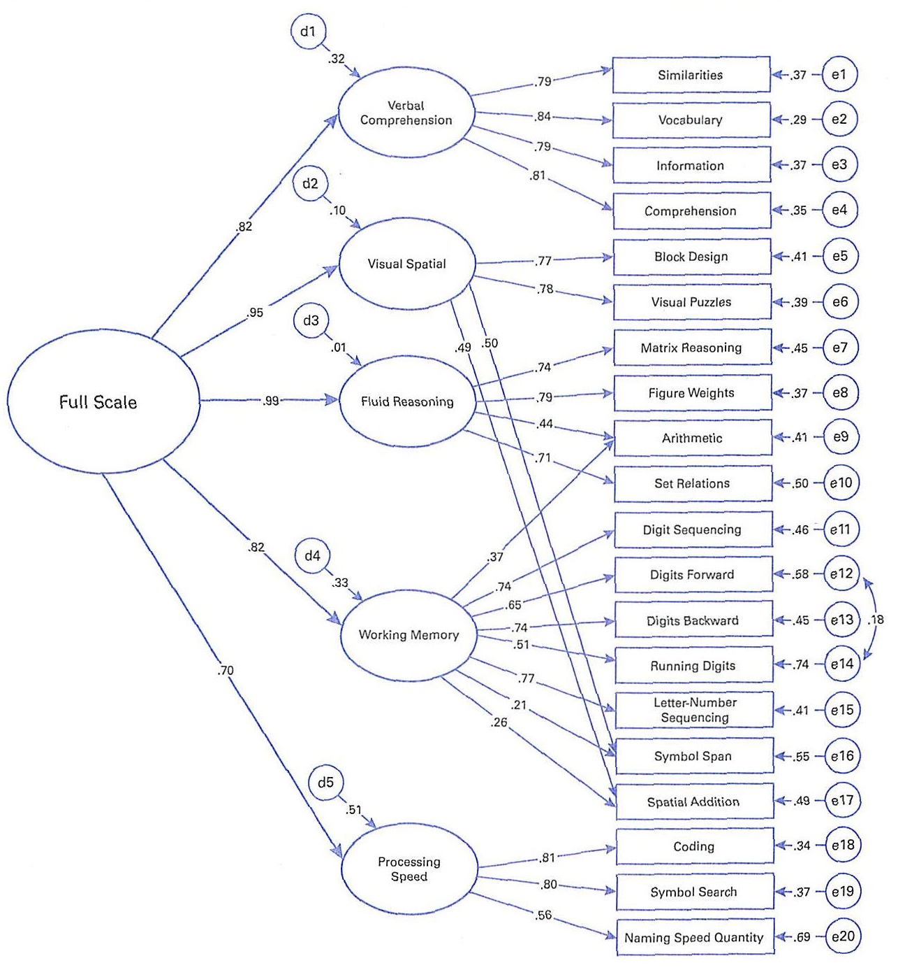
5 Factor Confirmatory Factor Model for the WAIS 5
Error or unique variance
0.70 x 0.70 = 49%
Unique Variance

Slide 43
Subtest g loadings
Subtest | g loading | % Variance | Subtest | g loading | % Variance
Figure Weights | 0.78 | 61% | Symbol Span | 0.65 | 42%
Arithmetic | 0.74 | 55% | Letter-Number Sequencing | 0.63 | 40%
Visual Puzzles | 0.74 | 55% | Digit Sequencing | 0.61 | 37%
Block Design | 0.73 | 53% | Digits Backward | 0.61 | 37%
Matrix Reasoning | 0.73 | 53% | Coding | 0.57 | 32%
Set Relations | 0.70 | 49% | Symbol Search | 0.56 | 31%
Vocabulary | 0.69 | 48% | Digits Forward | 0.53 | 28%
Similarities | 0.65 | 42% | Running Digits | 0.42 | 18%
Information | 0.65 | 42% | Naming Speed Quantity | 0.39 | 15%

Slide 44
95% Confidence Intervals
SEM and SEE

Slide 45
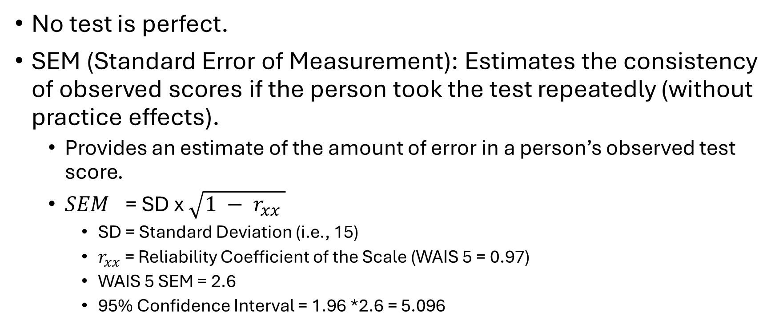
Standard Error Of Measurement (SEM)
No test is perfect.
SEM (Standard Error of Measurement): Estimates the consistency of observed scores if the person took the test repeatedly (without practice effects).
  Provides an estimate of the amount of error in a person’s observed test score.
  ${SEM}_{}$= SD x $\sqrt{1 − r_{xx} }$
    SD = Standard Deviation (i.e., 15)
    $r_{xx}$ = Reliability Coefficient of the Scale (WAIS 5 = 0.97)
    WAIS 5 SEM = 2.6
    95% Confidence Interval = 1.96 *2.6 = 5.096

Slide 46
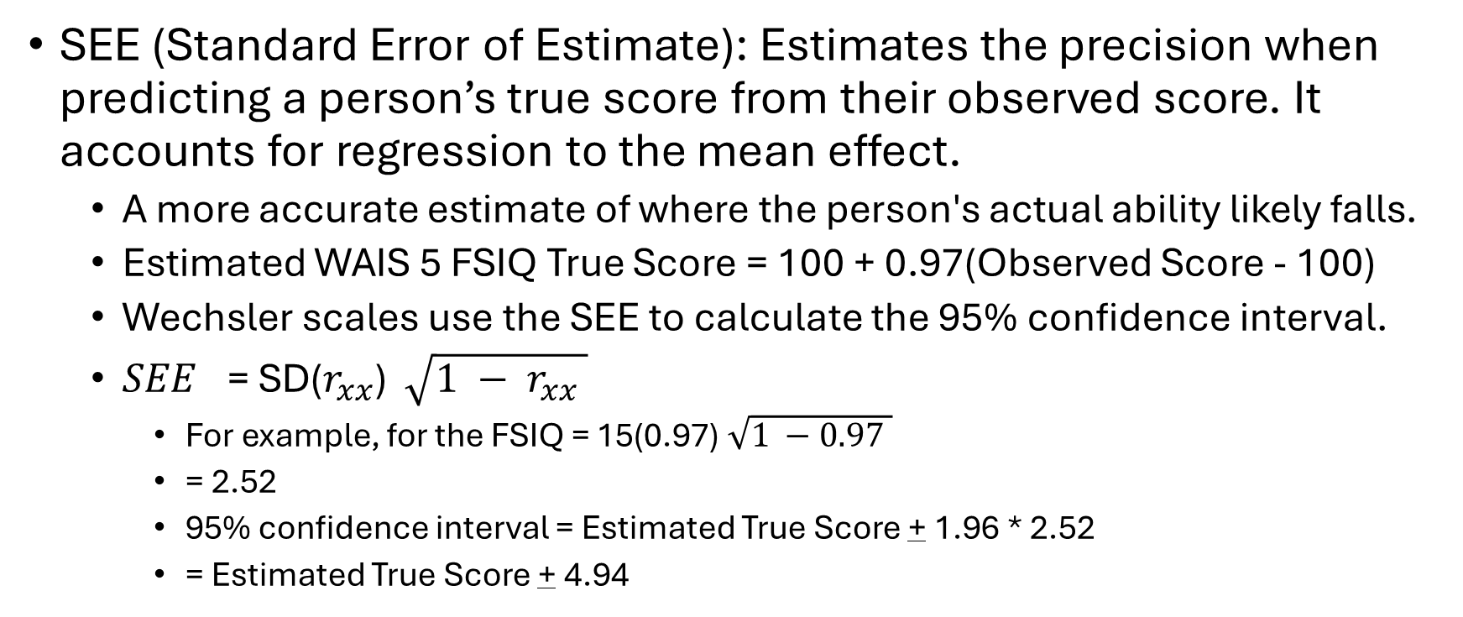
Standard Error of Estimate (SEE)
SEE (Standard Error of Estimate): Estimates the precision when predicting a person’s true score from their observed score. It accounts for regression to the mean effect.
  A more accurate estimate of where the person's actual ability likely falls.
  Estimated WAIS 5 FSIQ True Score = 100 + 0.97(Observed Score - 100)
  Wechsler scales use the SEE to calculate the 95% confidence interval.
  ${SEE}_{}$= SD($r_{xx}$) $\sqrt{1 − r_{xx} }$
    For example, for the FSIQ = 15(0.97) $\sqrt{1 −0.97 }$
    = 2.52
    95% confidence interval = Estimated True Score + 1.96 * 2.52
    = Estimated True Score + 4.94

Slide 47
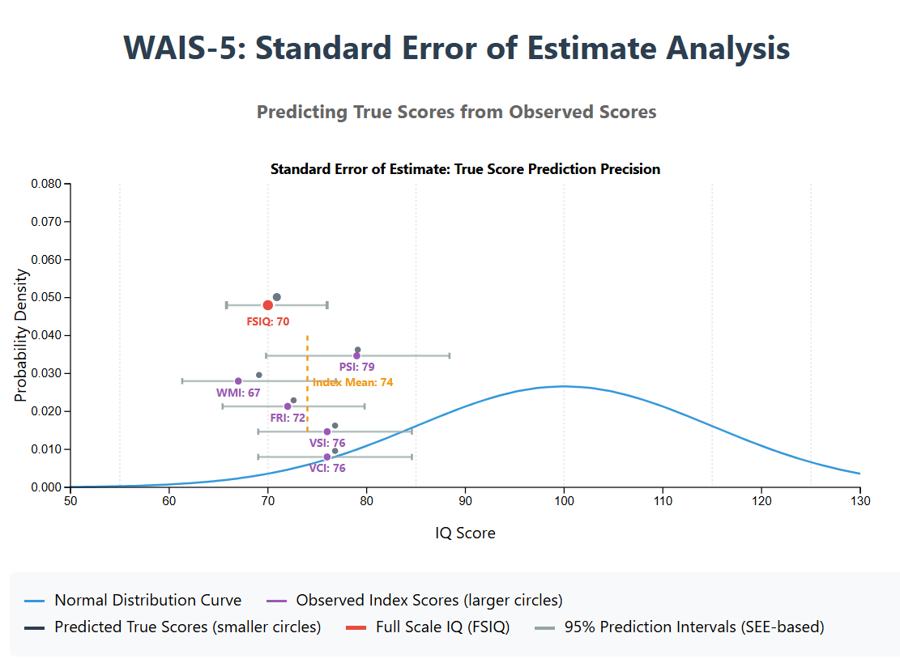
A composite score computed from imperfectly correlated scores is always more extreme, or further from the population mean, than the average of its parts. The extremity effect.

Slide 48
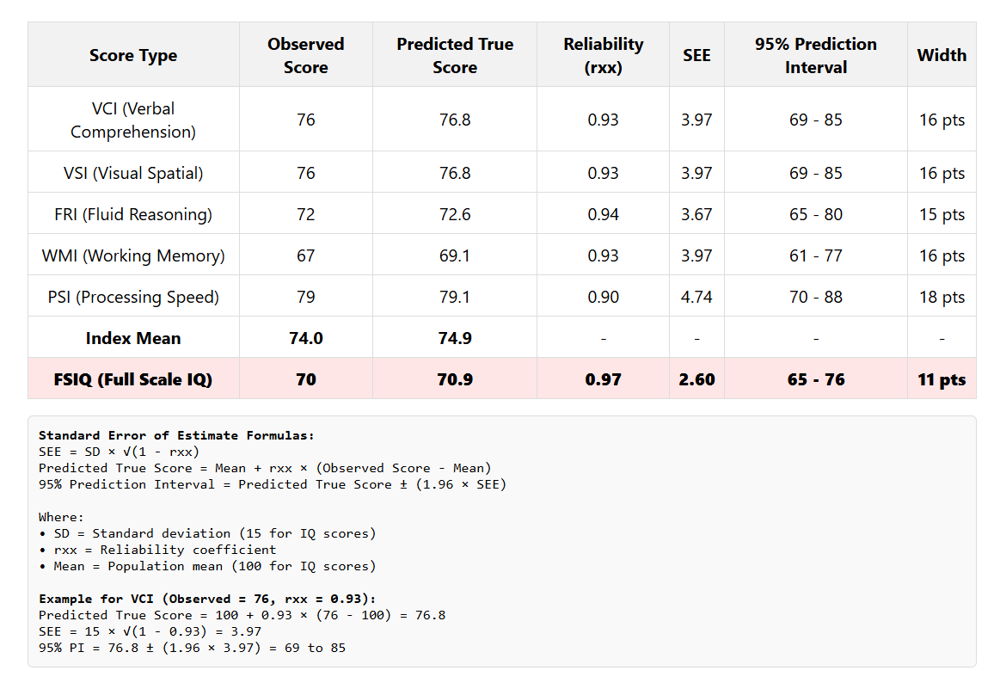

Slide 49
Interpretation

Slide 50

WAIS-5 Indices
Verbal Comprehension
  The ability to access and apply acquired knowledge through verbal concept formation, reasoning, and expression. Assesses an individual's ability to understand, use, and think with spoken language. It reflects the capacity to comprehend and express oneself using words.
  Visual Spatial
The ability to evaluate visual details and understand visual-spatial relations.
Fluid Reasoning
The ability to detect the underlying conceptual relations among visual objects and use reasoning to identify and apply rules.
Working Memory
The ability to register, maintain, and manipulate auditory information in conscious awareness. Registration requires attention, auditory discrimination, and concentration. It is essential for reasoning, learning, and comprehension.
Processing Speed
  Speed and accuracy of visual identification, decision making, and decision implementation. Requires visual scanning, visual discrimination, short-term visual memory, visual-motor coordination, and concentration. Assesses how quickly an individual can perform simple or routine cognitive tasks. It reflects the efficiency of cognitive processing.
Notes:
The WAIS-5 (Wechsler Adult Intelligence Scale, Fifth Edition) includes specific measures to assess mild intellectual disability (MID). It evaluates core cognitive functions such as verbal comprehension, perceptual reasoning, working memory, and processing speed. The sample data for individuals with MID can help in understanding their intellectual capabilities and aid in designing appropriate educational and support interventions.

Slide 51
Verbal Comprehension Index
High Scores | Low Scores
“Indicate well-developed verbal reasoning system with strong word knowledge acquisition, effective information retrieval, good ability to reason and solve verbal problems, and effective communication of knowledge.” | May indicate, “poorly developed word knowledge, difficulty retrieving acquired information, problems with verbal expression, or general difficulties with reasoning and problem-solving.”

Slide 52
Visual Spatial Index
High Scores | Low Scores
“Indicate a well-developed capacity to apply spatial reasoning and analyze visual details.” | May indicate, “Deficits in spatial processing, Difficulty with visual discrimination, poor visual attention, visual-motor integration deficits, or low general reasoning ability.”

Slide 53
Fluid Reasoning Index
High Scores | Low Scores
“Indicate a well-developed ability to abstract conceptual information from visual details and to effectively apply that knowledge.” Problem solving in novel circumstances. | May indicate, “difficulties identifying important visual information, difficulties linking visual information, to abstract concepts, difficulties understanding and applying conceptual or quantitative concepts, or low general reasoning ability.”

Slide 54
Working Memory Index
High Scores | Low Scores
“Indicate a well-developed ability to identify auditory information, maintain and update in temporary storage and re-sequence it for use in problem solving.” | May indicate, “inattention, auditory discrimination problems, difficulty actively maintaining and refreshing information in conscious awareness, weak cognitive control, low storage capacity, difficulty manipulating information in working memory, or low general cognitive functioning.”

Slide 55
Processing Speed Index
High Scores | Low Scores
“Indicate a well-developed ability to rapidly identify visual information, to make fast and accurate decisions, and to implement those decisions quickly.” | May indicate, “visual discrimination problems, distractibility, slow decision-making, motor difficulties, or generally slow cognitive speed.”

Slide 56
Intra-Individual Variability (IIV) (Dispersion)
The variability within a person’s cognitive profile.
Often measured by Intra-individual standard deviation (ISD)
High variability between cognitive domains can indicate underlying neurological conditions, learning disabilities, or developmental disorders.
Loss of executive control.

Slide 57
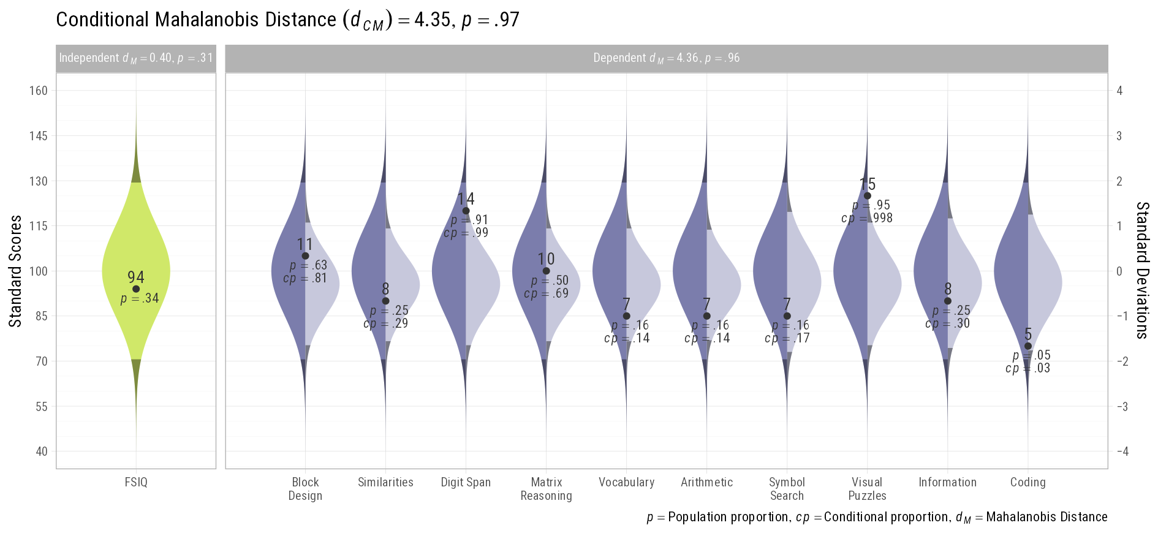
“Unusualness” Profile
Schneider, W. Joel, & Ji, F. (2023). Detecting unusual score patterns in the context of relevant predictors. Journal of Pediatric Neuropsychology, 9(1), 1–17. https://doi.org/10.1007/s40817-022-00137-x

Slide 58
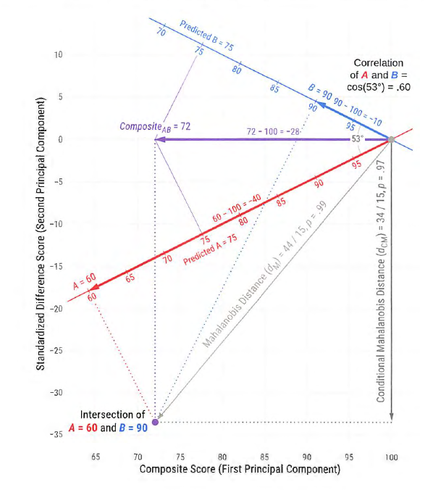
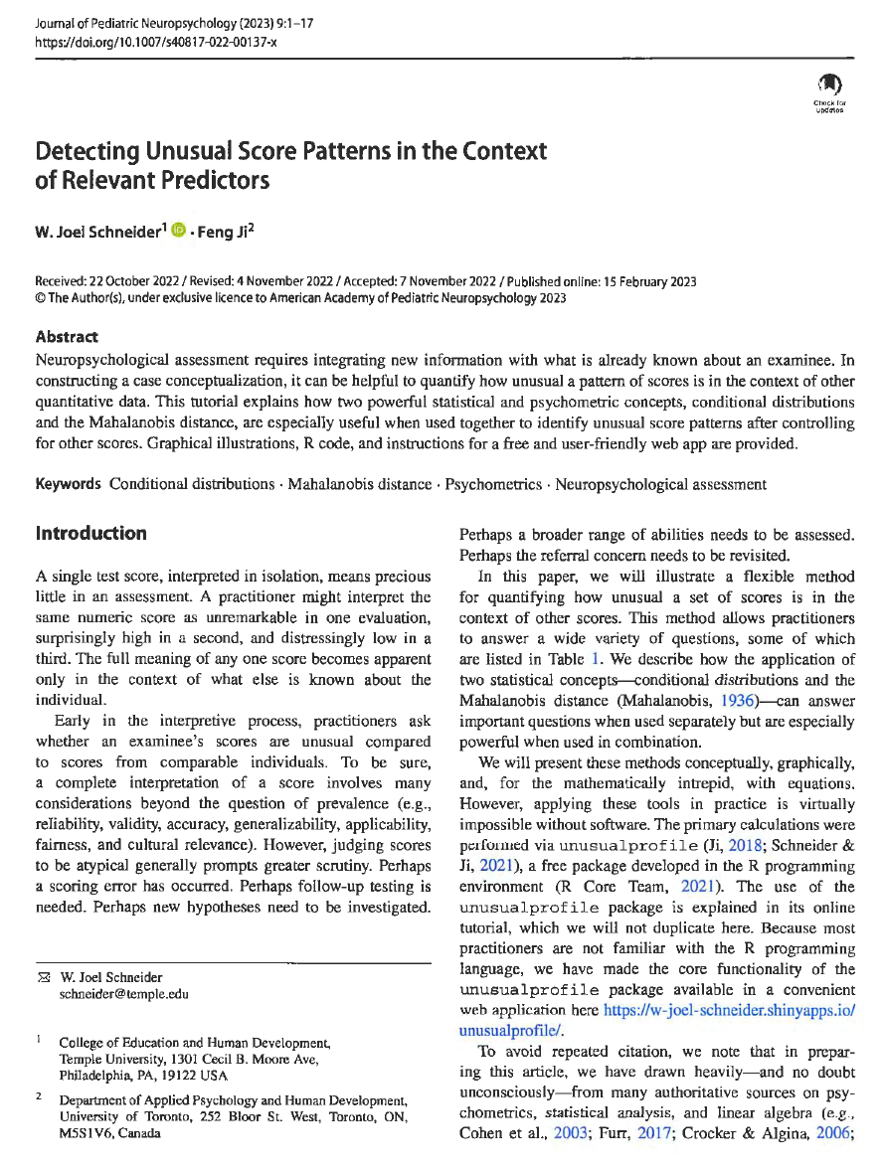
Graphic of calculations for “Unusualness”
Schneider, W. J., & Ji, F. (2023). Detecting unusual score patterns in the context of relevant predictors. Journal of Pediatric Neuropsychology, 9(1), 1–17. https://doi.org/10.1007/s40817-022-00137-x

Slide 59
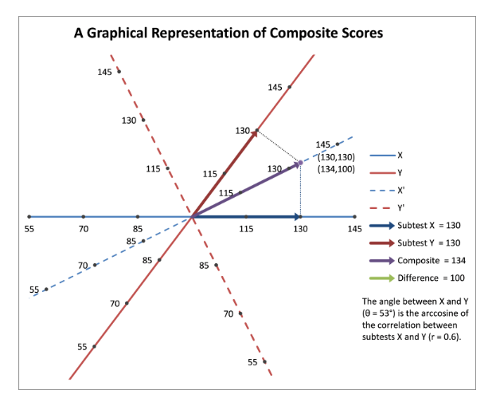
Graphic of calculations for Composite Scores
Schneider, W. J. (2011). A Geometric Representation of Composite Scores. https://assessingpsyche.wordpress.com/2011/03/29/a-geometric-representation-of-composite-scores/

Slide 60
Special Group Studies

Slide 61
Construct validity
The WAIS-5 development included studies on special groups like gifted individuals, those with intellectual disabilities, ADHD, and autism.
The data should not be used for diagnostics but supports construct validity.
Differences in scores validate the WAIS-5's performance.

Slide 62
Mild Intellectual Disability (ID) Sample
Of individuals diagnosed with mild ID, 89% had WAIS 5 FSIQ scores of < 75 compared to 9% of matched controls.
N = 55
Age mean = 31.8 (14.8)
Met DSM-5 criteria for diagnosis of ID including adaptive functioning deficits

Slide 63
Mild Intellectual Disability (ID)
Score | Mild ID |  | Matched Controls
 | Mean | Std. Dev. | Mean | Std. Dev. | p Value
Similarities (SI) | 4.5 | 1.9 | 9.2 | 2.7 | <.01
Vocabulary (VC) | 4.5 | 1.6 | 9.3 | 2.8 | <.01
Block Design (BD) | 4.5 | 2.5 | 9.6 | 2.8 | <.01
Visual Puzzles (VP) | 4.5 | 2 | 9.6 | 2.9 | <.01
Matrix Reasoning (MR) | 3.9 | 2.1 | 9.3 | 2.6 | <.01
Figure Weights (FW) | 4.6 | 1.5 | 8.9 | 3.3 | <.01
Digit Sequencing (DQ) | 4.2 | 2.3 | 9.5 | 2.7 | <.01
Running Digits (RD) | 5 | 2.1 | 9.9 | 2.7 | <.01
Coding (CD) | 3.7 | 2.2 | 9 | 2.9 | <.01
Symbol Search (SS) | 3.9 | 2.7 | 9.6 | 2.8 | <.01
Verbal Comprehension Index (VCI) | 69 | 10.5 | 95.9 | 13.9 | <.01
Visual Spatial Index (VSI) | 68.9 | 11.8 | 97.7 | 13.8 | <.01
Fluid Reasoning Index (FRI) | 67.7 | 9.7 | 95 | 14.1 | <.01
Working Memory Index (WMI) | 66.8 | 11.4 | 98 | 12.4 | <.01
Processing Speed Index (PSI) | 65.6 | 14.2 | 96.3 | 14.4 | <.01
Full Scale IQ (FSIQ) | 62.9 | 10.7 | 95.1 | 13.9 | <.01

Slide 64
Traumatic Brain Injury Sample
Prevalence in general adult population @ 12%
Frontal lobes and anterior temporal lobes are particularly vulnerable
N = 22
Age mean = 33.7 (9.5)
History of moderate or severe traumatic brain injury
Between 6 months and 18 months before testing
LOC > 1 hour

Slide 65
Traumatic Brain Injury (TBI) (Moderate-Severe)
Score | TBI |  | Matched Controls
 | Mean | Std. Dev. | Mean | Std. Dev. | p Value
Similarities (SI) | 6.8 | 2.2 | 9.3 | 3.3 | <.01
Vocabulary (VC) | 6.7 | 2.8 | 8.7 | 3.5 | <.05
Block Design (BD) | 7.2 | 2.8 | 9.3 | 3.2 | <.05
Visual Puzzles (VP) | 6.9 | 3.1 | 9 | 2.9 | <.05
Matrix Reasoning (MR) | 7 | 3.2 | 9.2 | 3.6 | <.05
Figure Weights (FW) | 6.6 | 2.2 | 8.5 | 2.5 | <.05
Digit Sequencing (DQ) | 6.6 | 1.7 | 9.7 | 2.9 | <.01
Running Digits (RD) | 7.4 | 1.6 | 10.2 | 3.1 | <.01
Coding (CD) | 6.3 | 3 | 9 | 2.7 | <.01
Symbol Search (SS) | 7 | 2.6 | 9.1 | 2.5 | <.01
Verbal Comprehension Index (VCI) | 82 | 13.1 | 94.3 | 16.9 | <.01
Visual Spatial Index (VSI) | 83.3 | 15.8 | 95.2 | 16.4 | <.05
Fluid Reasoning Index (FRI) | 82.4 | 14.2 | 93.5 | 15.1 | <.05
Working Memory Index (WMI) | 81.5 | 9.2 | 100 | 15.2 | <.01
Processing Speed Index (PSI) | 80.9 | 14 | 94.6 | 13.1 | <.01
Full Scale IQ (FSIQ) | 77.9 | 12 | 93.2 | 15.2 | <.01

Slide 66
Attention Deficit Hyperactivity Disorder (ADHD)
Prevalence in general adult population @ 6.8% symptomatic
Deficits in working memory and executive functions
IQ scores not generally useful in identifying ADHD
N = 21
Age mean = 26.6 (6.2)
Meets DSM-5 criteria for Dx of ADHD, Combined Presentation
Not taking ADHD medication for at least 24 hours before testing

Slide 67
Attention Deficit Hyperactivity Disorder (ADHD)
Score | ADHD |  | Matched Controls
 | Mean | Std. Dev. | Mean | Std. Dev. | p Value
Similarities (SI) | 10.7 | 2.6 | 10 | 2.9 | NS
Vocabulary (VC) | 11.2 | 3.3 | 11.6 | 2.8 | NS
Block Design (BD) | 11.8 | 2.4 | 11.1 | 3.1 | NS
Visual Puzzles (VP) | 10.5 | 2.5 | 10.5 | 2.7 | NS
Matrix Reasoning (MR) | 10.3 | 2.1 | 10.6 | 3 | NS
Figure Weights (FW) | 11 | 2.7 | 10.7 | 2.8 | NS
Digit Sequencing (DQ) | 10.1 | 2.3 | 10.3 | 0.36 | NS
Running Digits (RD) | 10 | 2.9 | 10.5 | 3.6 | NS
Coding (CD) | 9.9 | 1.9 | 10.3 | 2.8 | NS
Symbol Search (SS) | 11.1 | 2.7 | 10 | 2.8 | NS
Verbal Comprehension Index (VCI) | 105.3 | 14.2 | 104.6 | 13.4 | NS
Visual Spatial Index (VSI) | 106.4 | 11.4 | 104.2 | 14.5 | NS
Fluid Reasoning Index (FRI) | 103.6 | 10.3 | 103.4 | 13.1 | NS
Working Memory Index (WMI) | 100.5 | 12.6 | 102.5 | 18 | NS
Processing Speed Index (PSI) | 102.5 | 10.3 | 100.7 | 13.8 | NS
Full Scale IQ (FSIQ) | 105.3 | 10.4 | 105.4 | 12.2 | NS

Slide 68
Mild Cognitive Impairment (MCI)
Objectively measured evidence of memory impairment or impairments in another cognitive domain but do not have dementia.
Patients with MCI have gray matter loss in temporal, parietal, and frontal areas
N = 30
Age mean = 74.7 (5.8)

Slide 69
Mild Cognitive Impairment (MCI)
Score | MCI |  | Matched Controls
 | Mean | Std. Dev. | Mean | Std. Dev. | p Value
Similarities (SI) | 8.9 | 3 | 10.8 | 2.8 | <.01
Vocabulary (VC) | 9.7 | 3.3 | 9.8 | 2.3 | NS
Block Design (BD) | 9 | 2.8 | 9.5 | 1.9 | NS
Visual Puzzles (VP) | 8.7 | 2.9 | 9.5 | 2.4 | NS
Matrix Reasoning (MR) | 8.3 | 2.7 | 10.2 | 2.7 | <.01
Figure Weights (FW) | 9.4 | 2.5 | 9.4 | 2.5 | NS
Digit Sequencing (DQ) | 8.3 | 3.5 | 10.6 | 3.1 | <.01
Running Digits (RD) | 9.9 | 3.4 | 10 | 2.9 | NS
Coding (CD) | 8.8 | 2.7 | 10.2 | 2.9 | <.05
Symbol Search (SS) | 9.1 | 2.9 | 10.5 | 2.3 | <.05
Verbal Comprehension Index (VCI) | 95.7 | 16.8 | 101.6 | 13.1 | NS
Visual Spatial Index (VSI) | 93.4 | 14.8 | 97.3 | 10.6 | NS
Fluid Reasoning Index (FRI) | 93.6 | 12.5 | 98.7 | 11.8 | NS
Working Memory Index (WMI) | 94.5 | 18.8 | 101.8 | 13.9 | NS
Processing Speed Index (PSI) | 94.3 | 14.1 | 102 | 13.3 | <.05
Full Scale IQ (FSIQ) | 92.1 | 14.4 | 100.3 | 11.3 | <.01

Slide 70
Practice Effects

Slide 71
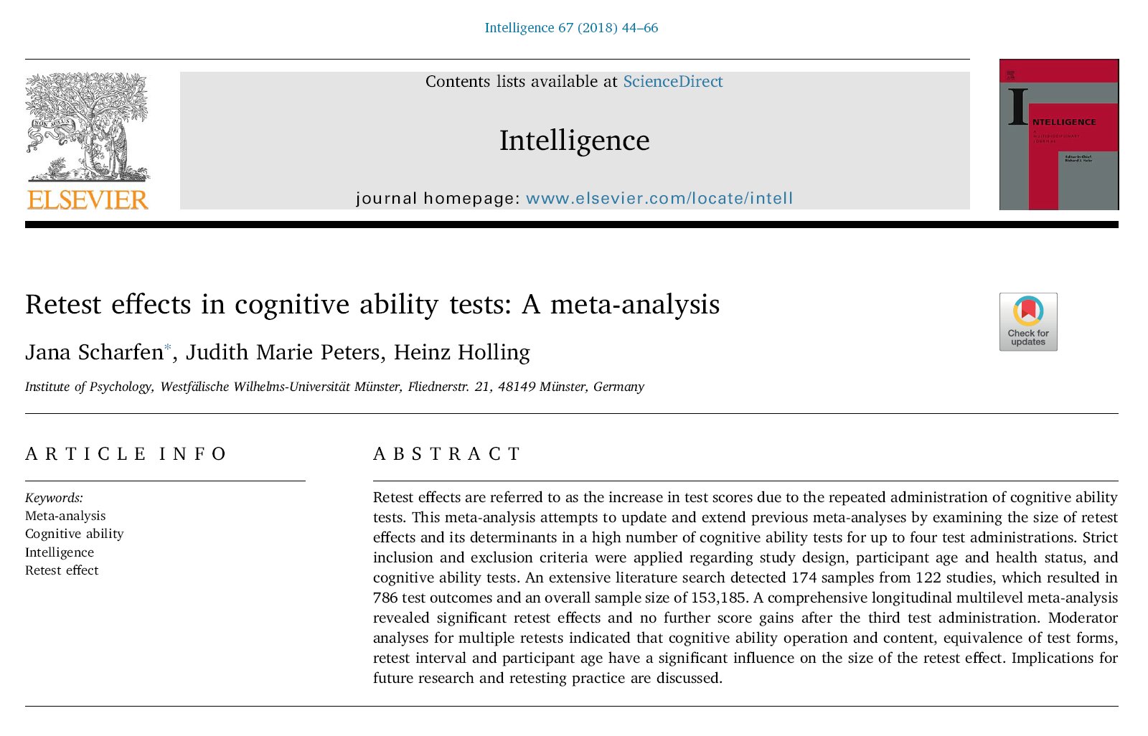
Re-Test Effect
“A gain in test scores of almost a third standard deviation for a mere repetition of a cognitive ability test without any further intervention between measurements has an impact on how we should deal with retesting and test experience in the future.”
Scharfen, J., Peters, J. M., & Holling, H. (2018). Retest effects in cognitive ability tests: A meta-analysis. Intelligence, 67, 44–66. https://doi.org/10.1016/j.intell.2018.01.003

Slide 72
Re-Test Effect (Scharfen et al., 2018)
“To illustrate, a person that achieved an IQ score of 100 in a first test, would be predicted to attain 105 IQ points when retested with a second test. An increase in test scores of half a standard deviation for the third and fourth test were revealed. Taking the example above, the person would be predicted to score 107 IQ points in a third and 108 in a fourth test. Nonetheless, in the light of the context of simply repeating a cognitive ability test, which occurs fairly often, this effect should not be neglected.”

Slide 73
Re-Test Effect
“The length of the test-retest interval had a significant influence on retest effects for up to four test administrations: The longer the test-retest interval between administrations, the smaller the retest effects.” p. 57.
Scharfen, J., Peters, J. M., & Holling, H. (2018). Retest effects in cognitive ability tests: A meta-analysis. Intelligence, 67, 44–66. https://doi.org/10.1016/j.intell.2018.01.003

Slide 74
Re-Test Effect
However, the retest effect decreased very slowly.
“To illustrate, increasing the test-retest interval by 50 weeks would lead to a decrease of the retest effect by 0.0008 x 50 = 0.04 standard deviations” (0.6 points).
Scharfen, J., Peters, J. M., & Holling, H. (2018). Retest effects in cognitive ability tests: A meta-analysis. Intelligence, 67, 44–66. https://doi.org/10.1016/j.intell.2018.01.003

Slide 75
Re-Test Effect
“In order to control for retest effects, the recommendation of using parallel, instead of identical test forms was supported by our results, as long as only a few retest are administered.” p. 59.
Scharfen, J., Peters, J. M., & Holling, H. (2018). Retest effects in cognitive ability tests: A meta-analysis. Intelligence, 67, 44–66. https://doi.org/10.1016/j.intell.2018.01.003

Slide 76
The “Flynn Effect” updated

Slide 77
Norm Obsolescence (The Flynn Effect)
In the United States there has been a growth of 3 IQ points every ten years, a pattern that has been constant for about a century (Flynn 1984, 1987, 2007; Pietschnig and Voracek 2015; Trahan et al. 2014)
The Flynn effect suggests that younger generations score higher on IQ tests than those prior (Dworak et al. 2023).

Slide 78
American Association on Intellectual and Developmental Disabilities (AAIDD)
AAIDD has stipulated that IQs must be adjusted for the Flynn effect when diagnosing intellectual disabilities.
“Current best practice guidelines recommend that in cases in which an IQ test with aged norms is used as part of a diagnosis of ID, a correction of the full-scale IQ score of 0.3 points per year since the test norms were collected is warranted” (Schalock et al. 2021, p. 42).

Slide 79
WAIS IV / WAIS 5 Comparisons
Validity data presented in the WAIS 5 Technical and Interpretive Manual (Wechsler et al. 2024b) based on 186 adolescents and adults tested on the WAIS-IV and WAIS-5 in counterbalanced order—as well as a second counterbalanced study of 98 16-year-olds tested on the WISC-V and WAIS-5—directly address the magnitude of the Flynn effect for contemporary American society.

Slide 80
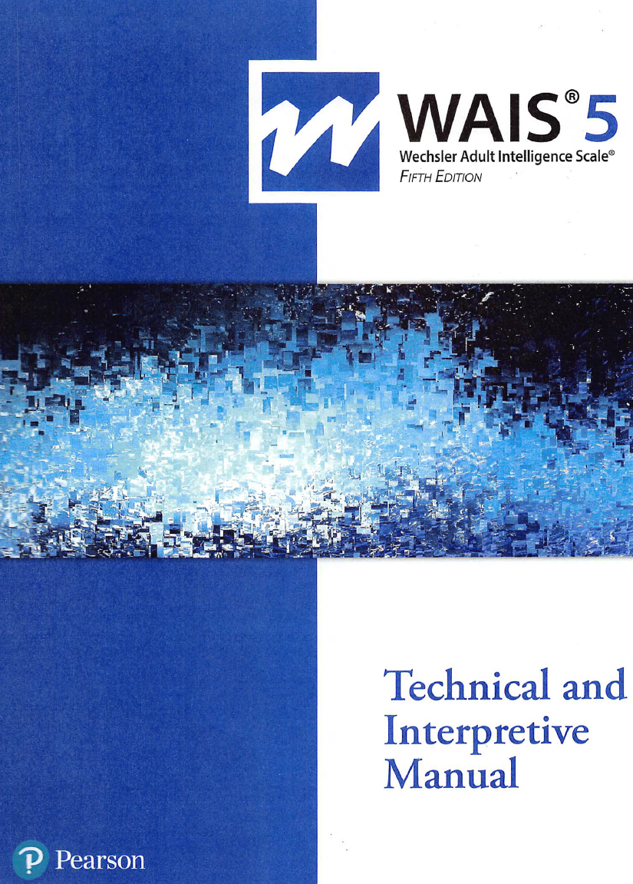
WAIS IV / WAIS 5 Comparisons
Full Scale IQs correlated 0.92 between the two versions of WAIS.
For the WAIS-IV and WAIS-5, the differences for the FSIQ, VCI, and FRI were 1.3, 1.3, and 1.3 points per decade respectively.
This would suggest that the Flynn Effect is now slowing in the U.S.

Slide 81
WAIS IV / WAIS 5 Comparisons
One change from the WAIS-IV to WAIS-5 is noteworthy—the reduction in the number of subtests that contribute to the Full Scale, from 10 to 7.
Compounding that change is the different contribution made by the primary indexes (and hence by the CHC broad abilities) to FSIQ.
Most notably, the Processing Speed Index and Working Memory Index comprised 40% of the WAIS-IV Full Scale, a value that was reduced to 28.6% on the WAIS-5.

Slide 82
WAIS-5 Flynn Effect
Factors: Mixed Race data increased in census data
May be slowing in Europe and now in U.S.
1 point per decade per meta-analyses
Raiford, S. E., & Courville, T. (2024, September). (PDF) equivalence of Q-Interactive ® and paper administration of Cognitive Tasks: WAIS ® -5 Q-Interactive Technical Report 16. pearsonassessment.com. https://www.researchgate.net/publication/384402526_Equivalence_of_Q-interactive_R_and_Paper_Administration_of_Cognitive_Tasks_WAIS_R_-5_Q-interactive_Technical_Report_16

Slide 83
Ask a Neuropsychologist

Slide 84

A few comments.
The most significant change in the field has been the digitization of neuropsychology.
The other major change, is the development of statistical procedures that allow for more sophisticated analyses of neuropsychological data.
  Bayesian statistics
  Multi-variate analyses
  Intra-individual variability (IIV) (Dispersion)
    “Unusualness” Profiles
  Mahalanobis distance
Finally, AI has arrived.
  Case Fleet
  Reverb
  Parchment (HIPAA compliant)
  Claude

Slide 85
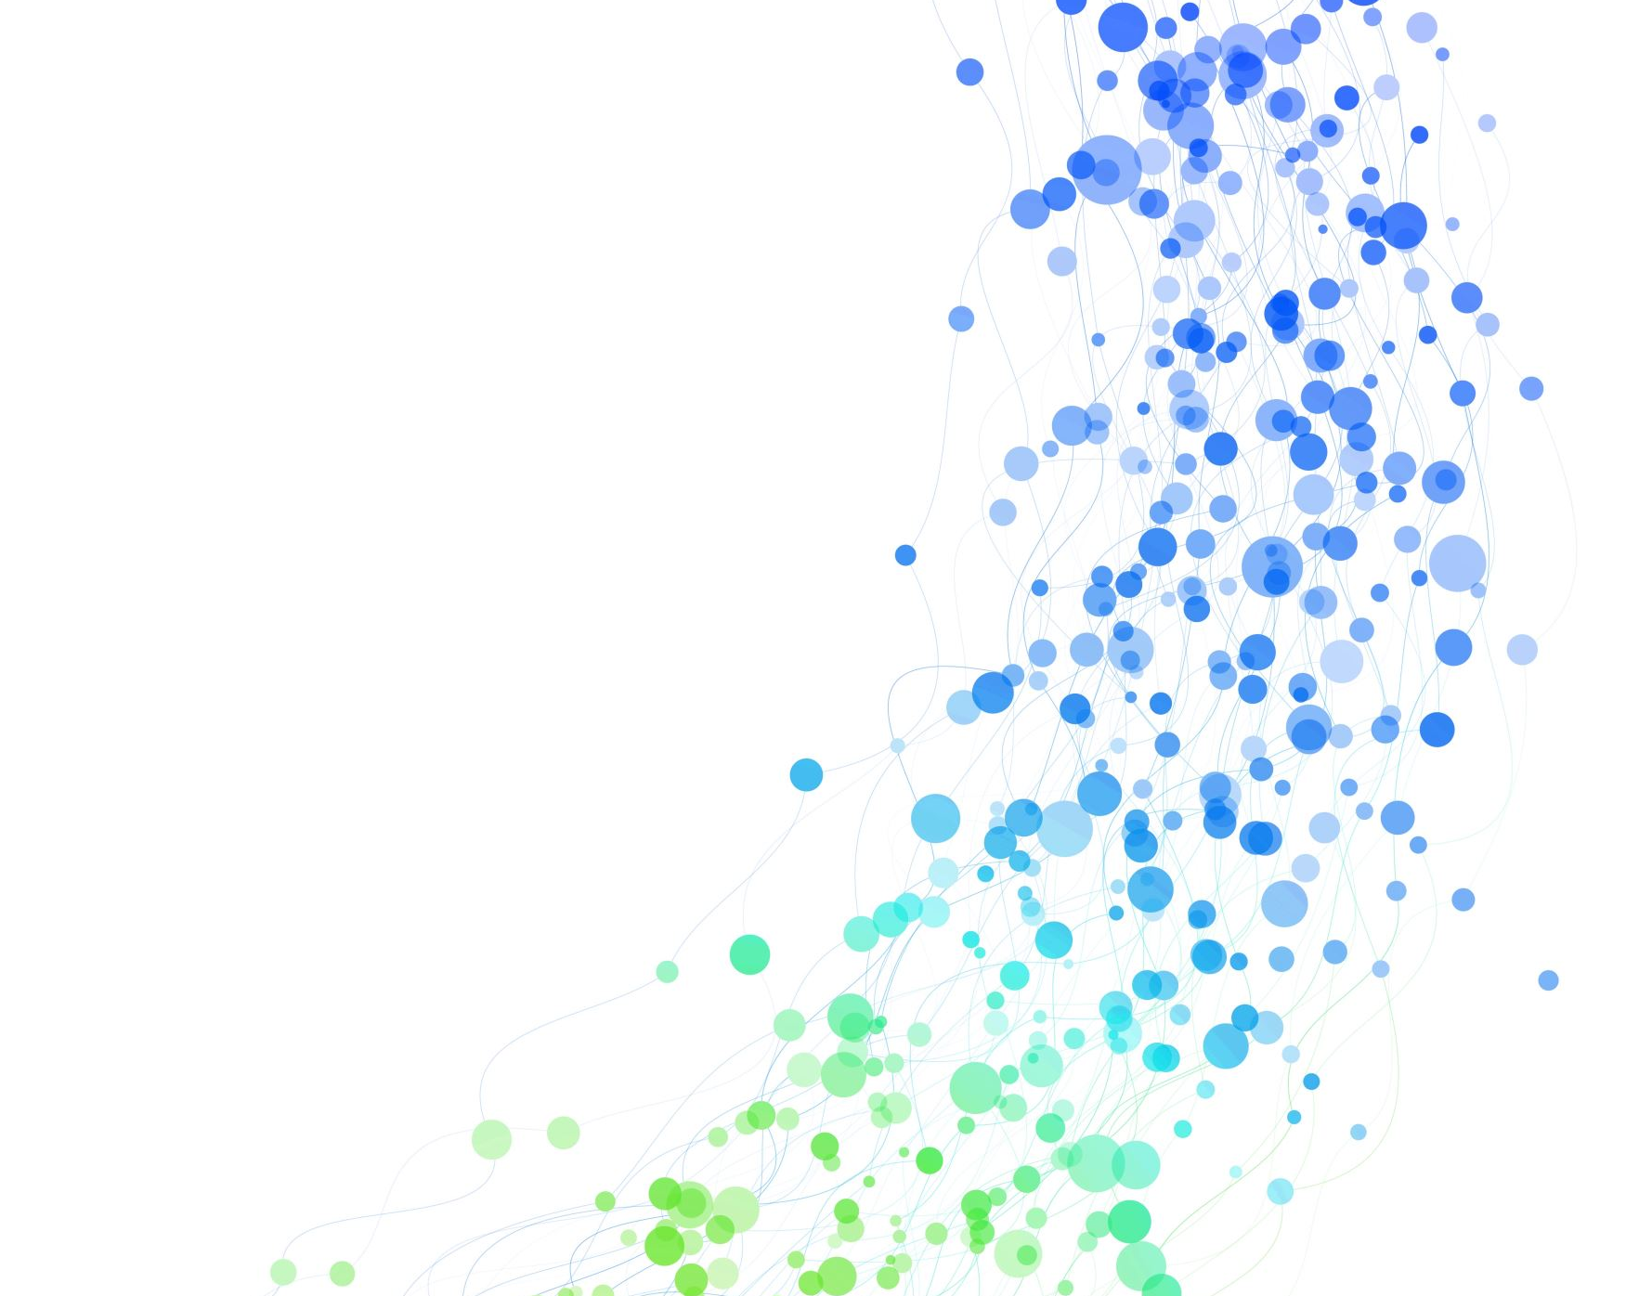
Bayesian Analysis
Priors and Posterior probability

Slide 86
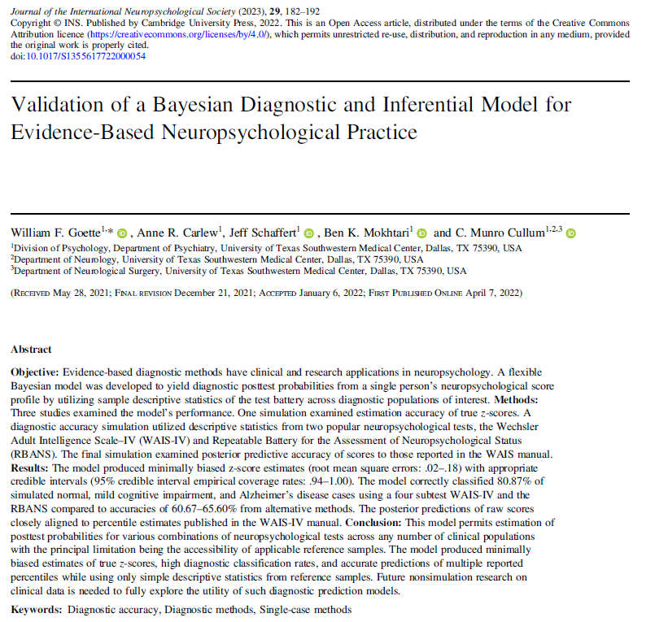
A seminal article on Bayesian multivariate analysis
Statistical procedures for determining diagnostic group membership based upon patterns of performance across multiple tests (multivariate) combined with pre-test probabilities.
Goette, W. F., Carlew, A. R., Schaffert, J., Mokhtari, B. K., & Cullum, C. M. (2022). Validation of a Bayesian diagnostic and inferential model for evidence-based neuropsychological practice. Journal of the International Neuropsychological Society, 29(2), 182–192. https://doi.org/10.1017/s1355617722000054

Slide 87
Intra-Individual Variability (IIV)
“Unusualness” or Test Scatter

Slide 88
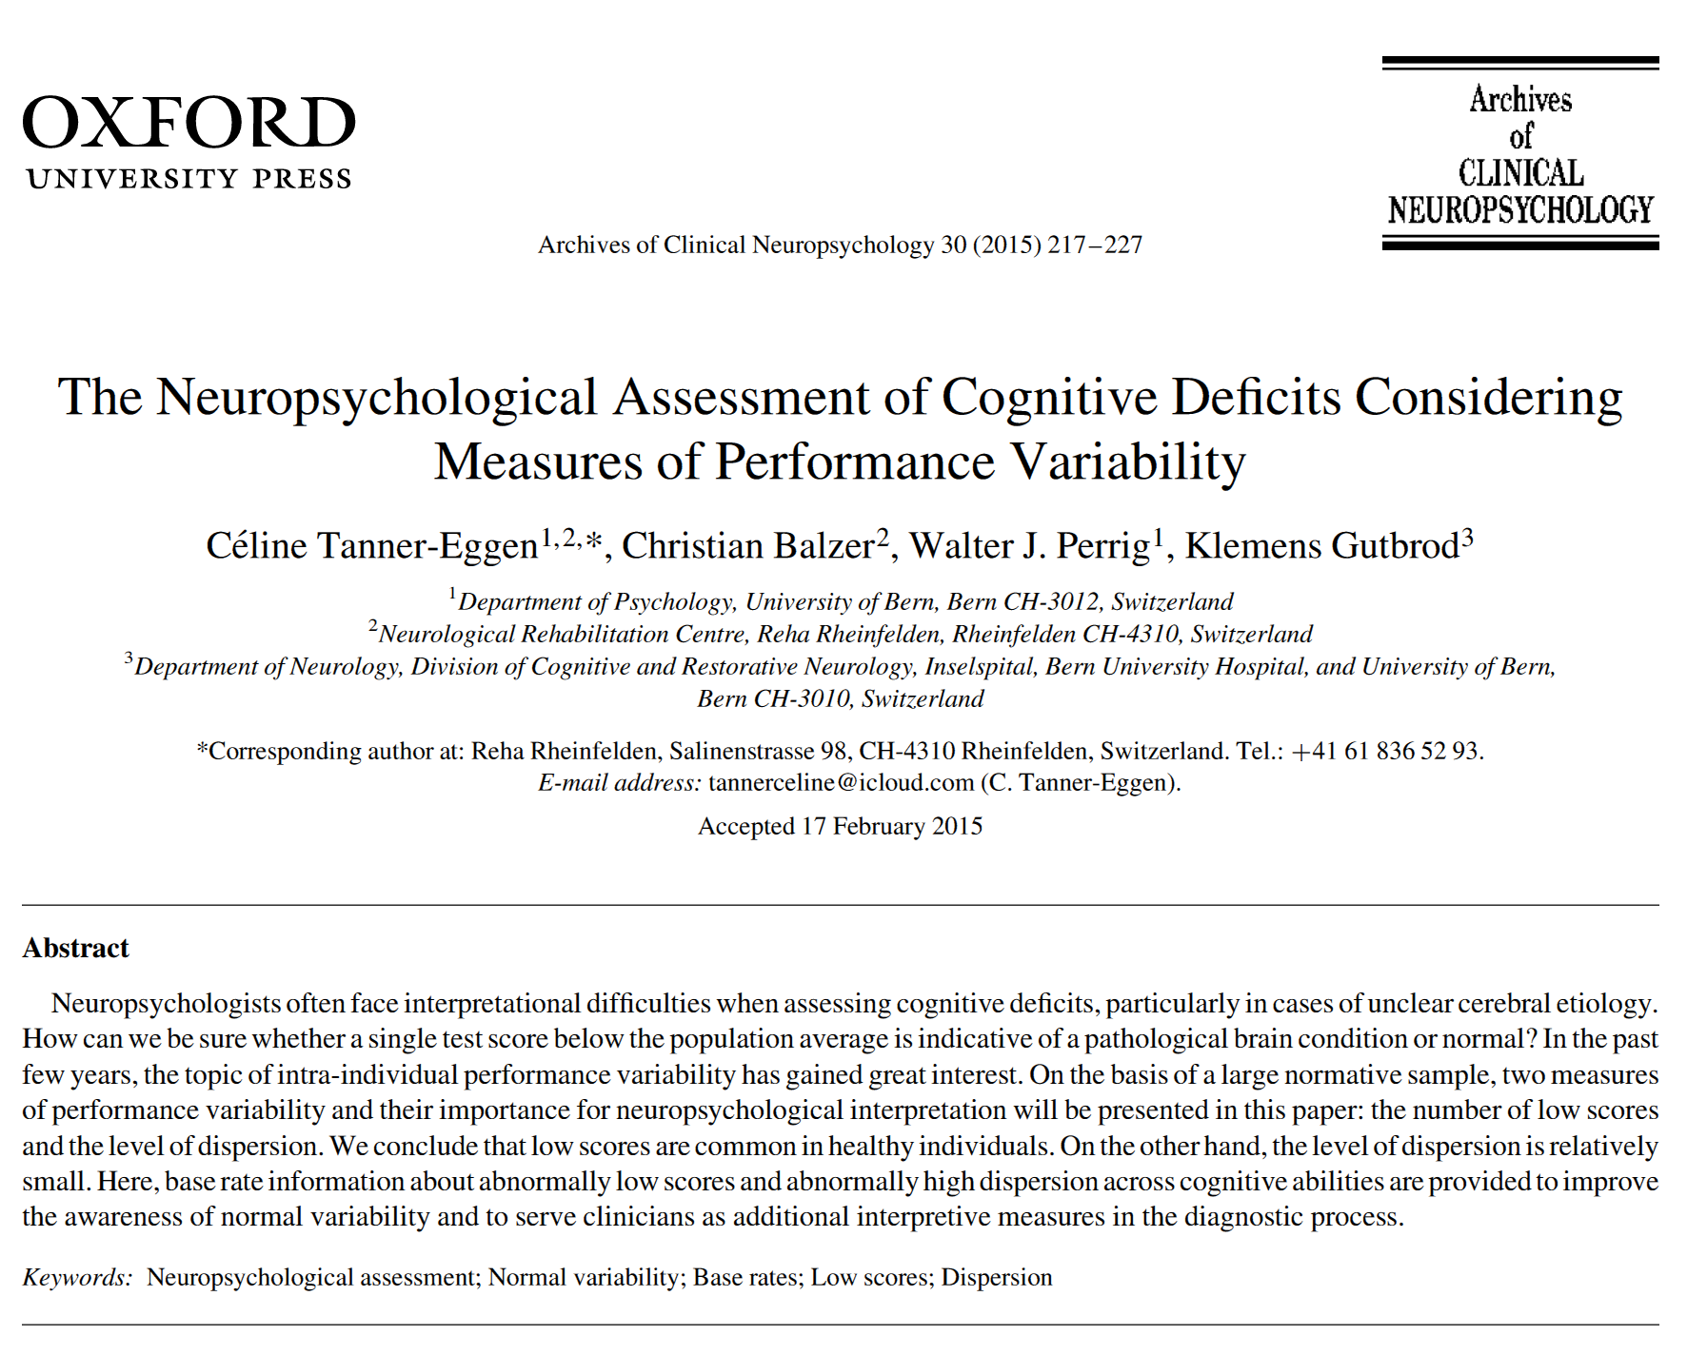
Dispersion within cognitive profiles
“Marked IIV (Intra-Individual Variability) is often associated with acquired neurocognitive deficits.
In this case, it is assumed that an abnormal brain condition interferes with a person’s ability to perform at a characteristic level of neuropsychological functioning.”
The loss of top-down (executive) control leads to greater variability in performance.
Tanner-Eggen, C., Balzer, C., Perrig, W. J., & Gutbrod, K. (2015). The neuropsychological assessment of cognitive deficits considering measures of performance variability. Archives of Clinical Neuropsychology, 30(3), 217–227. https://doi.org/10.1093/arclin/acv008

Slide 89
Dispersion within cognitive profiles
Recent research has suggested that the dispersion of scores (scatter) within a profile may be associated with greater cognitive impairments.
Used Intra-individual Standard Deviation (ISD) as measure of scatter.

Slide 90
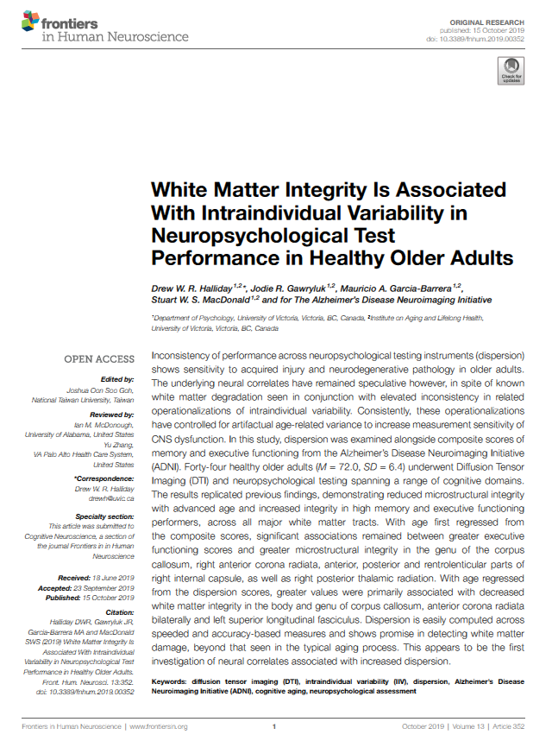
Intraindividual Test Score Variability Associated with White Matter Integrity
Halliday et al. (2019) found that “inconsistency across neuropsychological test performance is associated with white matter integrity in multiple brain regions.
This may be especially important for individuals who do not present with marked deficits on any one particular task, but instead present with multiple, mild deficits that may otherwise go unnoticed.”
Halliday, D. W., Gawryluk, J. R., Garcia-Barrera, M. A., & MacDonald, S. W. (2019). White matter integrity is associated with intraindividual variability in neuropsychological test performance in Healthy Older Adults. Frontiers in Human Neuroscience, 13. https://doi.org/10.3389/fnhum.2019.00352

Slide 91
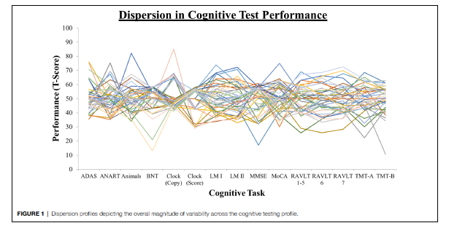
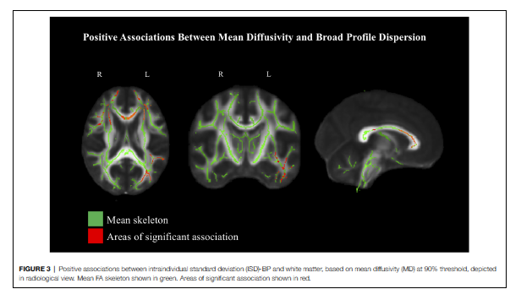
Dispersion and white matter correlations (using Diffusion Tensor Imaging (DTI))
Halliday, D. W., Gawryluk, J. R., Garcia-Barrera, M. A., & MacDonald, S. W. (2019). White matter integrity is associated with intraindividual variability in neuropsychological test performance in Healthy Older Adults. Frontiers in Human Neuroscience, 13. https://doi.org/10.3389/fnhum.2019.00352

Slide 92
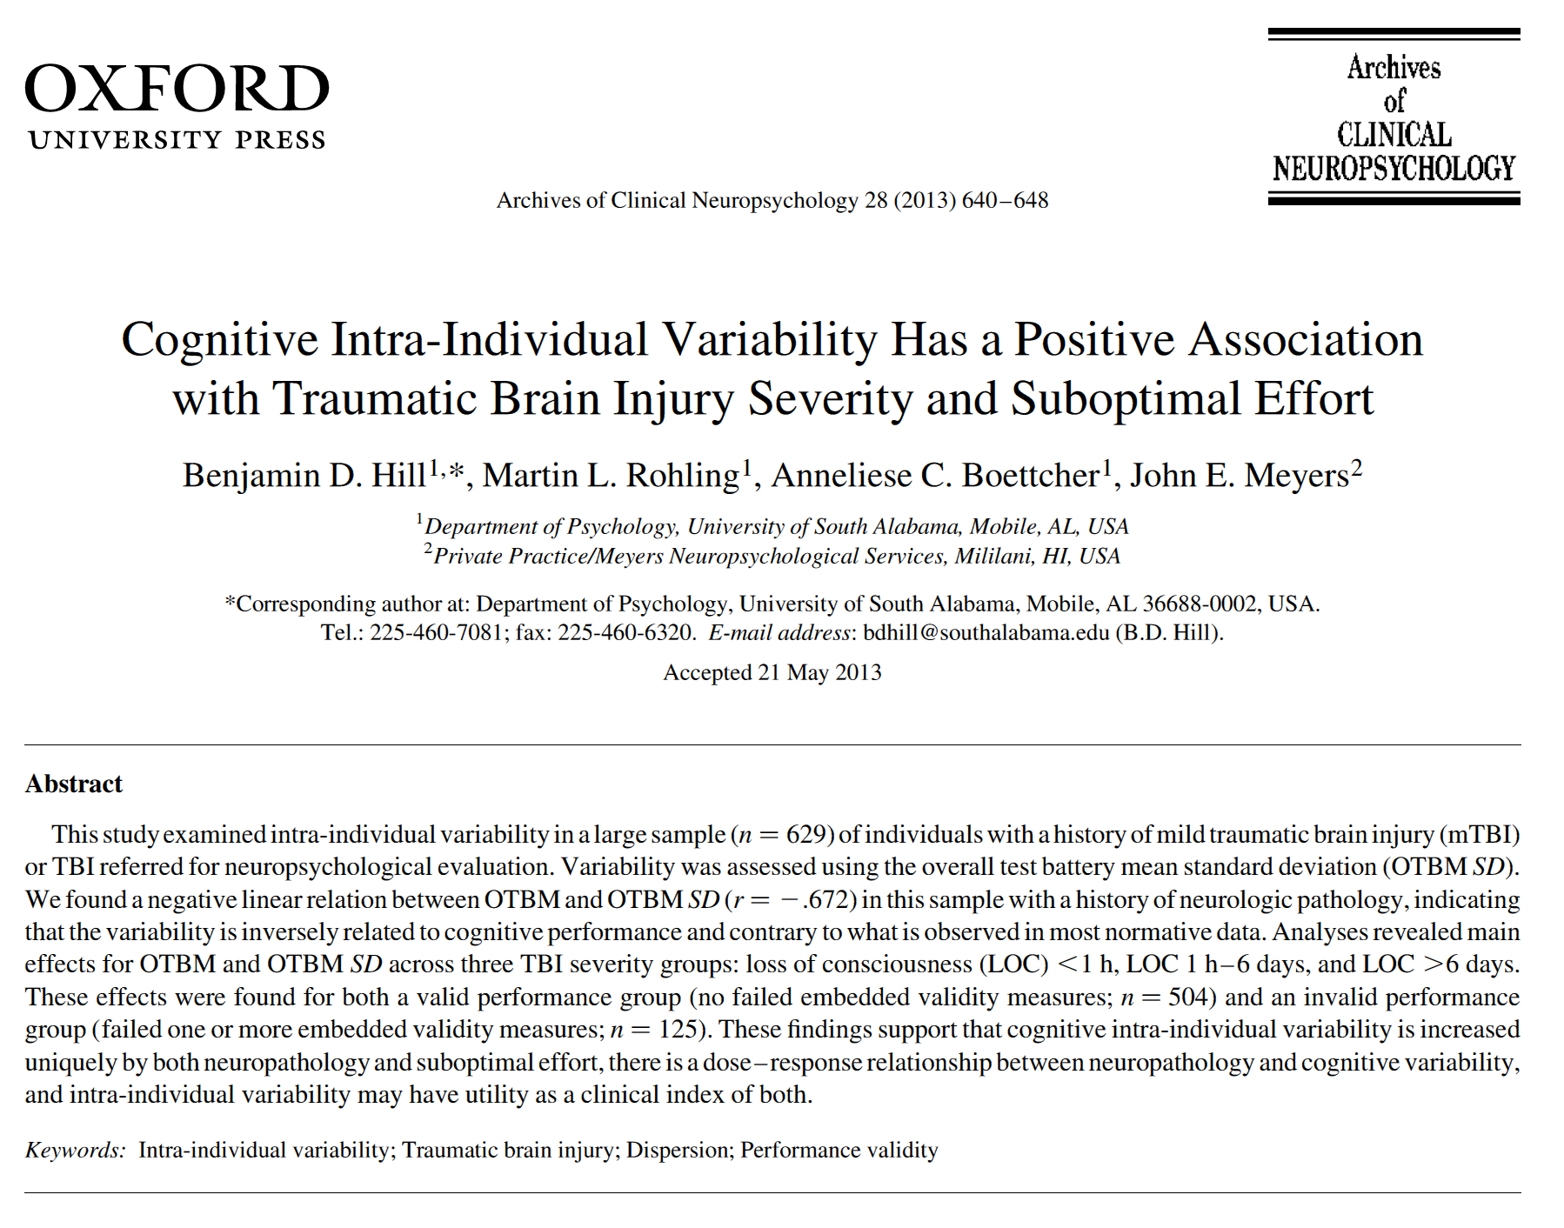
Intra-Individual Variability in Traumatic Brain Injury (TBI)
Hill et al. (2013) found greater intra-individual variability (IIV) in those with traumatic brain injury – demonstrating a dose-response relationship on the standard deviation of the Overall Test Battery Mean (OTBM) from Meyers Neuropsychological Battery (MNB).
More severe TBI resulted in greater variability.
Hill, B. D., Rohling, M. L., Boettcher, A. C., & Meyers, J. E. (2013). Cognitive intra-individual variability has a positive association with traumatic brain injury severity and suboptimal effort. Archives of Clinical Neuropsychology, 28(7), 640–648. https://doi.org/10.1093/arclin/act045

Slide 93
Are there any newer instruments that are particularly correlated to executive functioning that should be on our radar?

Slide 94
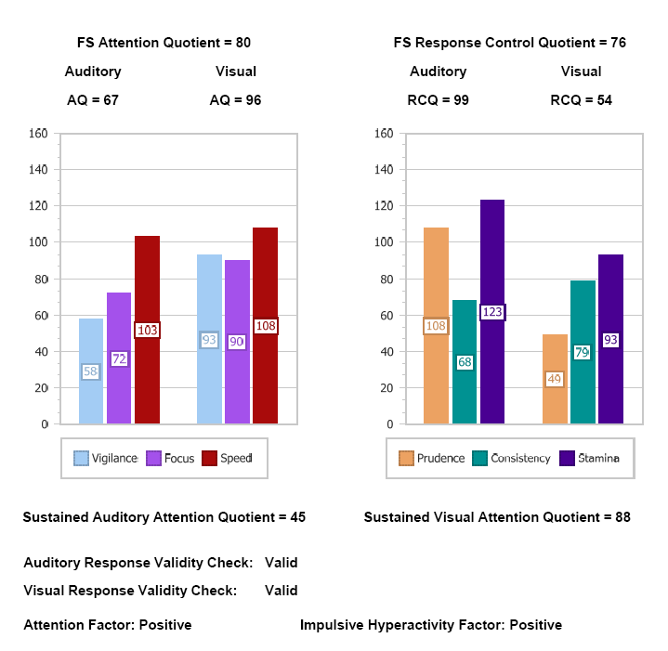
Integrated Visual and Auditory (IVA-2) Continuous Performance Test

Slide 95
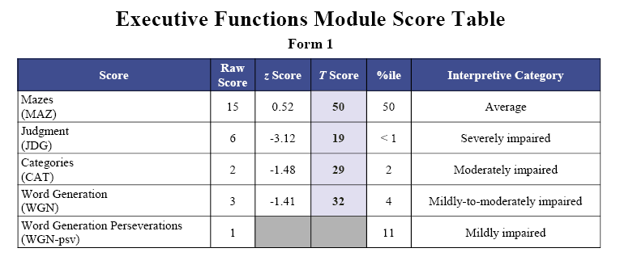
Neuropsychological Assessment Battery Executive Module

Slide 96
NIH Toolbox
NIH Toolbox Cognition Battery Executive Function Measures
The NIH Toolbox Cognition Battery includes several well-validated measures specifically designed to assess executive function components.
These computerized tests offer advantages in standardization, precision timing, and ease of administration compared to traditional paper-and-pencil assessments.

Slide 97
NIH Toolbox
Key Executive Function Measures
1. Dimensional Change Card Sort Test (DCCS)
This measure assesses cognitive flexibility and set-shifting abilities.
Participants match cards based on either color or shape, with rules changing throughout the test. The computerized format allows precise measurement of:
  Reaction times during rule switches
  Error rates during transitions
  Overall accuracy across conditions

Slide 98
NIH Toolbox
2. Flanker Inhibitory Control and Attention Test
This test evaluates inhibitory control and selective attention.
Participants focus on a central stimulus while ignoring flanking distractors. The test measures:
  Response inhibition capacity
  Ability to filter irrelevant information
  Processing speed under interference conditions

Slide 99
NIH Toolbox
3. List Sorting Working Memory Test
This assessment targets working memory capabilities.
Participants are presented with visual and auditory stimuli (animals and food items) that they must mentally organize and recall in size order. It evaluates:
  Working memory capacity
  Mental manipulation abilities
  Information organization skills

Slide 100
NIH Toolbox
Advantages of the NIH Toolbox EF Measures
Standardization: Nationally representative normative data across the lifespan (ages 3-85)
Efficiency: Administration typically takes 5-7 minutes per test
Accessibility: Available in both English and Spanish
Sensitivity: Capable of detecting subtle executive function differences
Technological integration: Results can be automatically scored
The NIH Toolbox Cognition Battery has been widely adopted in both clinical and research settings, including major initiatives like the Adolescent Brain Cognitive Development (ABCD) study, making it one of the most influential newer approaches to executive function assessment.

Slide 101
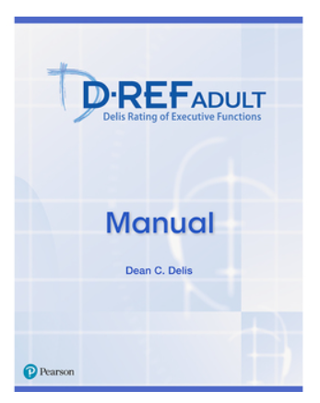
Delis Rating of Executive Functions, Adult
D–REF Adult
Self-Report and Other-Report of Executive Functions

Slide 102
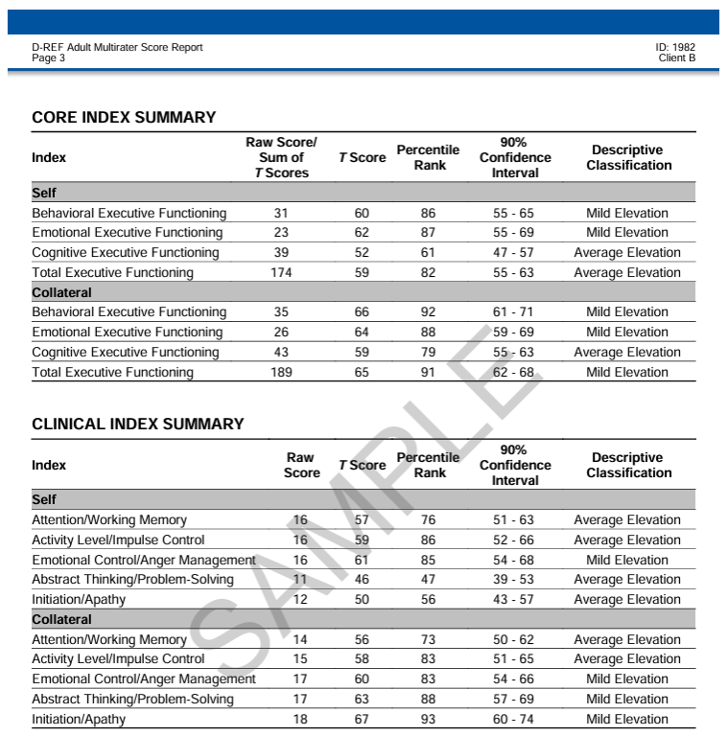
Delis Rating of Executive Functions, Adult
D–REF Adult
Self-Report and Other-Report of Executive Functions

Slide 103

Delis-Kaplan Executive Function System Advanced
(D-KEFS™ Advanced) (2025)
The D-KEFS Advanced includes six tests that assess working memory, concept formation, cognitive shifting, fluency of thinking, planning, organization, inhibition, feedback utilization, behavioral initiation, and problem-solving.
D-KEFS Advanced Trail Making Test
D-KEFS Advanced Verbal Fluency Test
D-KEFS Advanced Color-Word Interference Test
D-KEFS Advanced Tower Test
D-KEFS Advanced Social Sorting Test
D-KEFS Advanced Risk-Reward Decision Test

Slide 104
Can you talk to us about performance validity tests and symptom validity tests (sometimes referred to as malingering tests or effort tests)? What are some norming or other issues with any of these tests we should be aware of, particularly when it comes to clients with an intellectual disability? What about when it comes to clients with severe executive functioning deficits? Dementia? Other conditions?

Slide 105
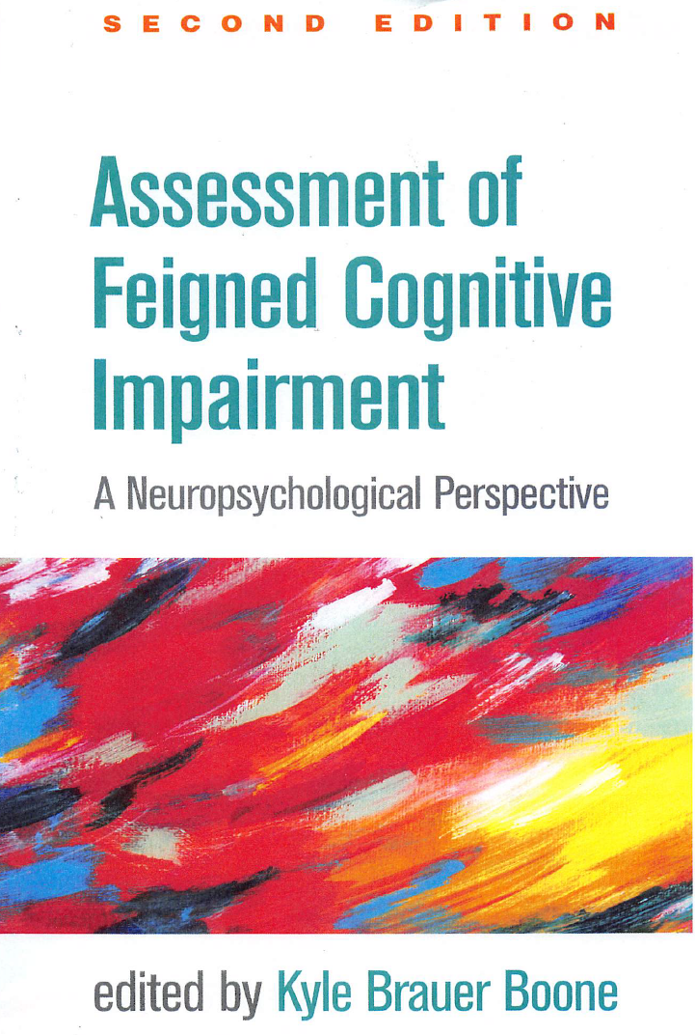
Review of common PVTs in ID
Victor, T. L., & Boone, K. B. (2021). Identification of feigned intellectual disability. In Kyle Brauer Boone (Ed.), Assessment of feigned cognitive impairment a neuropsychological perspective (pp. 453–480). essay, The Guilford Press.

Slide 106
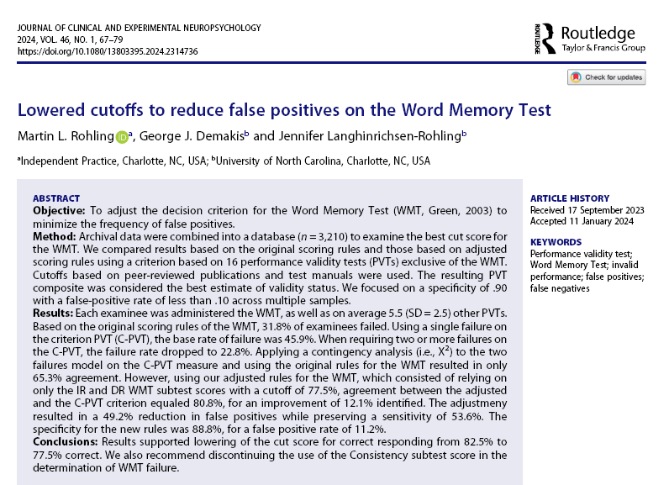
Word Memory Test: Updated Cutoffs

Slide 107
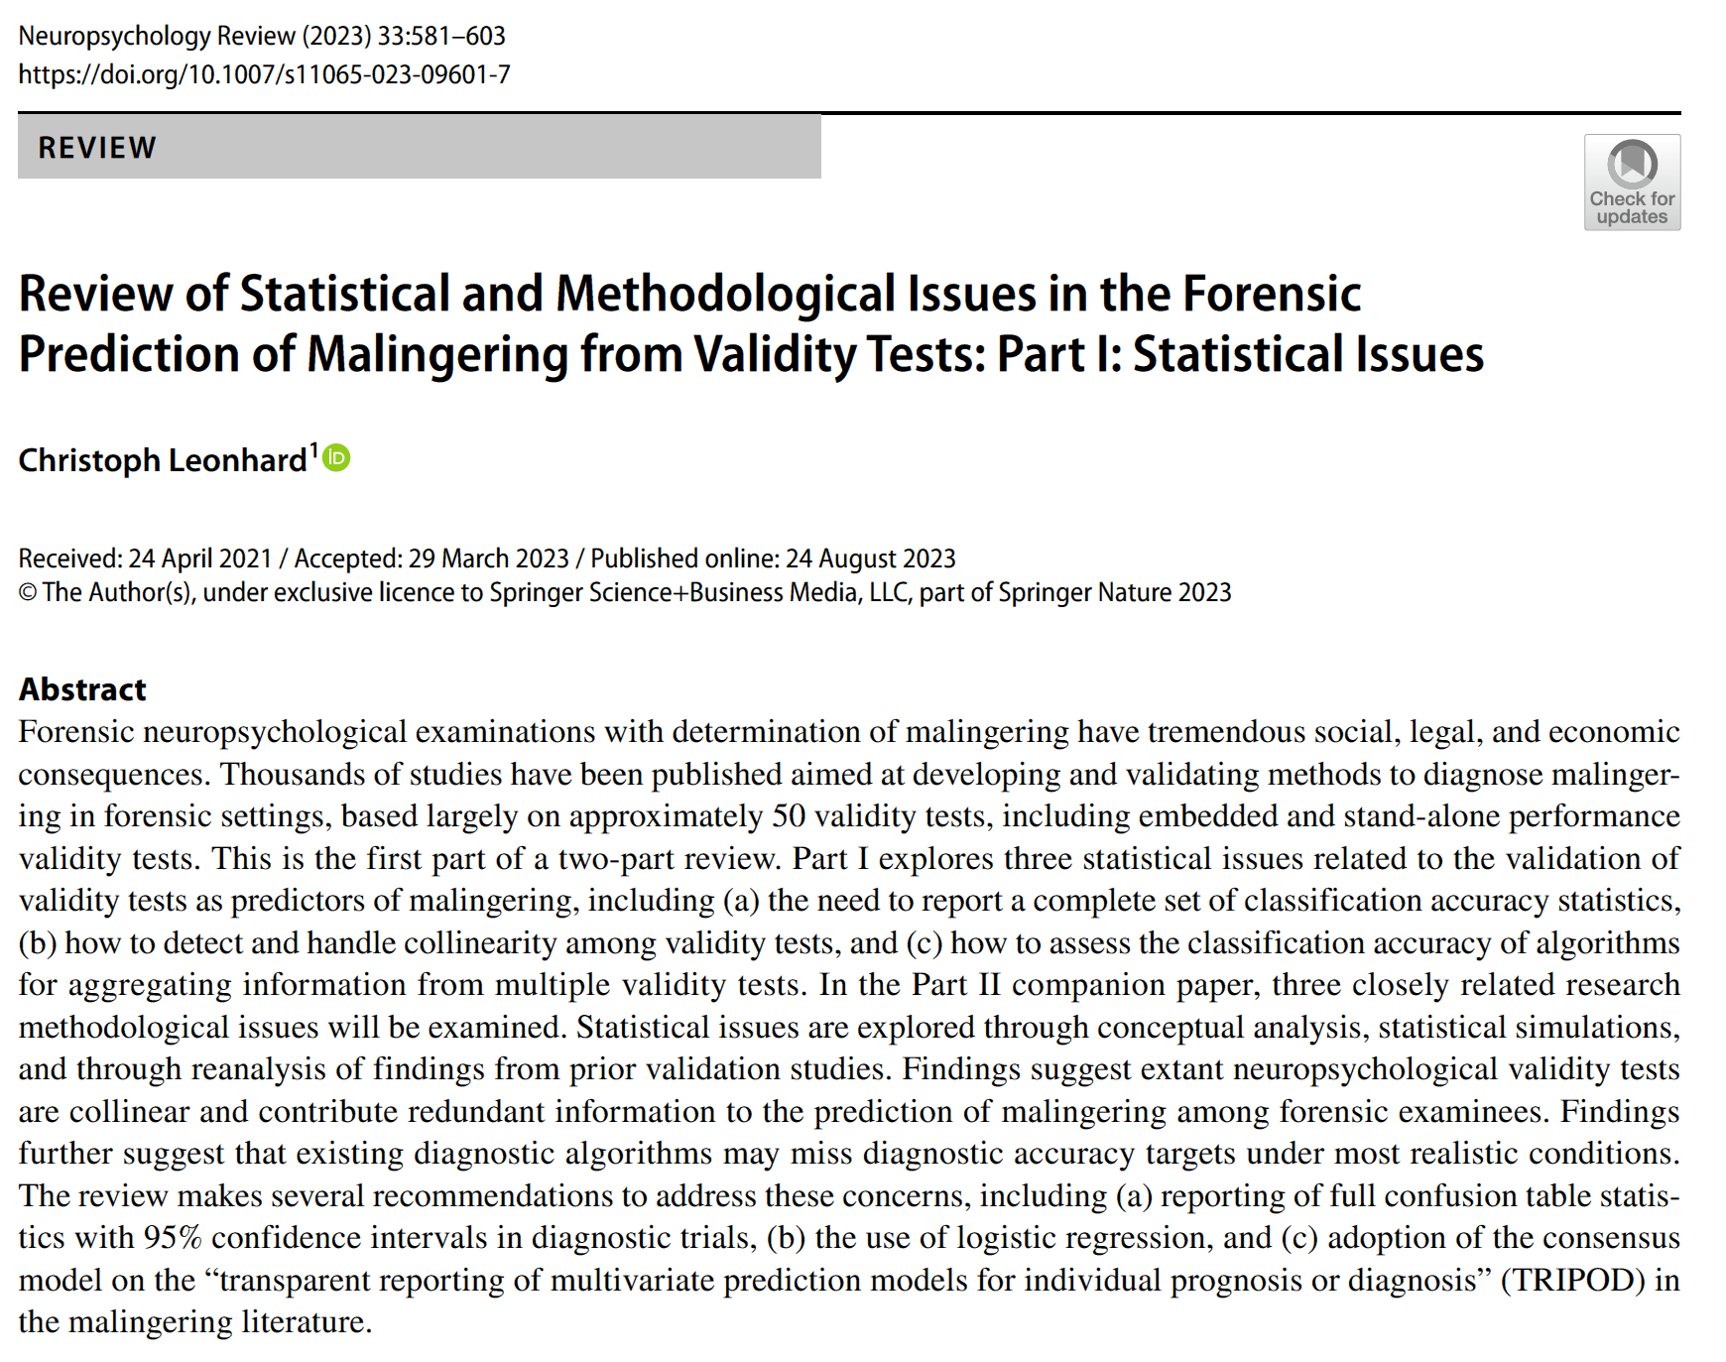
Leonhard (2023): Review of statistical and methodological issues…
Leonhard argued that virtually ALL of the PVT literature is inadequate because of the problem of establishing a “gold standard” in research studies for determining who is malingering and who is not.
Simulation studies and “known group” designs are inadequate.
Argues that such a standard is foundational to any research.

Slide 108
Leonhard (2023): Review of statistical and methodological issues…
Leonhard also argued that “chaining” of the results of one test to another (as Larrabee did) is an example of “Idiot’s Bayes.”
That all of the PVTs are actually just one test in the guise of different measures.
Bayesian analysis requires independent measures.

Slide 109
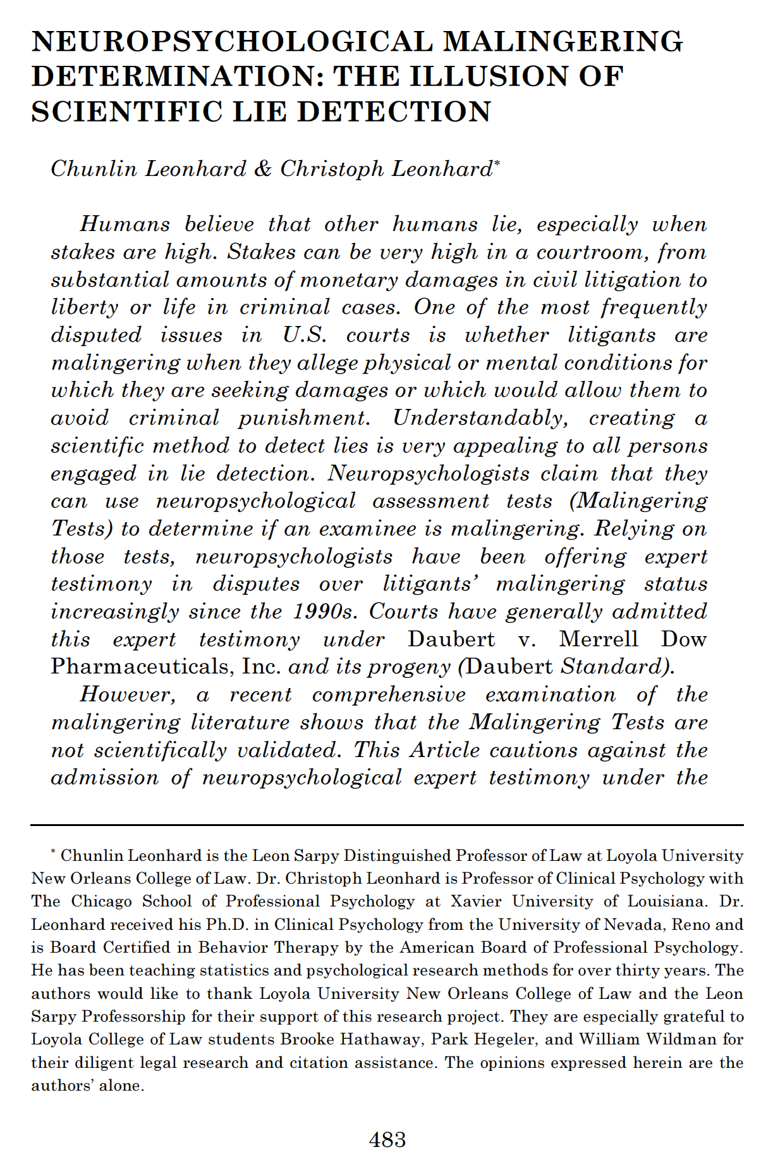
Leonhard & Leonhard (2023)
Leonhard, Chunlin, & Leonhard, C. (n.d.). Neuropsychological malingering determination: The illusion of scientific lie detection. Digital Commons @ University of Georgia School of Law. https://digitalcommons.law.uga.edu/glr/vol58/iss2/3/

Slide 110

Counter-Point

Slide 111
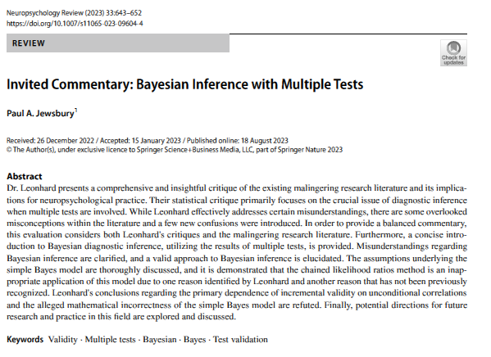
Jewsbury’s refutation of Leonhard
“Leonhard (2023a) overstates the importance of independence between test results in determining incremental validity and redundancy between tests when suggesting that tests should be combined or eliminated based on correlations alone.”
“The simple Bayes method is a mathematically valid method to calculate posterior probabilities based on multiple test results.”
Jewsbury, P.A. (2023). Invited commentary: Bayesian inference with multiple tests. Neuropsychology Review, 33:643-652).

Slide 112
Jewsbury’s refutation of Leonhard
Jewsbury agreed with Leonhard that Larrabee’s chaining of PVTs was invalid.
Should NOT ignore PVTs that are passed (contradicting Larrabee).
Jewsbury, P.A. (2023). Invited commentary: Bayesian inference with multiple tests. Neuropsychology Review, 33:643-652).

Slide 113
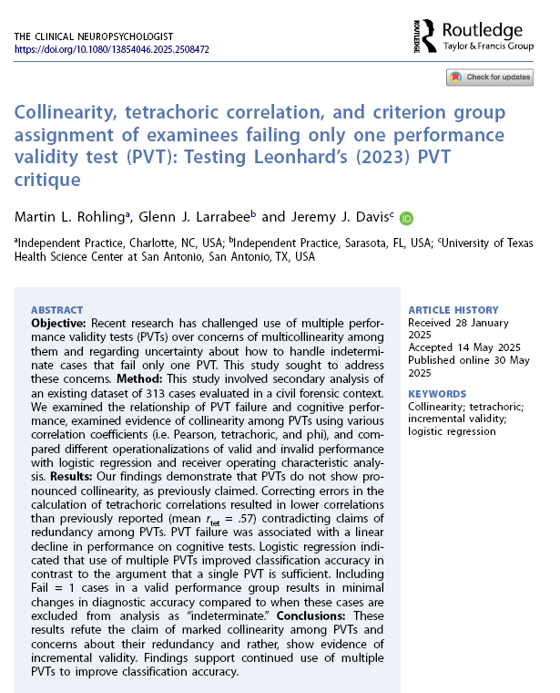
Rohling et al. (2025) refutation of Leonhard
PVTs are designed to ensure that performance data reflect an examinee's true abilities, not to determine "veracity."
PVTs are not just one test repeated over and over.
Use of multiple PVTs improves accuracy.
> 2 PVT failures is a good indication of invalidity.
Rohling, M. L., Larrabee, G. J., & Davis, J. J. (2025). Collinearity, tetrachoric correlation, and Criterion Group assignment of Examinees Failing Only One performance validity test (Pvt): Testing Leonhard’s (2023) PVT Critique. The Clinical Neuropsychologist, 1–17. https://doi.org/10.1080/13854046.2025.2508472

Slide 114
What are the biggest barriers for courts and juries to understand the work you do and the results of your assessments?
What could/should attorneys be doing to fill those gaps in understanding?

Slide 115
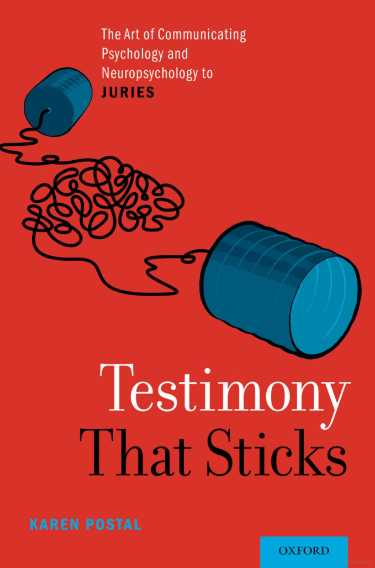
Testimony That Sticks: The Art of Communicating Psychology and Neuropsychology to Juries
Postal, K. (2019). Testimony that sticks: The art of communicating psychology and neuropsychology to juries. Oxford University Press.

Slide 116
While you are administering a neuropsych test or number of tests, can you generally get an impression on what the results of the assessment will be in real time ahead of scoring?

Slide 117
How much of the scoring is subjective to the examiner? Can you give some examples of where variability in scoring may or may not exist?

Slide 118
Administration and scoring errors are common
Ramos, Alfonso and Schermerhorn (2009) summarized the extant research on examiner errors and reported that most research studies reported sufficient average examiner error to produce significant changes in IQ scores for individuals.
The most frequent types of errors reported included a failure to record responses, use of incorrect basal and ceiling rules, reporting an incorrect global IQ score, incorrect adding of subtest scores, incorrect assignment of points for specific items, and incorrect calculation of the individual’s age.

Slide 119
Administration and scoring errors are common
On Wechsler-related studies, Ramos et al.'s review found that studies have reported average error rates from 7.8 to 25.8 errors per test record, almost 90% of examiners making one error, and in one study 2/3 of the test records reviewed resulted in a change in the Full Scale IQ.
Examiner errors do not appear instrument specific as Ramos et al’s reported an average error rate of 4.63 errors per test record on the WJ III Tests of Cognitive Abilities.

Slide 120
Of what value is past neuropsych testing and how do you go about comparing results of past and current testing? What limitations are there? What do you want to know about past testing? Or not know? And when?

Slide 121
What are the minimum materials required to produce an adequate neuropsychological report? If you could ask for any materials you wanted, what would you request and from whom?

Slide 122
How much time is required to conduct adequate testing with a client?

Slide 123
How much time is required to conduct adequate testing with a client?

Slide 124
When a test is updated, how do you determine when to begin administering it?
For example, would you begin using the WAIS-V as soon as it becomes available?
If not, what does your community advise about stopping the administration of an old version of a test?
Could using a new version instead of an old one result in potentially inflated scores based on an updated population norming?
What kind of considerations are relevant when determining which version to use?

Slide 125
Dale G. Watson, Ph.D.
Clinical and Forensic Neuropsychology
3377 Deer Valley Road, PMB 310
Antioch, CA 94531
(866) 536-5301
watson.dale@comcast.net

